Slide 1
Geim International Innovation Award
In honor of the distinguished work and lifetime achievements of 2010 Nobel Laureate in Physics, Prof. Sir Andre Geim for work carried out after getting the Noble Prize award.
Citation:
"For extraordinary scientific innovation that enables a successful business and contributes to shaping a sustainable future.”

Slide 2
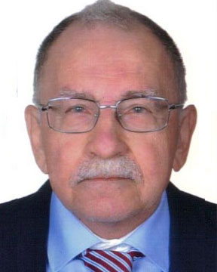
Sustainable Industrial Processing Summit
2024 STARS:
Georgios N. Anastassakis
Professor
National Technical University of Athens, Greece
Field: Mineral Processing
GEIM INTERNATIONAL INNOVATION AWARD
FLOGEN STARS OUTREACH

Slide 3
Dr. Georgios Anastassakis receiving the Geim International Innovation Award from Dr. Florian Kongoli at FLOGEN SIPS 2024

Slide 4
Dr. Florian Kongoli congratulating Dr. Georgios Anastassakis during the FLOGEN SIPS 2024 award ceremony

Slide 5
Dr. Georgios Anastassakis delivering an acceptance speech during the FLOGEN SIPS 2024 award ceremony

Slide 6
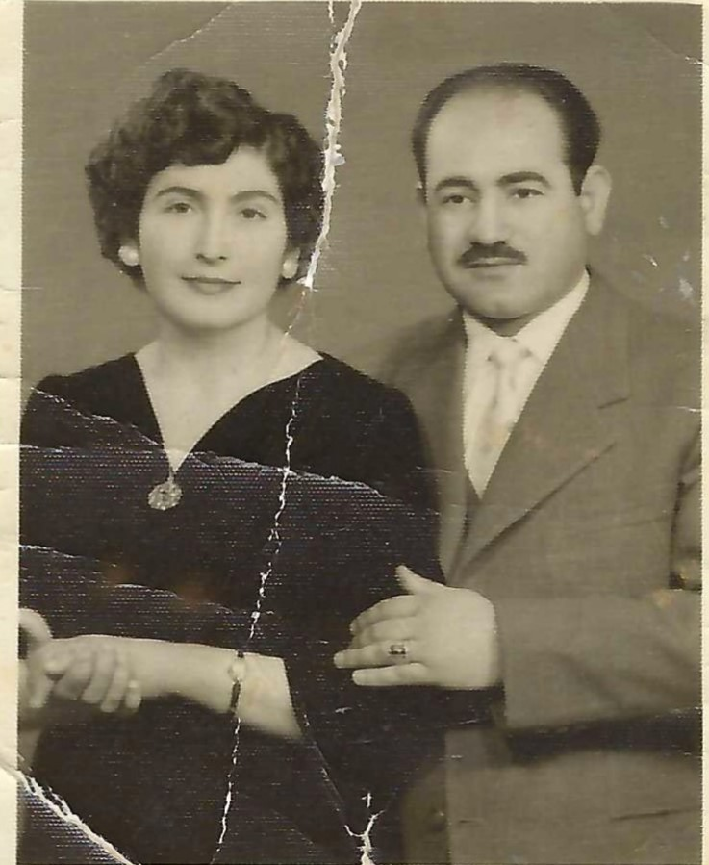
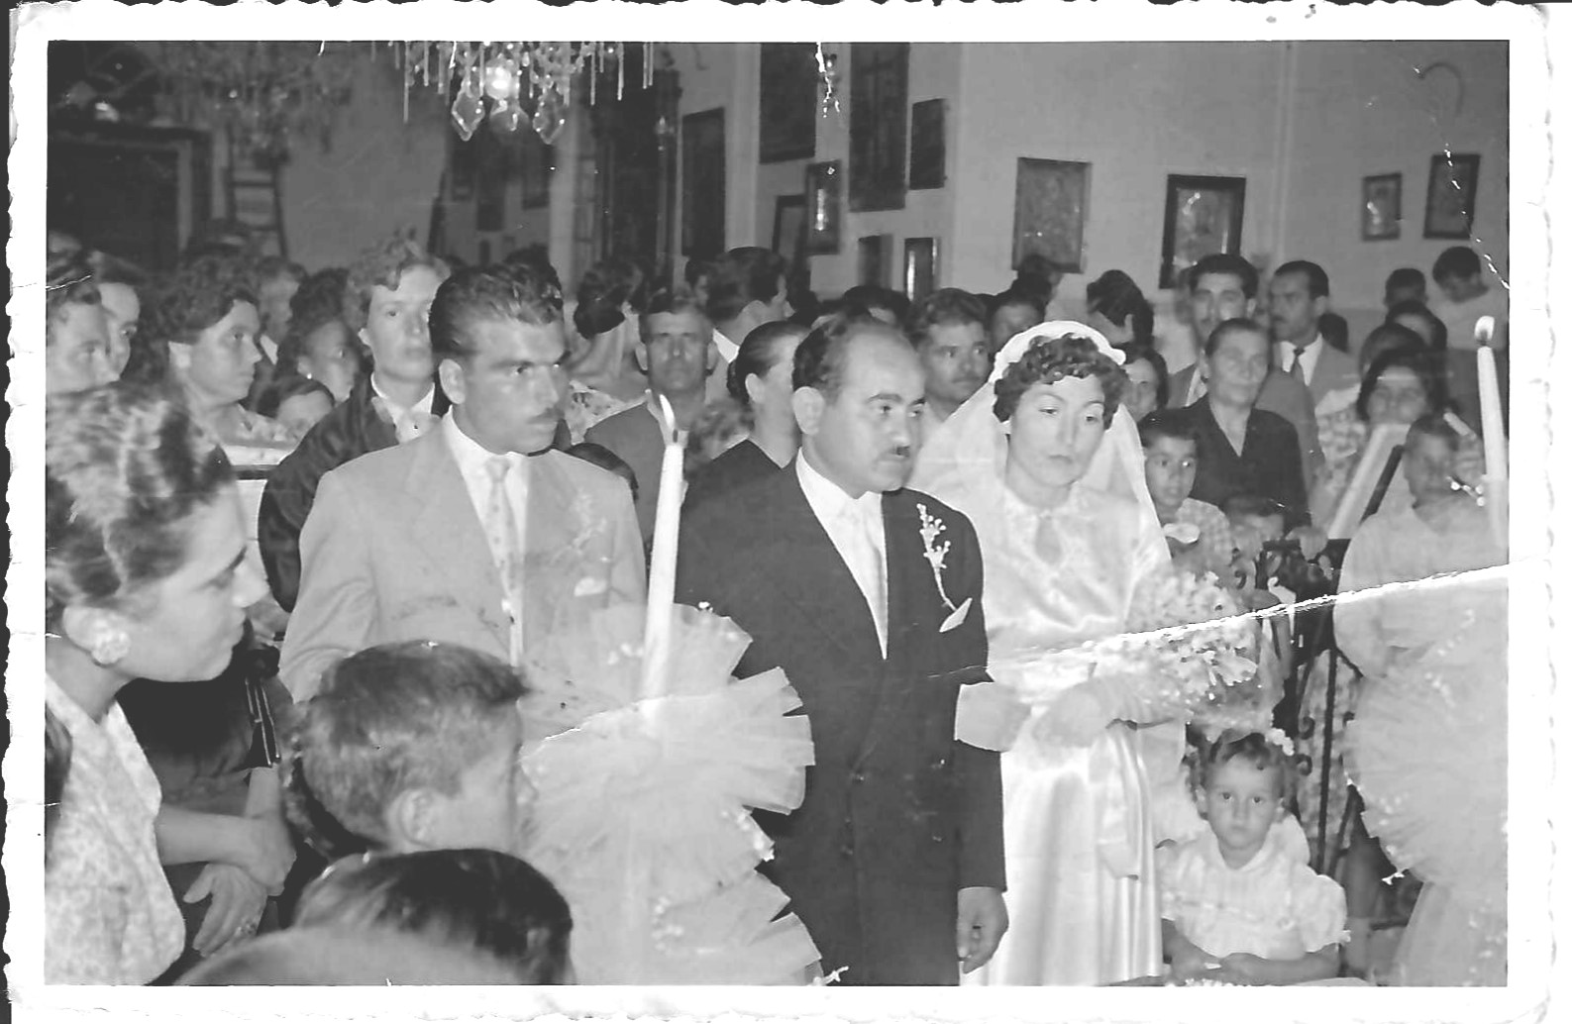
Parents Nikolaos and Evgenia, married in Sept. 1957

Slide 7
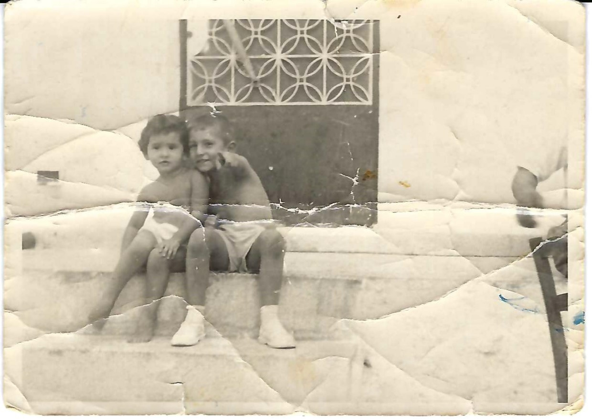
Georgios with his father and his sister Maria
Georgios with his father
Georgios and Maria in front of their home, 1963

Slide 8
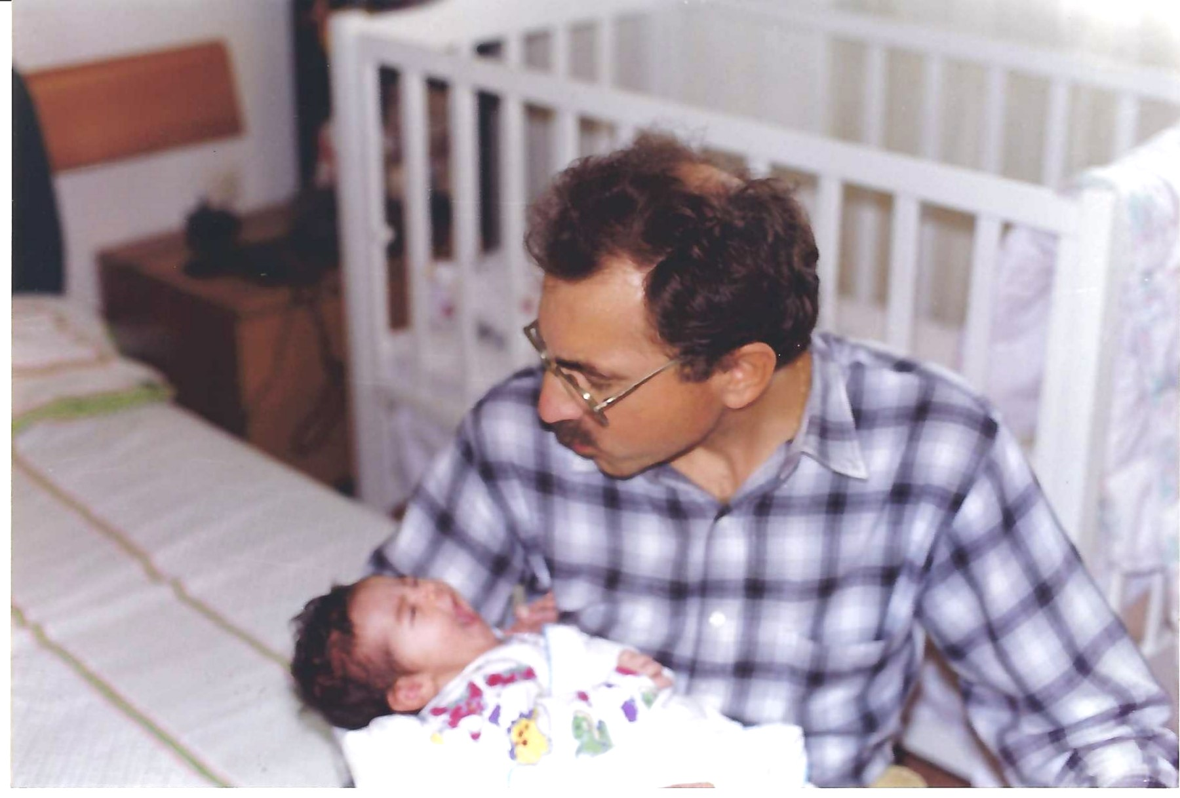
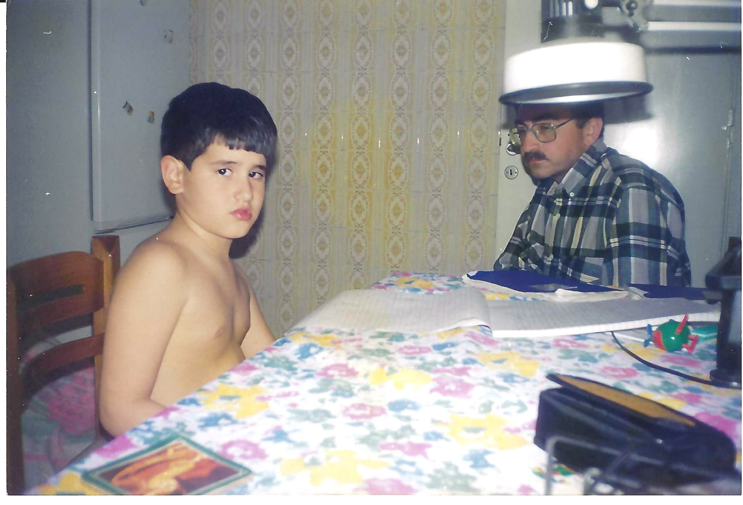
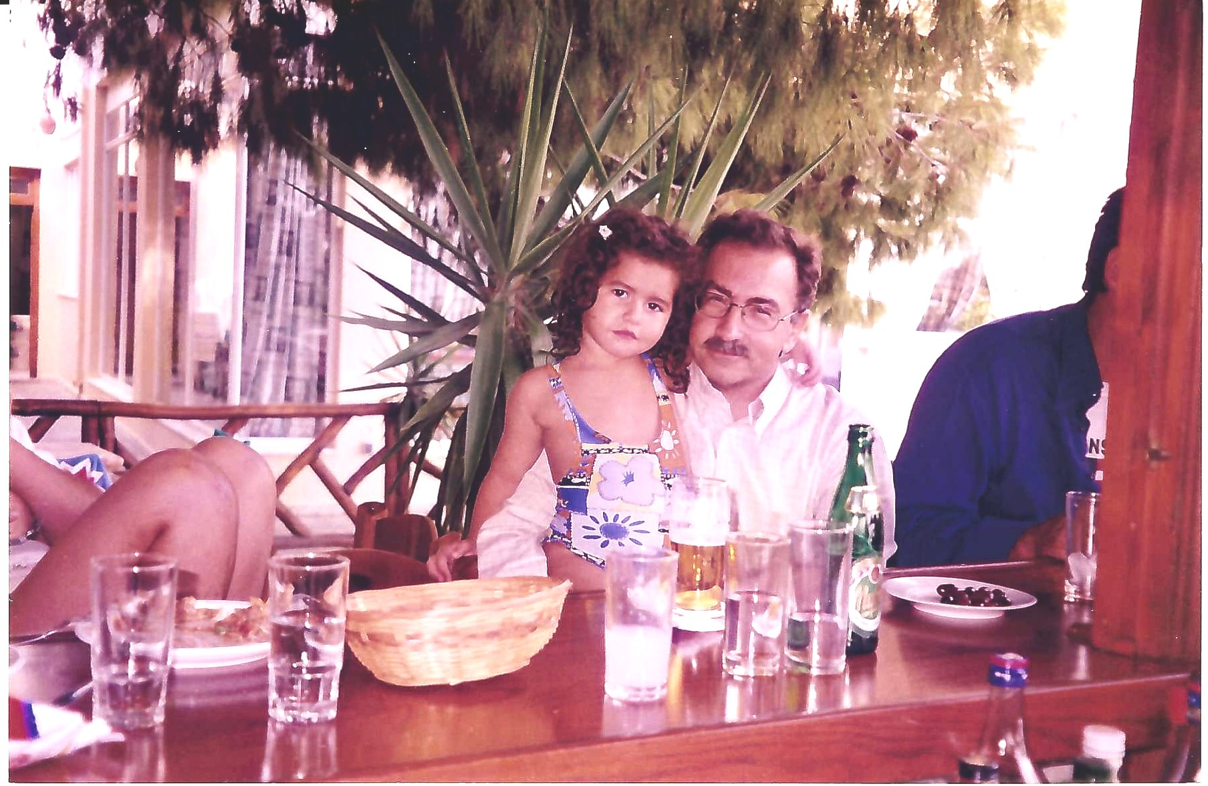
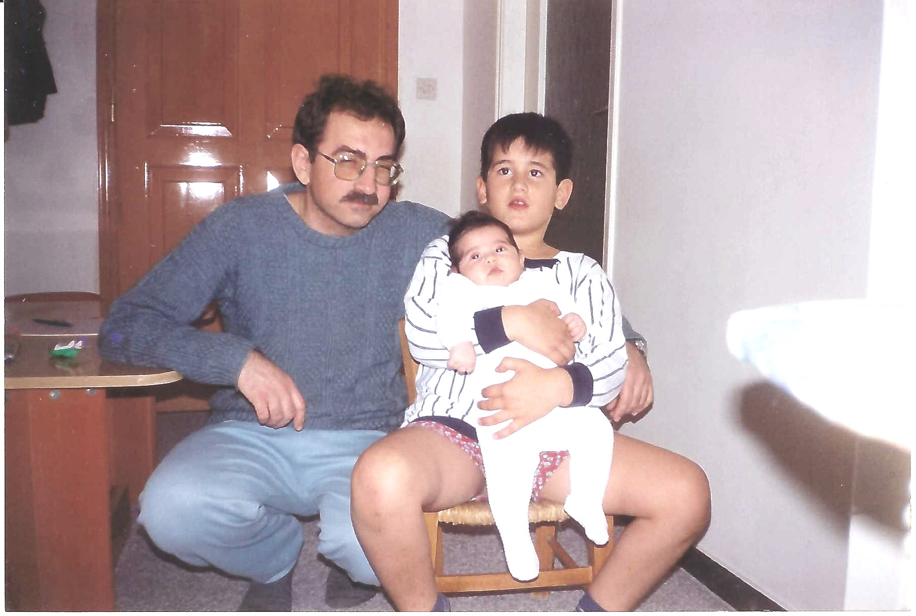
… with his nephew Nikolaos and niece Ioulia
Playing with baby-Ioulia
Teaching Nikolaos

Slide 9
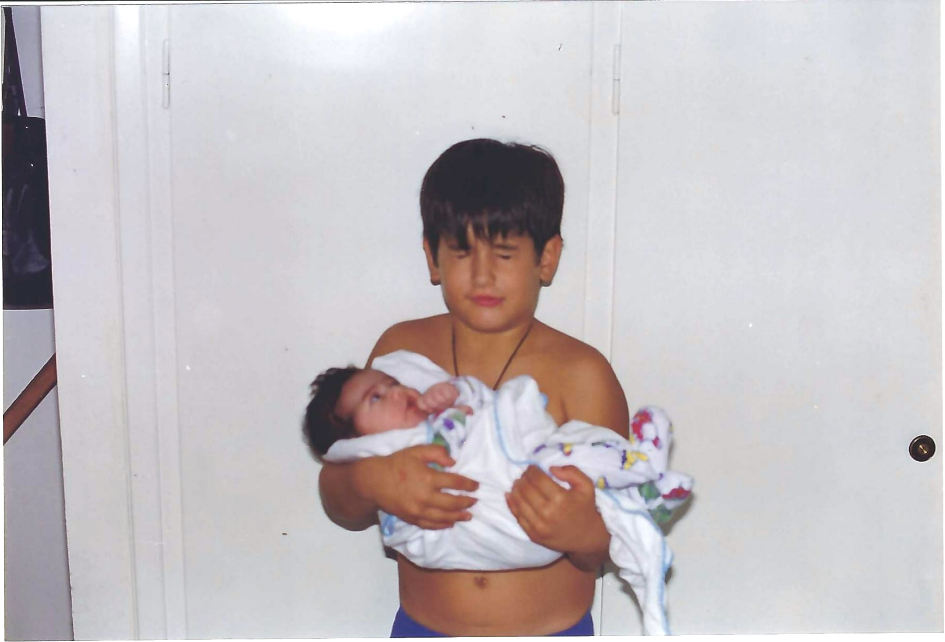
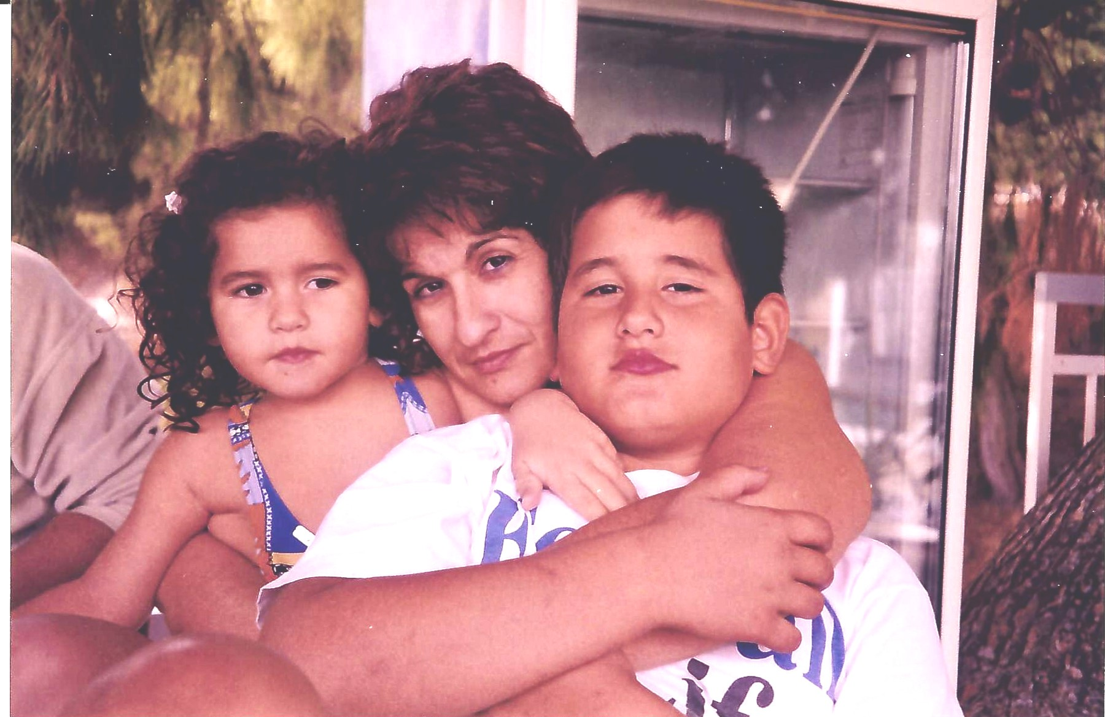
… Nikos with his eyes closed as a reaction not to be photographed and Ioulia looking at him puzzled
…Maria with her kids Nikos and Ioulia

Slide 10
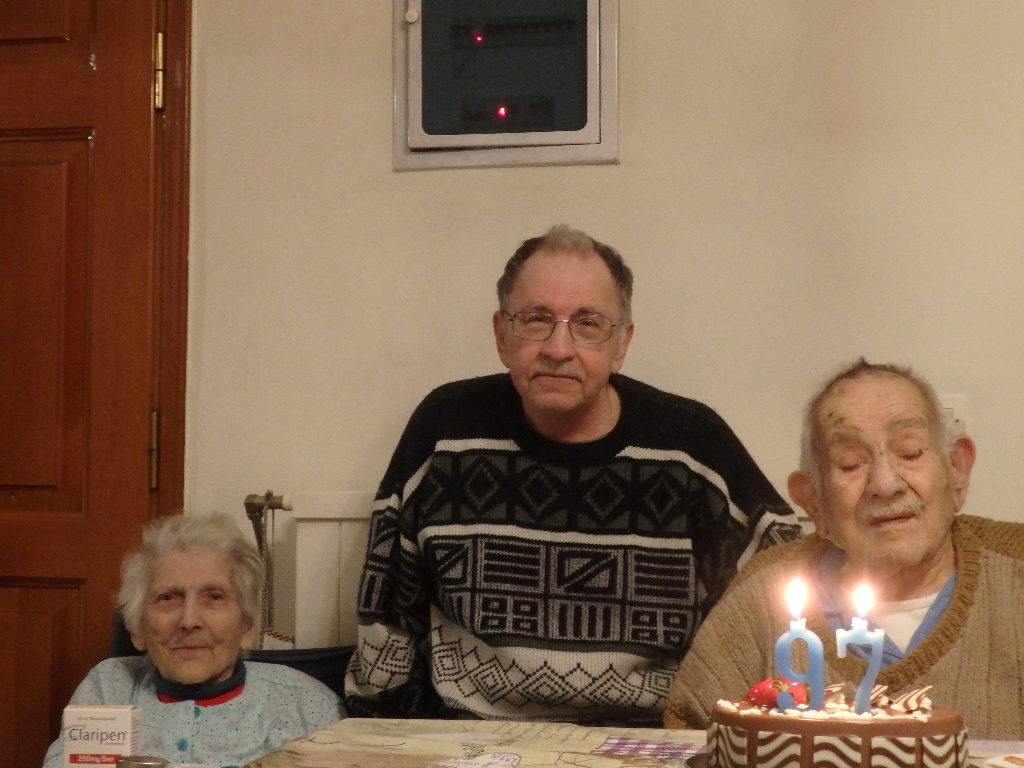
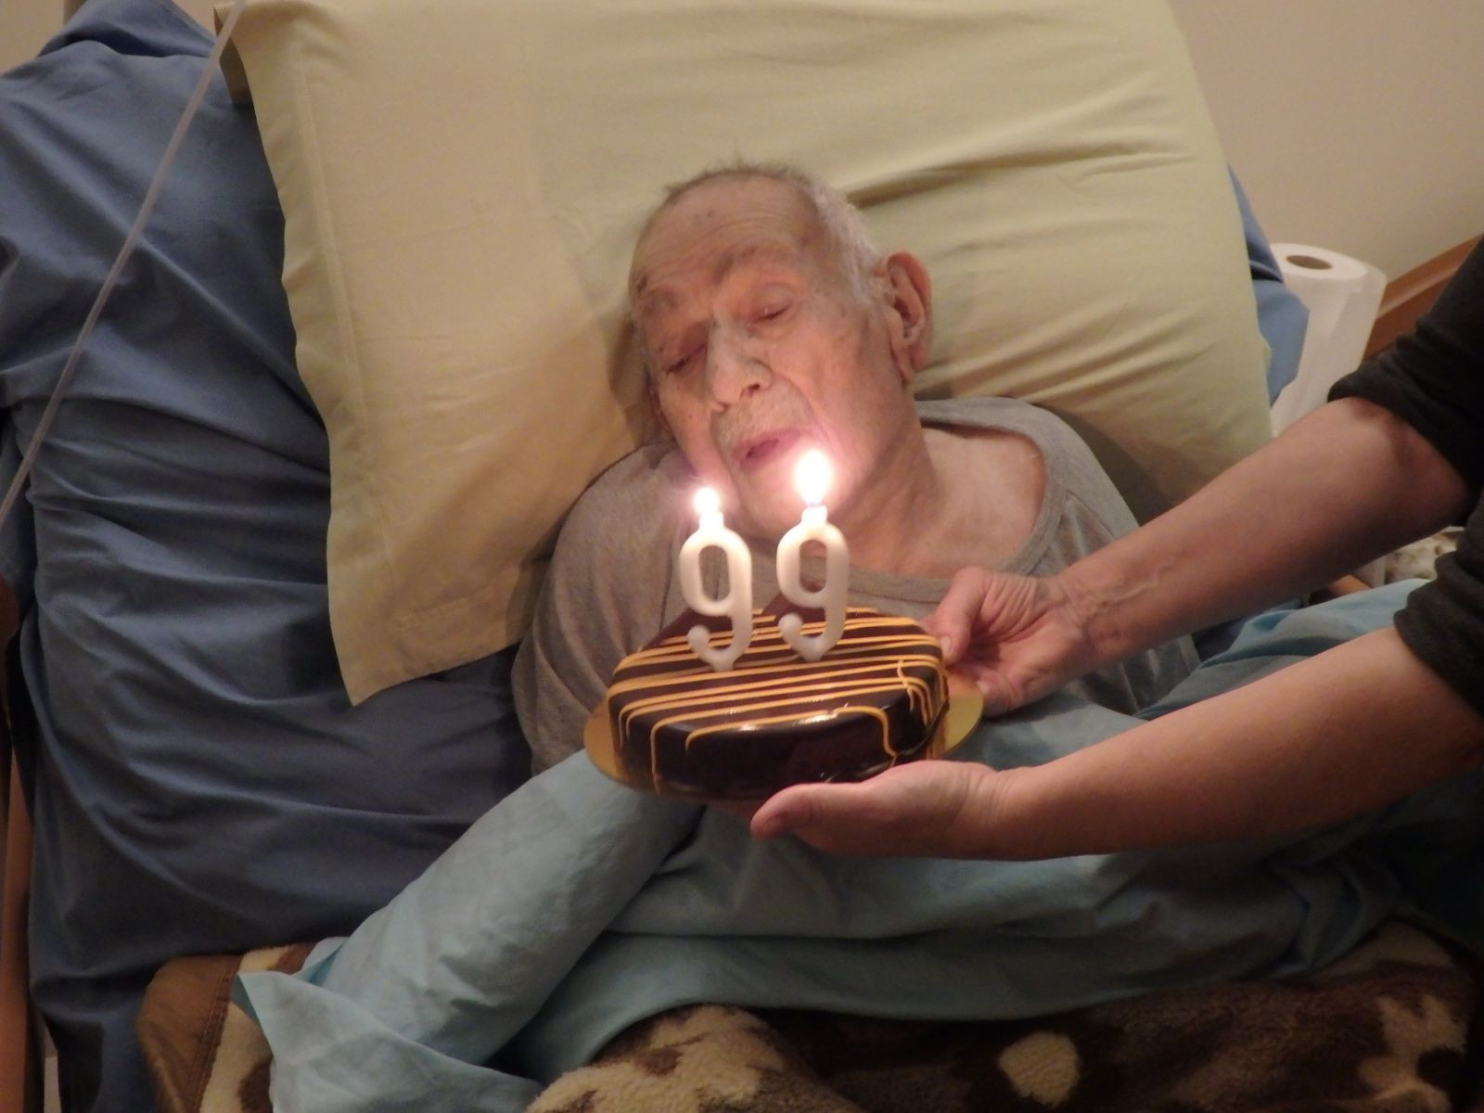
Parents in very old age
Mother in the age of 94

Slide 11
… memorial from Preliminary School
D-class (1967-68), with his classmates and teacher Stamatina Rozaki in the preliminary school

Slide 12
… memorial from Preliminary School
Daily class Gymnastics

Slide 13
… with a group of students in Amsterdam, 2004

Slide 14
NTUA Schools welcoming Chinese Universities (the honoree as Deputy Dean of Mining and Metallurgical Eng. School), NTUA Campus, 2019
NTUA Dean

Slide 15
… 1st Lifetime Presentation Estoril, Portugal, 3rd European Workshop on Chemistry, Energy and the Environment (Estoril – Portugal, 1997) (May 1997), organized by C.A.C. Sequeira (middle 1st row)

Slide 16
Coffee break, XIII International Symposium on Surfactants in Solution (SIS-2000), Gainesville, Florida, USA, June 2000
from left: Profs. B. Modgil (Florida State Univ.-USA), honoree, T. Healy (Melbourne Univ., Australia), and Eug. Shcukin (John Hopkins-USA, Moscow State Univ.-Russia)

Slide 17
… in Cape Town, coffee break with Profs P. Somasundaran of Columbia Univ. (left) and D.W. Fuerstenau of Berkley University (middle), IMPC 2003

Slide 18
… in Istanbul, Turkey, Balkan Mineral Processing Congress Committee meeting, 2010

Slide 19
Balkan Mineral Processing Congress, Belgrade-Serbia, 2015 co-chairing with Prof. I. Grigorova of Sofia Mining Univ.

Slide 20
XVIII International Coal Preparation Congress (ICPC), St. Petersburg, Russia, break from the works of the ICPC International Committee, June 2016

