Slide 1
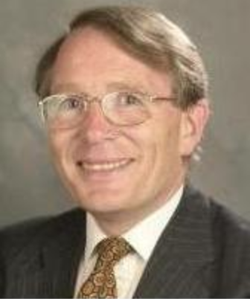
Fray International Sustainability Award
In honor of the distinguished work and lifetime achievements of Dr. Derek J. Fray, Emeritus Professor, University of Cambridge, UK whose illustrious biography includes among others almost 400 scientific papers, approximately 179 patents arising from 62 families of patents and several Fellowships of some of the most prestigious professional societies around the world.
Citation:
Politics : "For Leadership in developing new advanced public policy frameworks related to the efficiency of mineral and metal resources for a global sustainable development"
Corporations: "For Leadership in developing and applying new innovative business plans and operation technologies for a sustainable development of the company in the environment, economy and social points of view"
Academia: " For Leadership in developing new technologies that contribute to a global sustainable development as per FLOGEN Sustainability Framework in the environment, economy and social points of view "

Slide 2
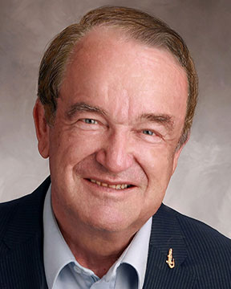
Sustainable Industrial Processing Summit
2024 STARS:
Hans Leuenberger
Professor
University of Florida, Orlando
Field: Pharmaceutical Sciences and Industrial Applications
FRAY INTERNATIONAL SUSTAINABILITY AWARD
FLOGEN STARS OUTREACH

Slide 3
Dr. Hans Leuenberger receiving the Fray International Sustainability Award from Dr. Florian Kongoli at FLOGEN SIPS 2024

Slide 4
Dr. Florian Kongoli congratulating Dr. Hans Leuenberger during the FLOGEN SIPS 2024 award ceremony

Slide 5
Dr. Hans Leuenberger delivering an acceptance speech during the FLOGEN SIPS 2024 award ceremony

Slide 6
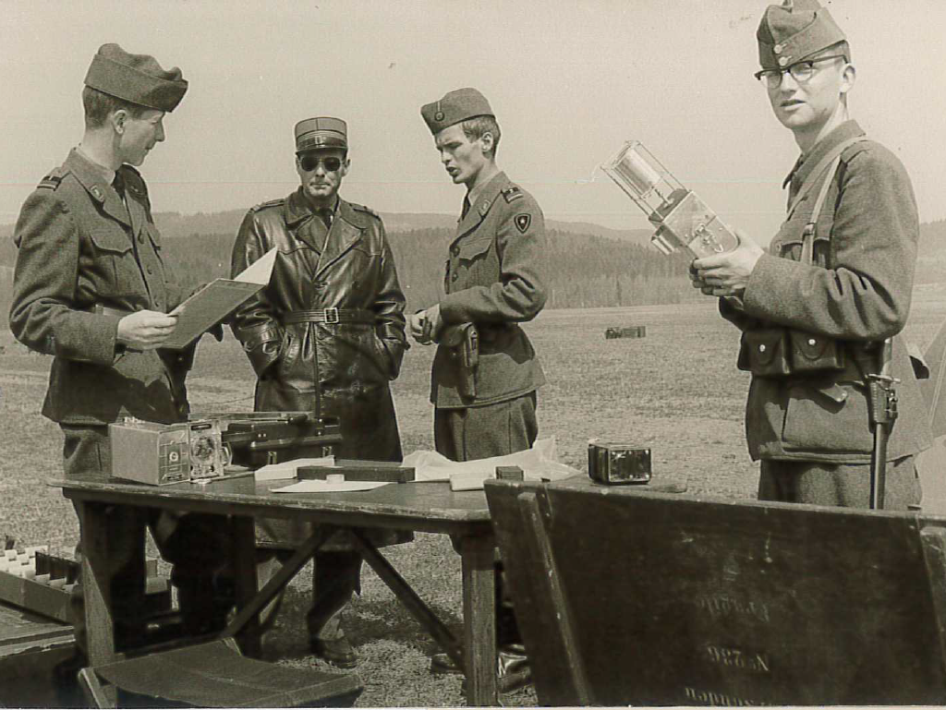
First task in the Swiss Army as an artillery weather soldier, part time (1962-68)

Slide 7
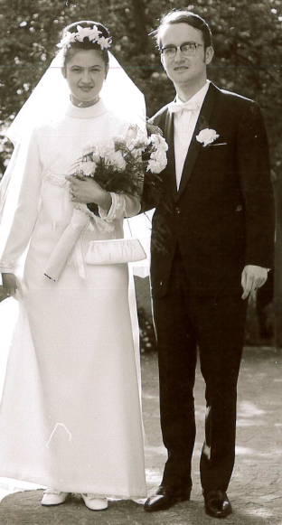
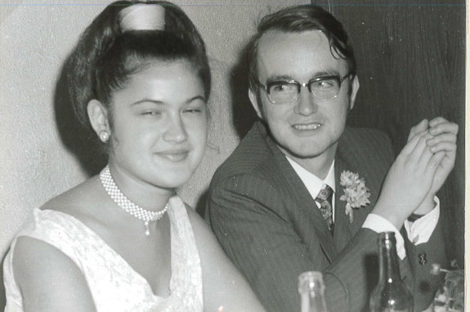
Wedding with Adriana in Pratteln 1969

Slide 8
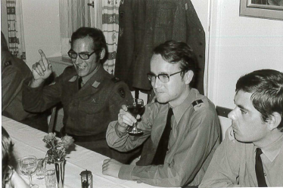
Hans trained scientists to be promoted to Swiss Army AC-specialists or Chief-Physicists (1968-93)

Slide 9
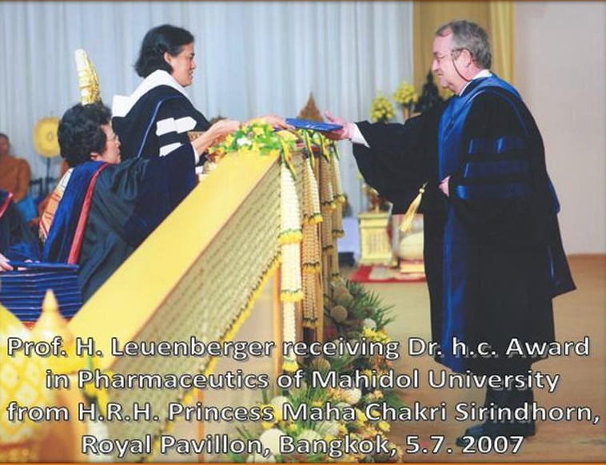

Slide 10
May 2023 Keynote Lectures in Tokyo (left) and Osaka (right)

