Slide 1
Murad International Life Improvement Award
An Award in honor of the distinguished work and lifetime achievements of 1998 Nobel Laureate in Medicine and his contribution in applying his discovery in the pharmaceutical field.
Citation:
"For Leadership in developing and applying new medical methods and technologies for a sustainable development in the environmental, economic, and social points of view ”

Slide 2
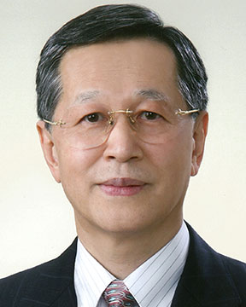
Sustainable Industrial Processing Summit
2024 STARS:
Koji Abe
Director
National Center of Neurology & Psychiatry, Tokyo, Japan
Field: Oxidative Stress
MURAD INTERNATIONAL LIFE IMPROVEMENT AWARD
FLOGEN STARS OUTREACH

Slide 3
Dr. Haruhiko Inufusa receiving the Murad International Life Improvement Award on behalf of Dr. Koji Abe from Dr. Florian Kongoli at FLOGEN SIPS 2024

Slide 4
Dr. Haruhiko Inufusa delivering an acceptance speech on behalf of Dr. Koji Abe during the FLOGEN SIPS 2024 award ceremony

Slide 5
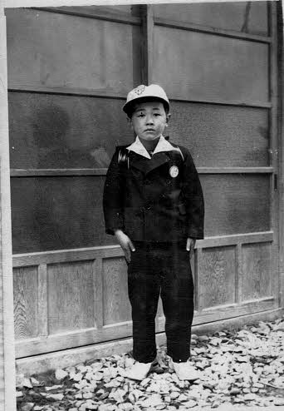
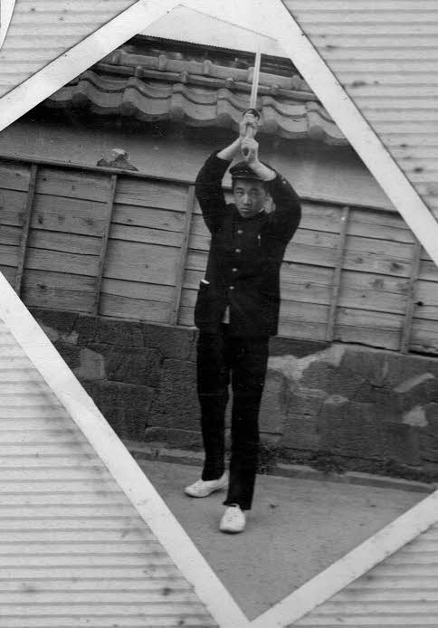
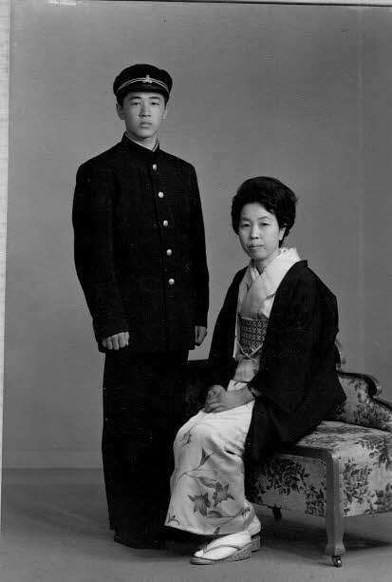
Elementary School Junior High School High School
(Samurai Kendo)

Slide 6
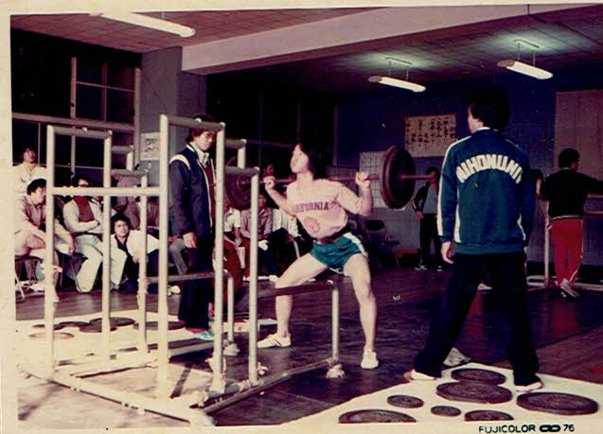
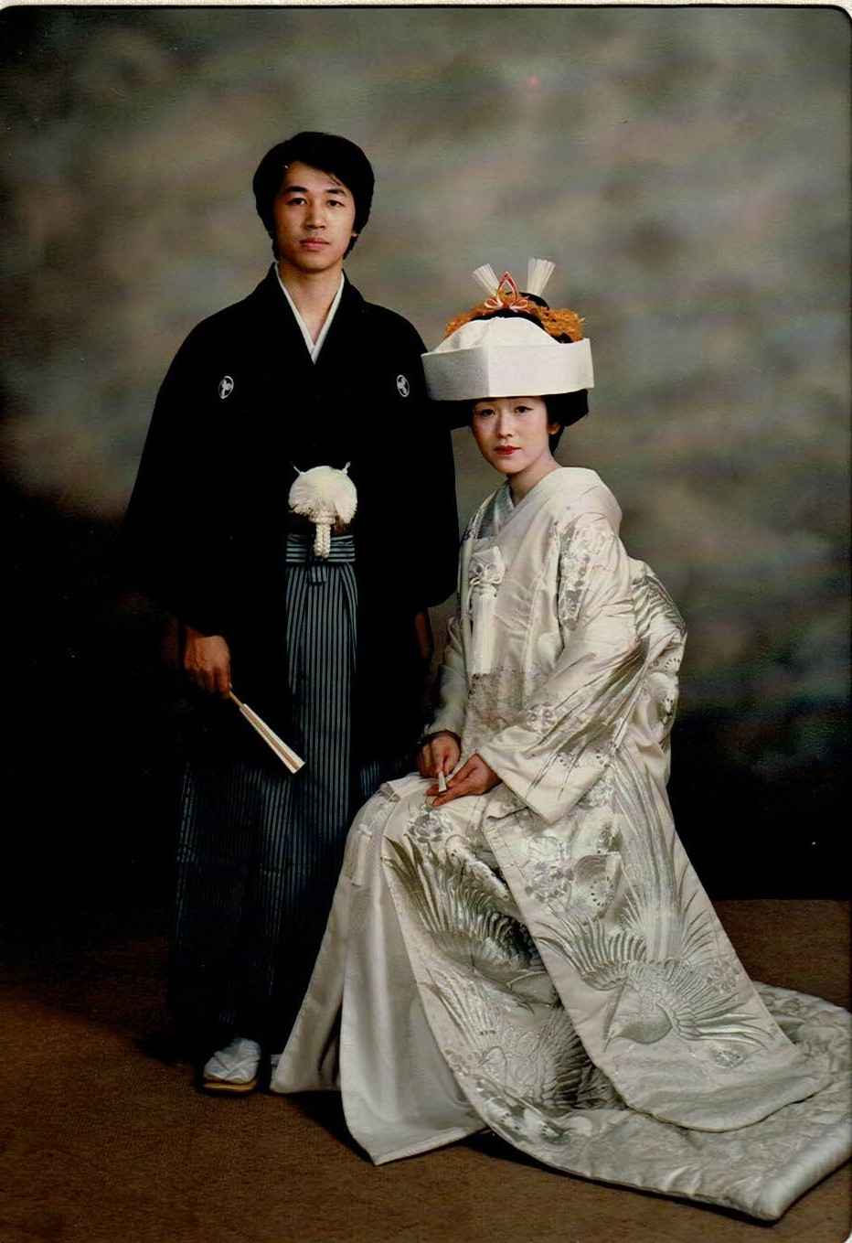
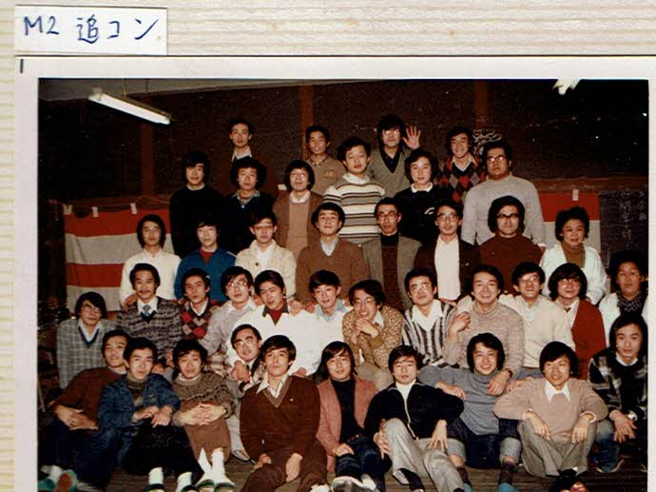
Tohoku University Medical School in Sendai at 18 years old
dormitory party in 1978

Slide 7
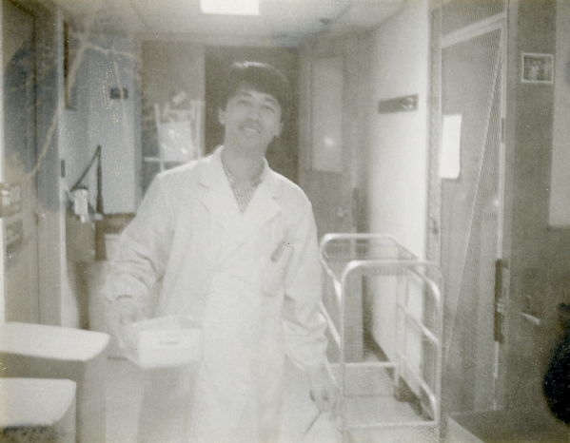
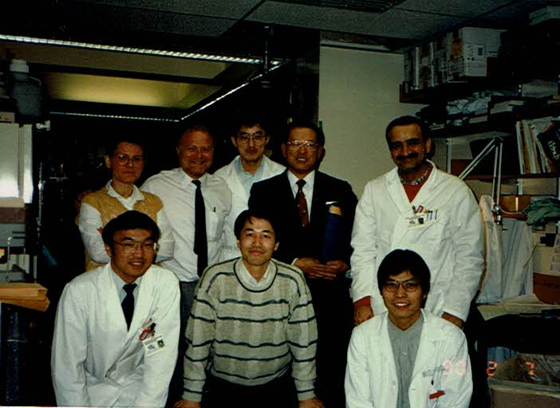
Year 1988,
A research fellow carried DNA agarose gel at MGH Neurogenetics Lab.
After post-graduating school, he went abroad to Mass. General Hospital of Harvard Medical School in Boston (USA) from year 1988 to 1990.

Slide 8
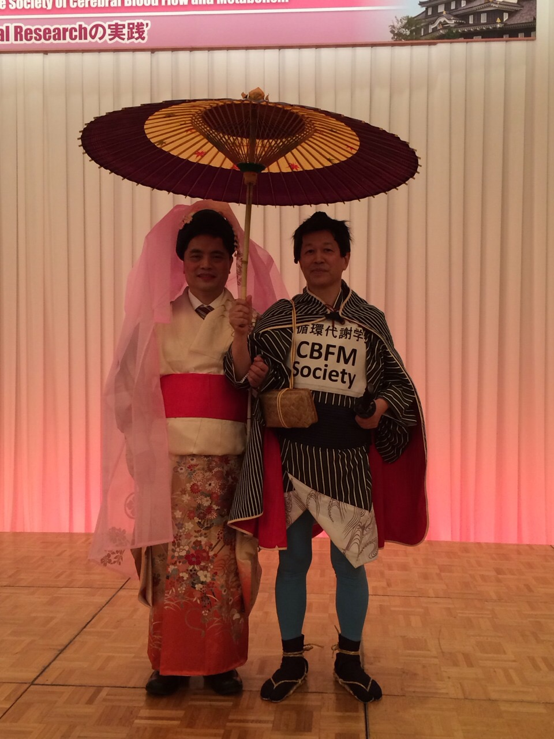
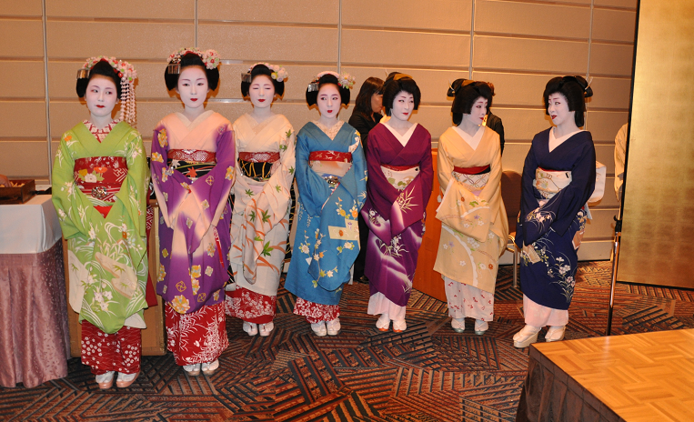
Dr. Koji Abe was promoted to the Professor and Chairman of Neurology at Okayama University Medical School in Japan.

Slide 9
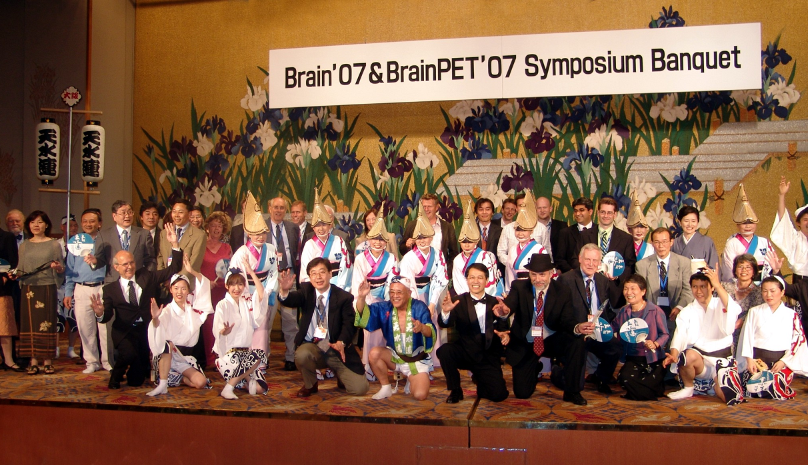
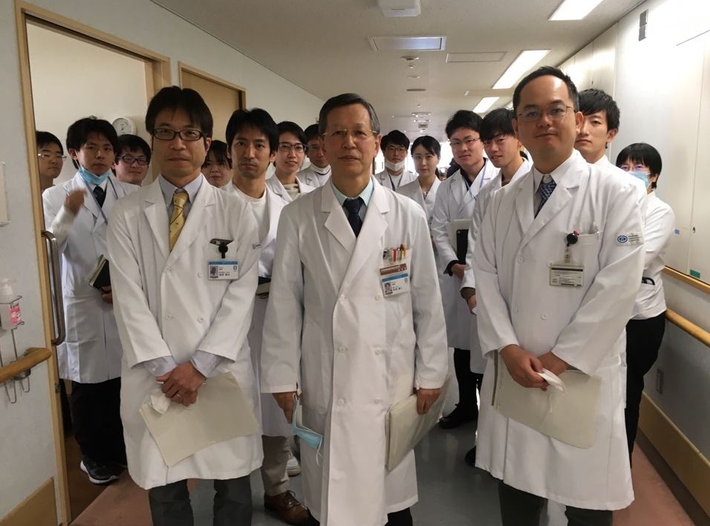
Professor Koji Abe has been publishing more than 850 papers, on many important fields of neurology especially in the mechanism of ischemic brain damage, gene and stem cell therapy, neuroprotection, and neuroimaging.
After retirement of Okayama University, he again promoted to the Head of National Center Hospital of Neurology and Psychiatry (NCNP) in Tokyo for 3 years (2021-2024).
Grand Round of Neurology

