Slide 1
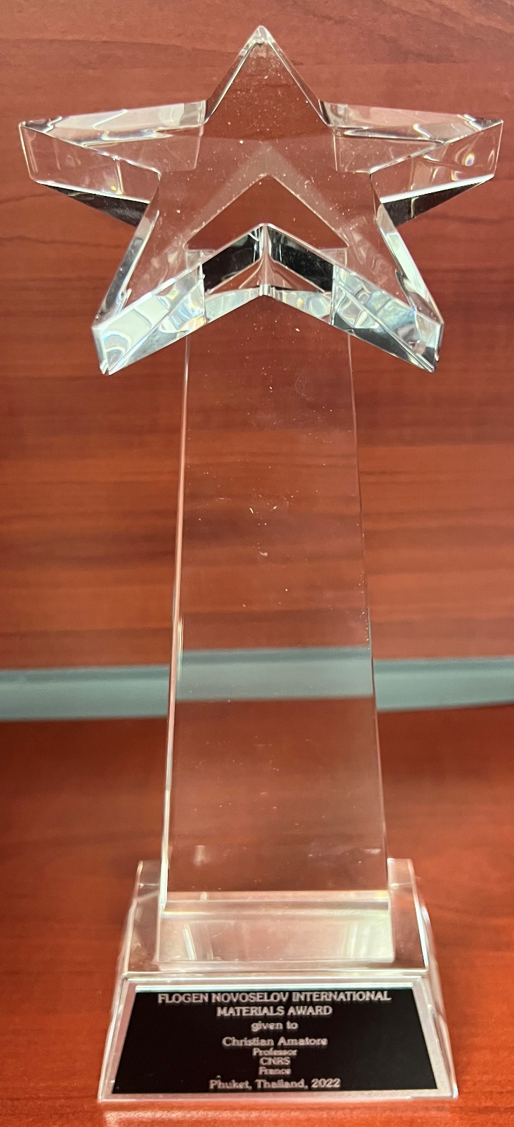
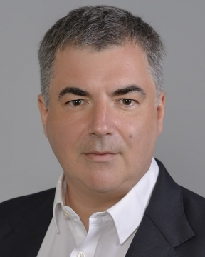
Novoselov International Materials Award
An Award in honor of the lifetime achievements of Prof. Sir. Konstantin Novoselov, 2010 Nobel Laureate in Physics and his distinguished work in the field of materials.
Citation:
" For Leadership in developing and applying new materials methods and technologies as per FLOGEN Sustainability Framework in the environmental, economic, and social points of view”

Slide 2
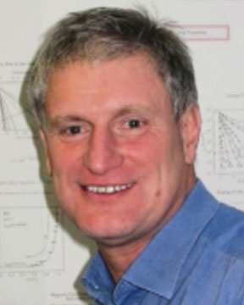
Sustainable Industrial Processing Summit
2024 STARS:
Ludwig Schultz
Professor
TU Dresden, Germany
Field: Intelligent Materials/Superconductivity
NOVOSELOV INTERNATIONAL MATERIALS AWARD
FLOGEN STARS OUTREACH

Slide 3
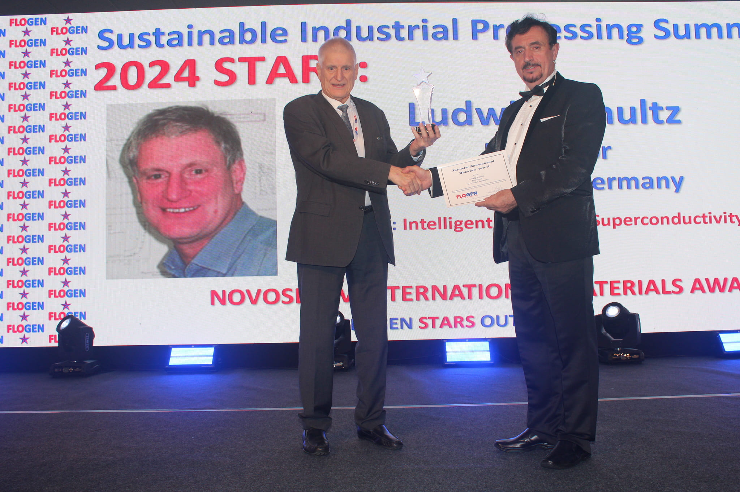
Dr. Ludwig Schultz receiving the Novoselov International Materials Award from Dr. Florian Kongoli at FLOGEN SIPS 2024

Slide 4
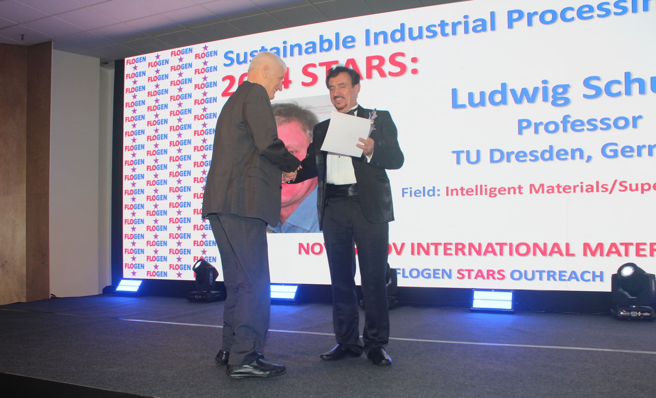
Dr. Florian Kongoli congratulating Dr. Ludwig Schultz during the FLOGEN SIPS 2024 award ceremony

Slide 5
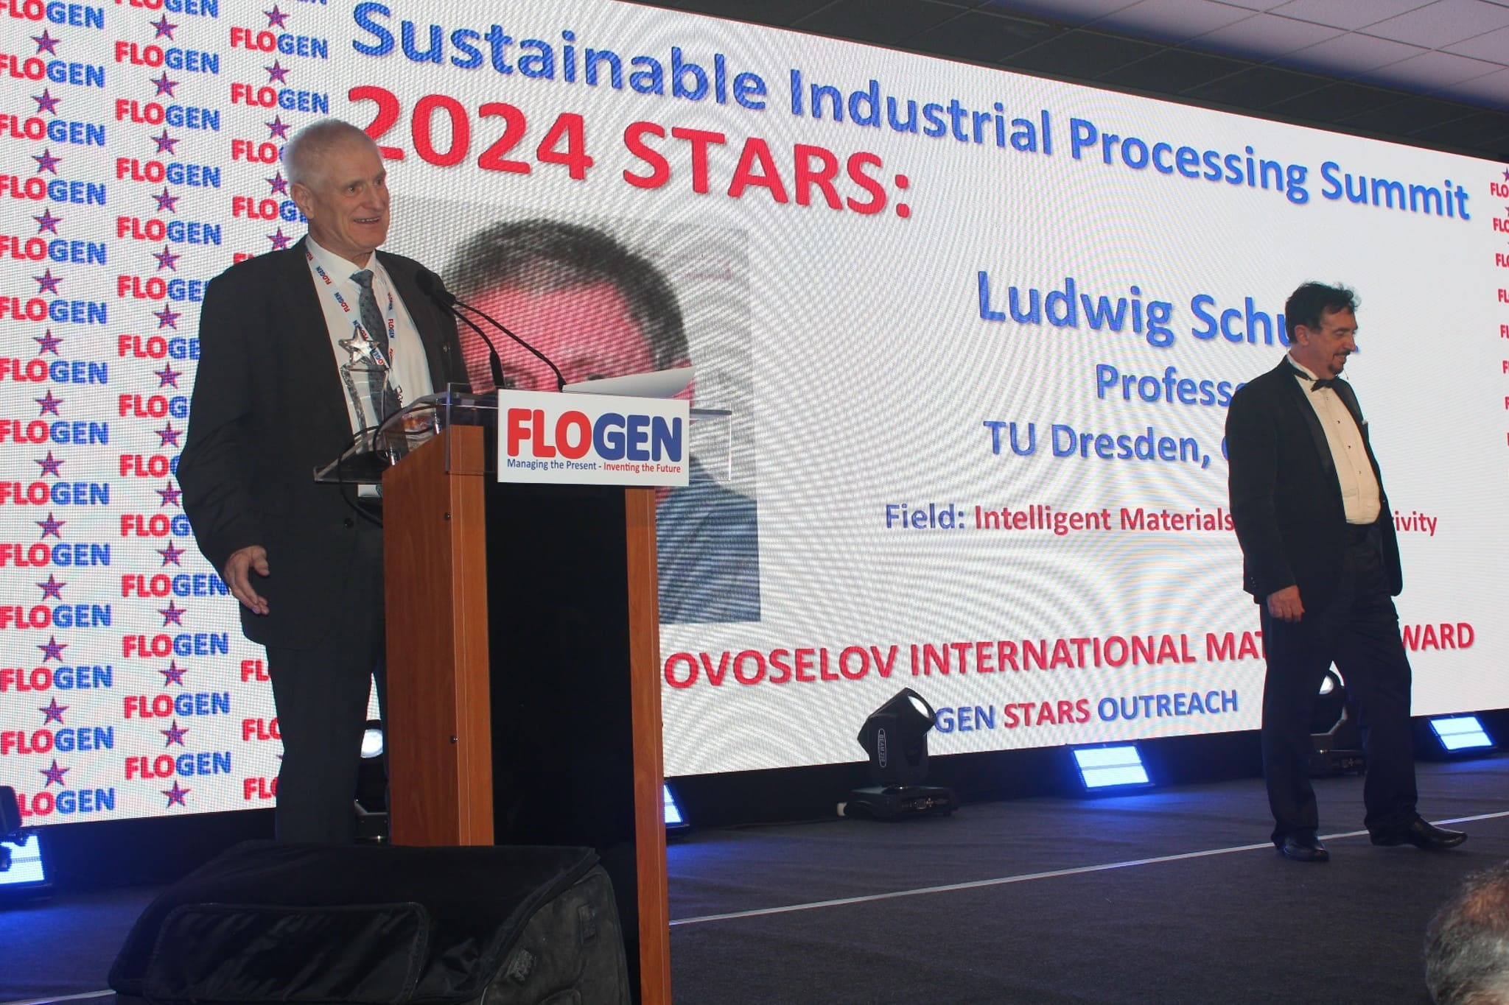
Dr. Ludwig Schultz delivering an acceptance speech during the FLOGEN SIPS 2024 award ceremony

Slide 6
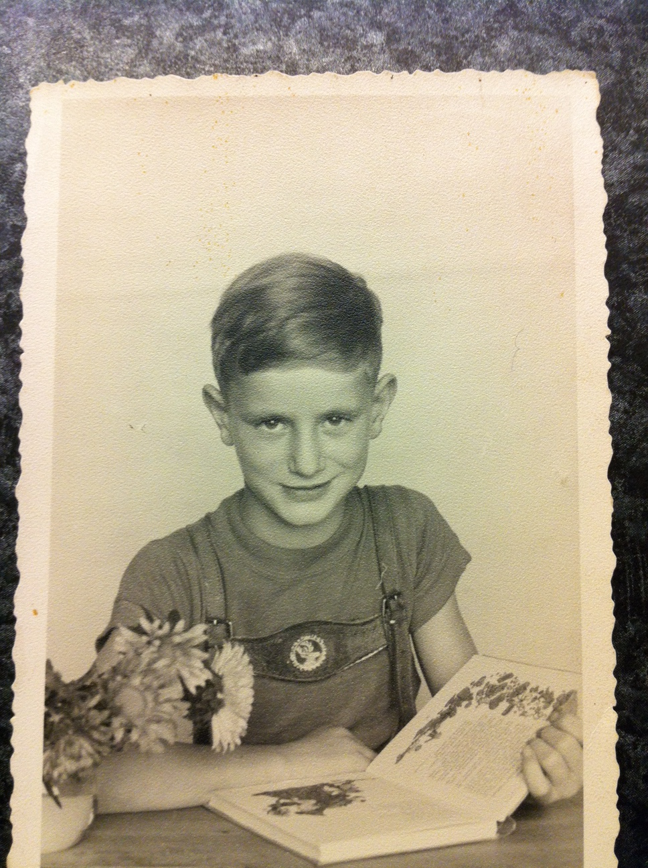
Ludwig as a young boy

Slide 7
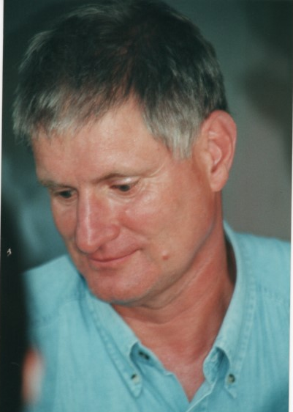
Ludwig Schultz as a student

Slide 8
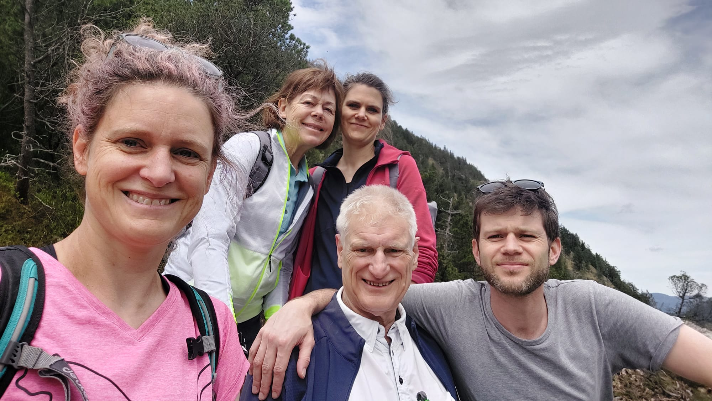
Ludwig and his family

Slide 9
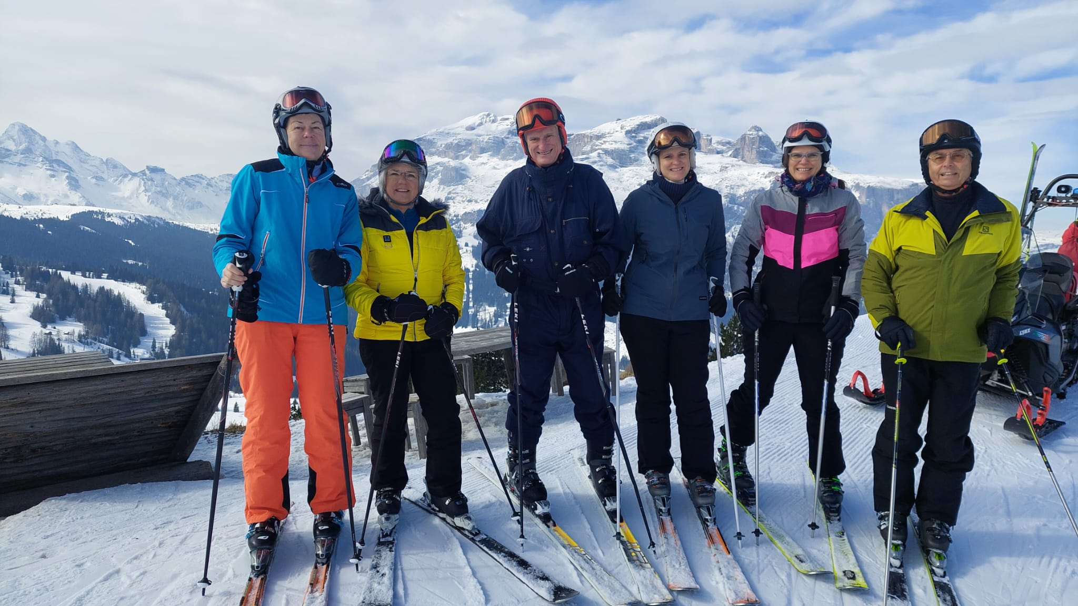
Skiing in Italy

Slide 10
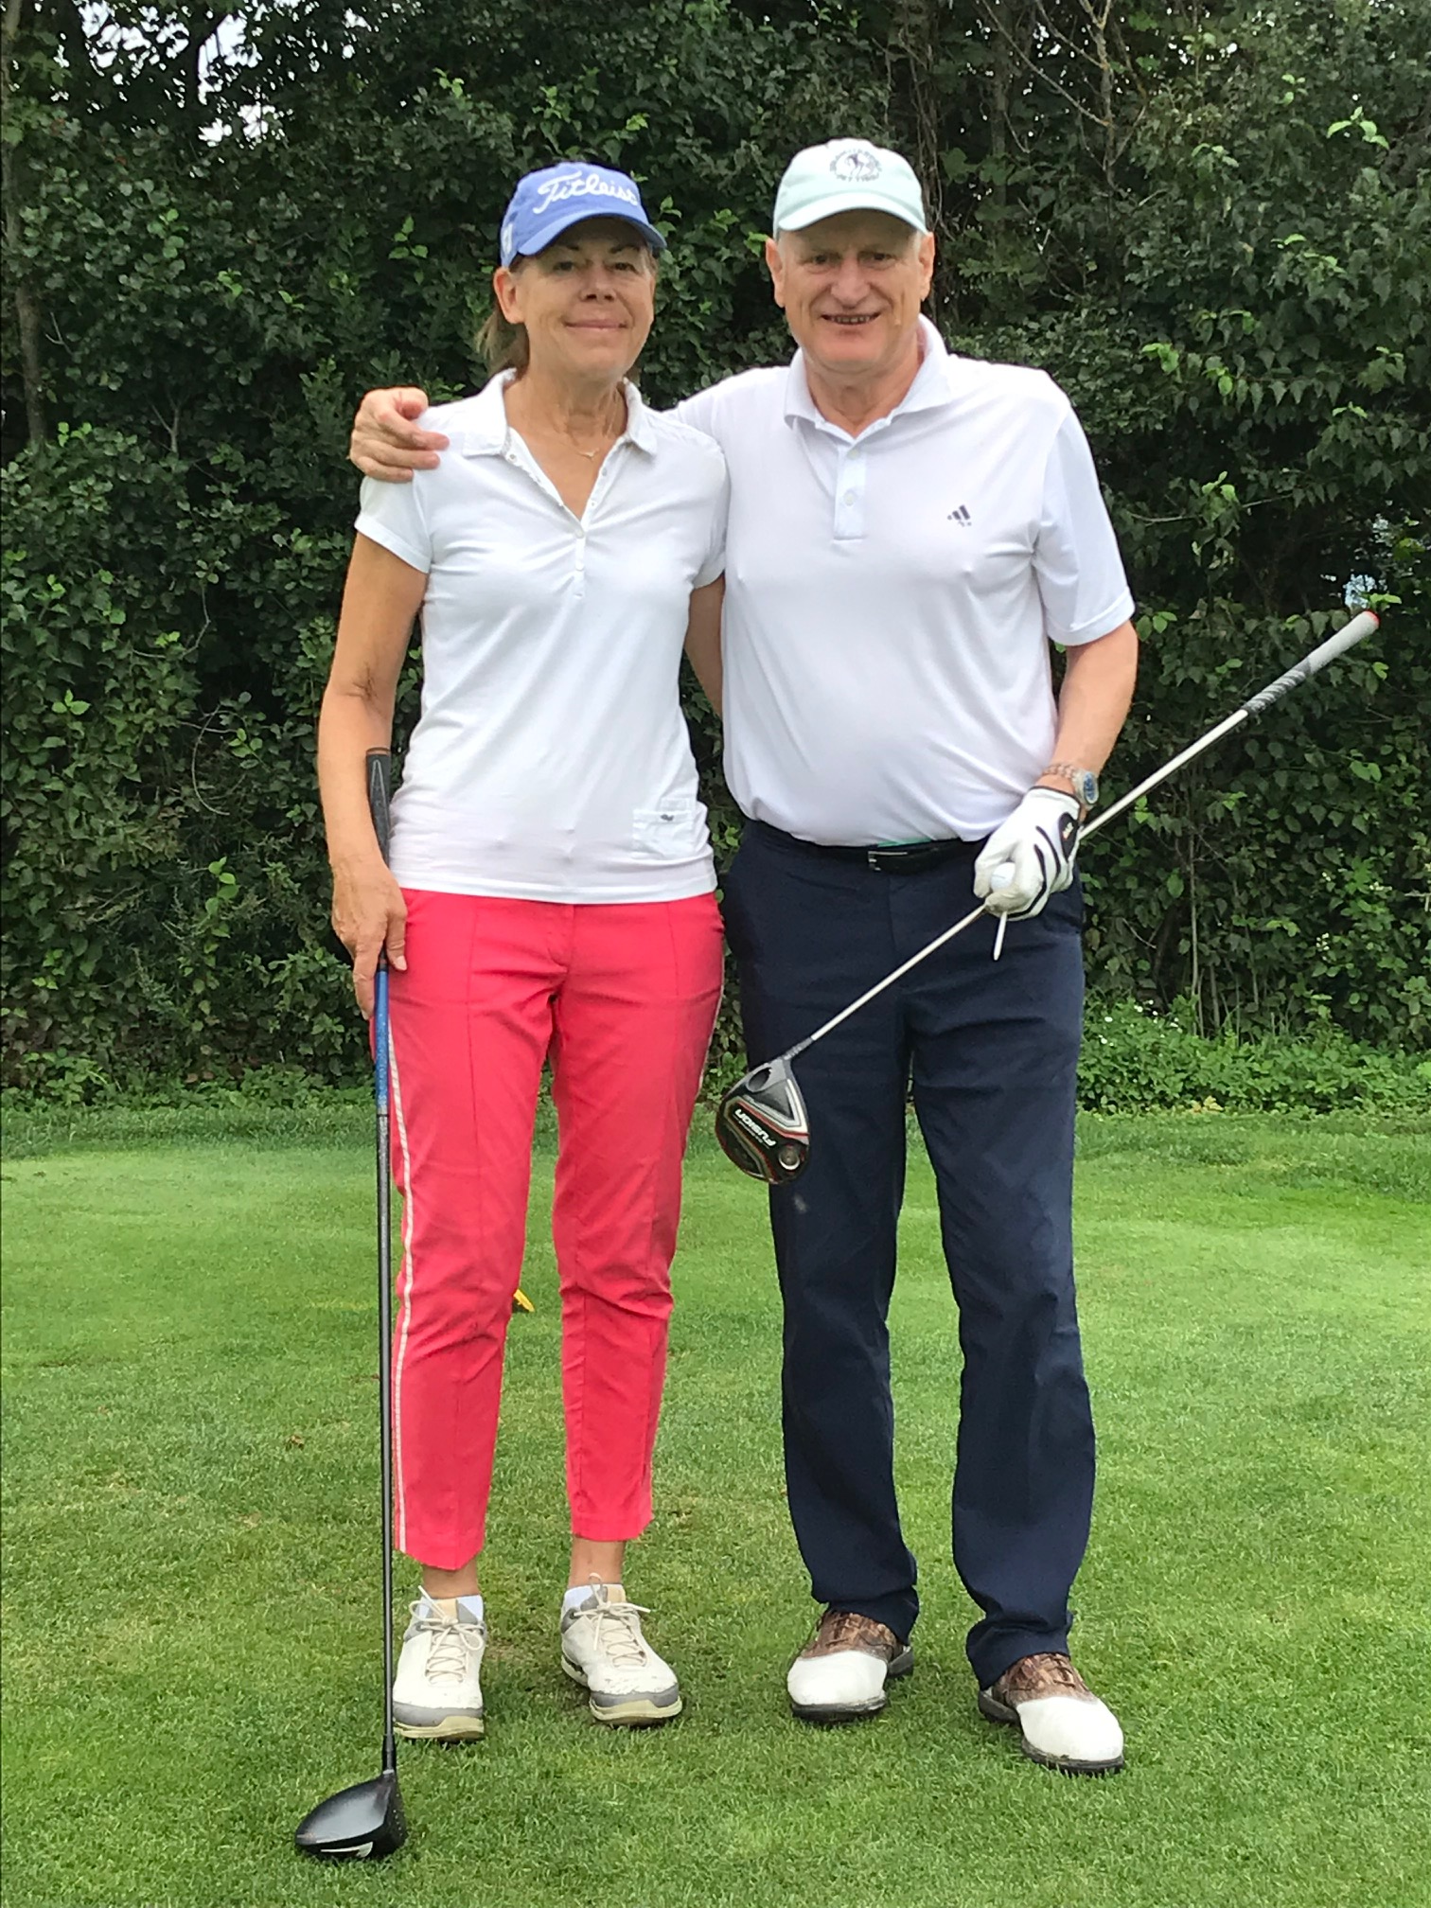
On the golf course

Slide 11
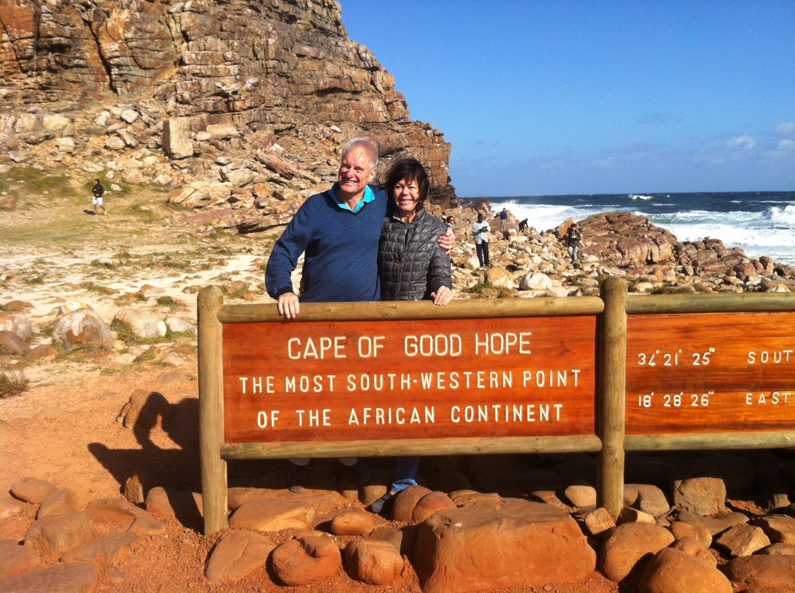
Visit at Cape of Good hope

Slide 12
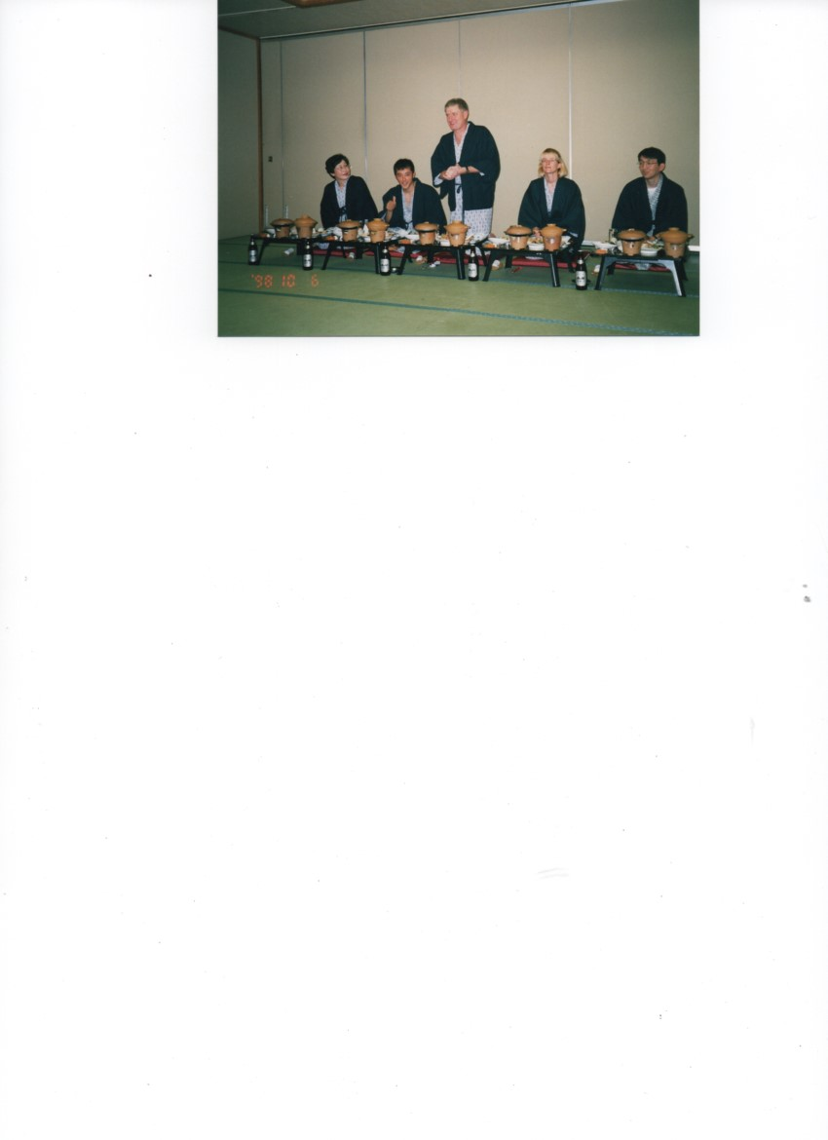
Conference in Japan

Slide 13
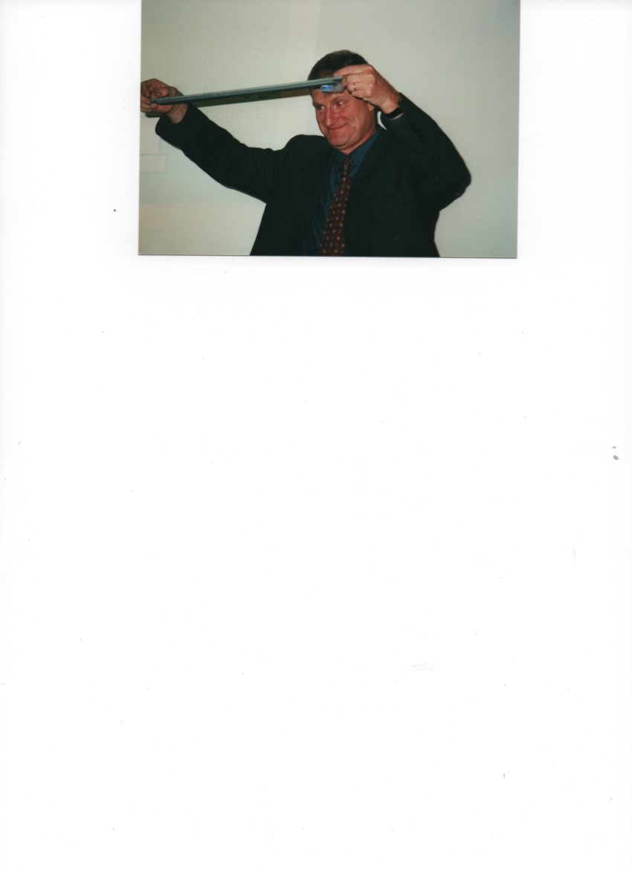
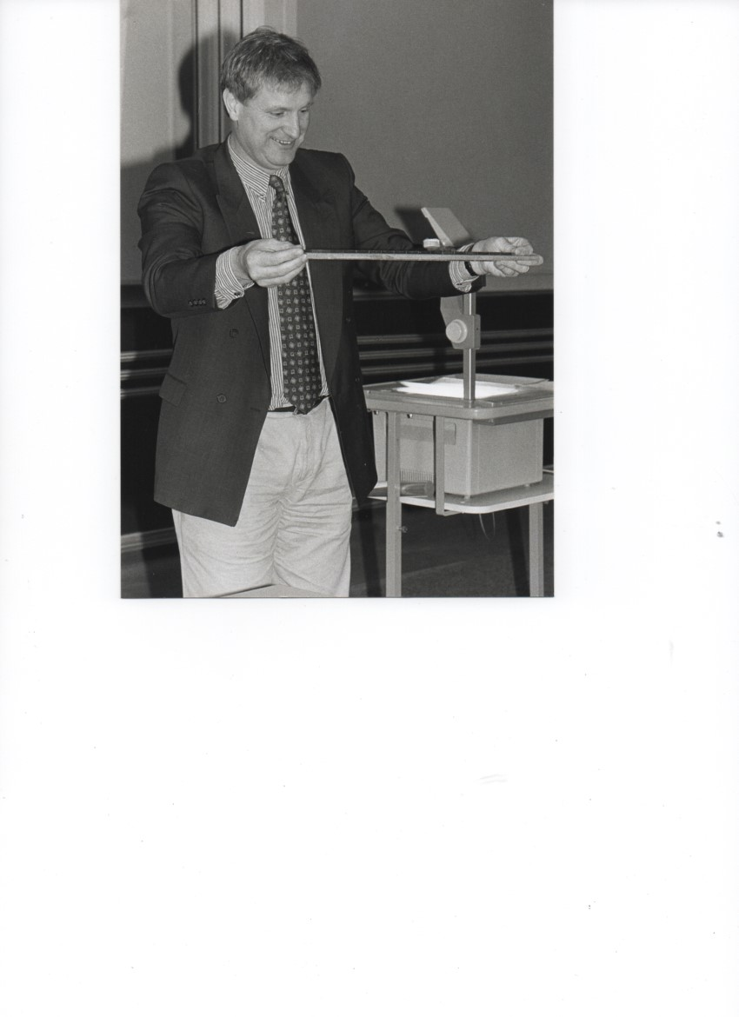
Demonstrating Superconducting Levitation

Slide 14
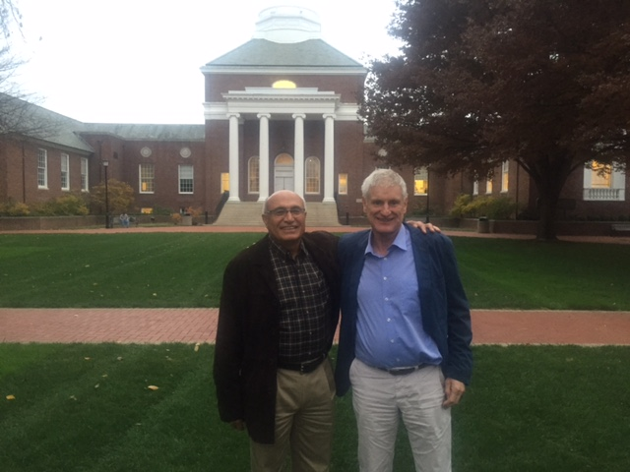
Visit at the University of Delaware

Slide 15
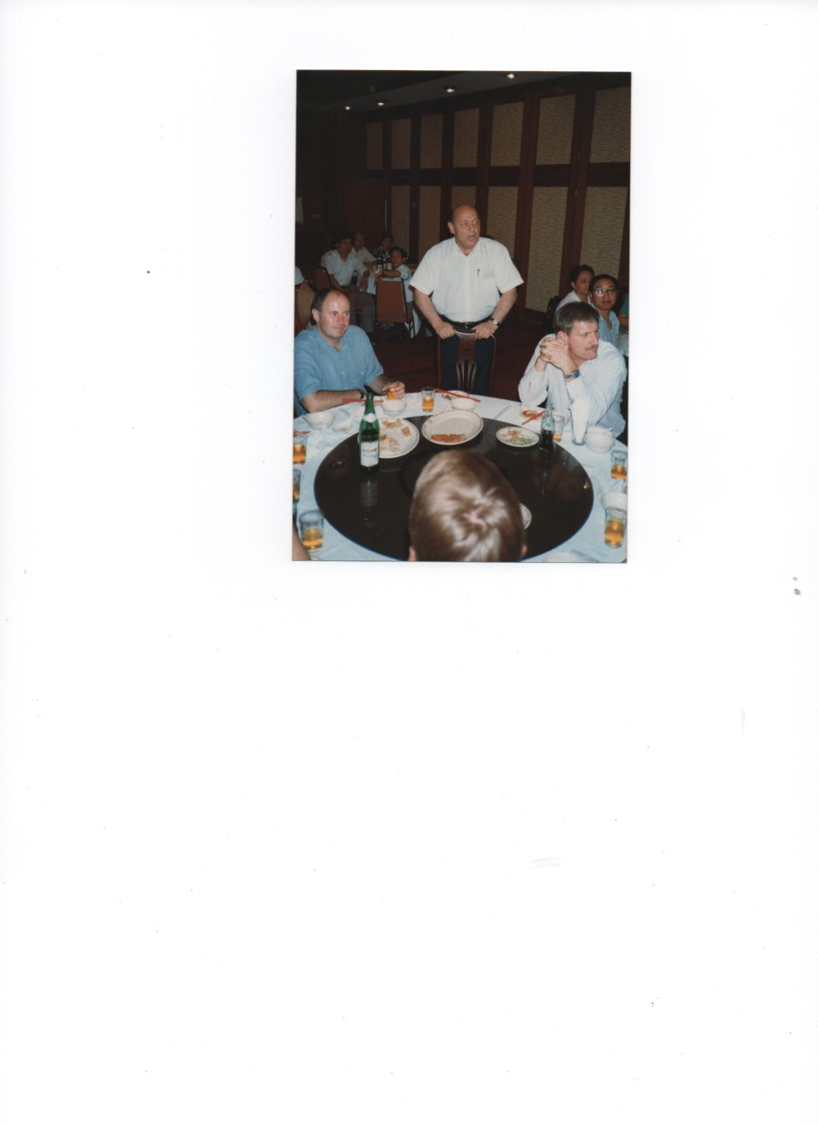
Dinner with Helmut Kronmüller and Josef Fidler in Japan

Slide 16
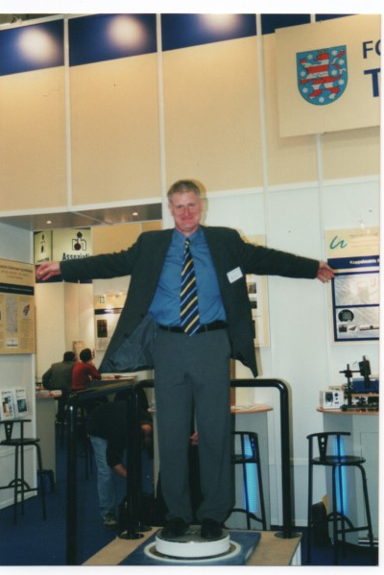
Levitated by Supercondectors

Slide 17
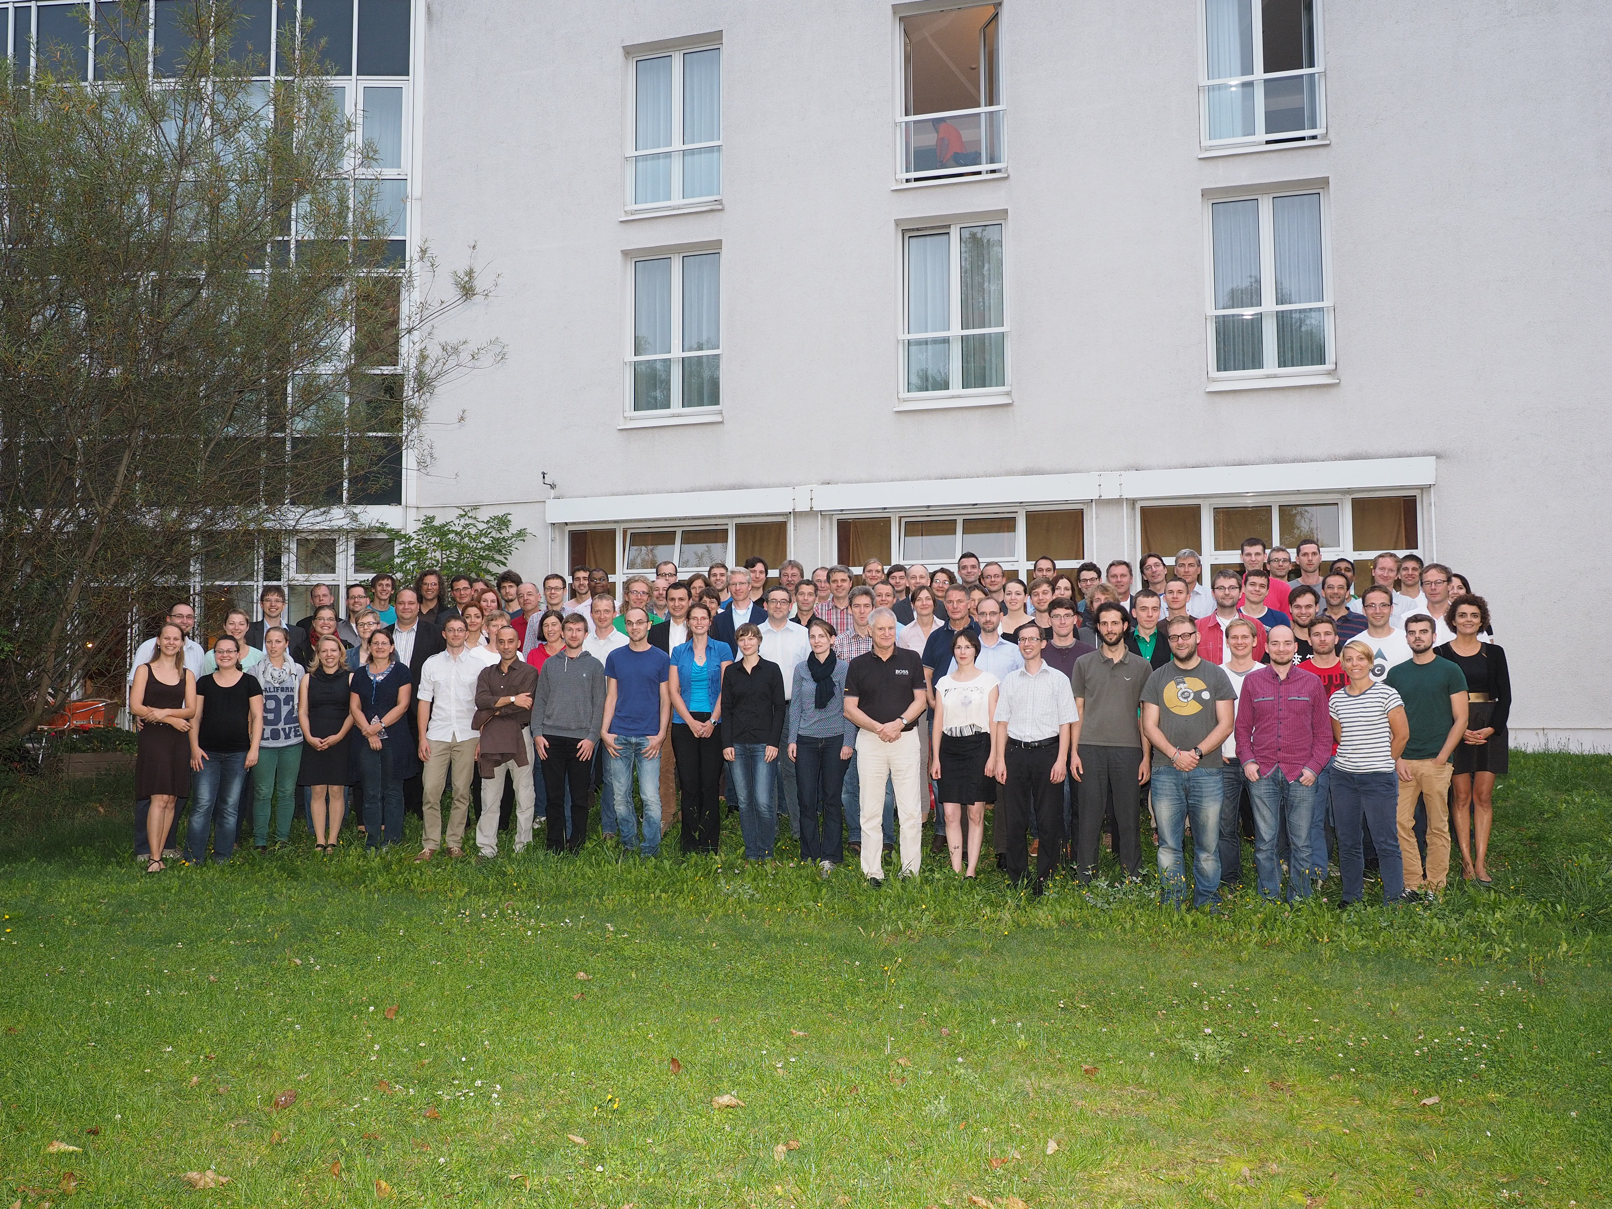
PhD Seminar 2014

