Slide 1
Stoddart International Scientific Award
In honor of the distinguished work and lifetime achievements of 2016 Nobel Laureate in Chemistry, Prof. Sir Fraser Stoddart.
Citation:
"For extraordinary scientific achievements as per FLOGEN Sustainability framework”

Slide 2
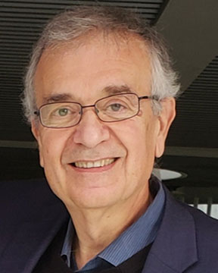
Sustainable Industrial Processing Summit
2024 STARS:
Mercouri G. Kanatzidis
Professor
Northwestern University, USA
Field: Solid State Chemistry
STODDART INTERNATIONAL SCIENTIFIC AWARD
FLOGEN STARS OUTREACH

Slide 3
Dr. Mercouri Kanatzidis receiving the Stoddart International Scientific Award from Dr. Florian Kongoli at FLOGEN SIPS 2024

Slide 4
Dr. Florian Kongoli congratulating Dr. Mercouri Kanatzidis during the FLOGEN SIPS 2024 award ceremony

Slide 5
Dr. Mercouri Kanatzidis delivering an acceptance speech during the FLOGEN SIPS 2024 award ceremony

Slide 6
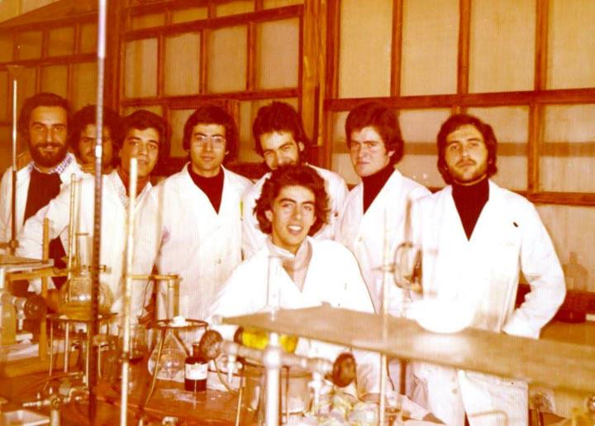
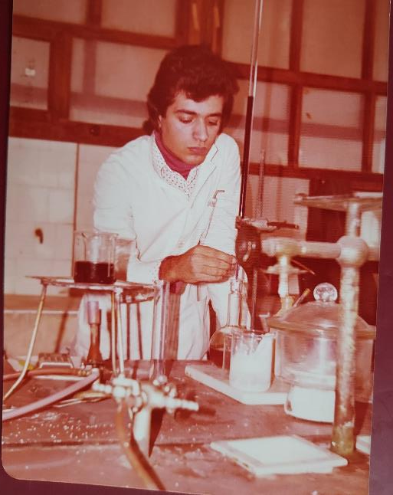
Freshman year 1975
University of Thessaloniki
Freshman year 1975
General chemistry lab
University of Thessaloniki

Slide 7
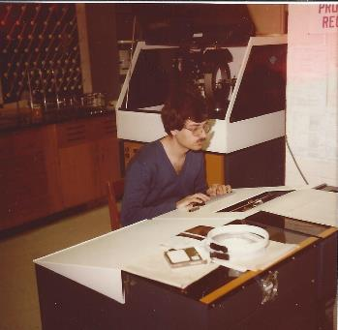
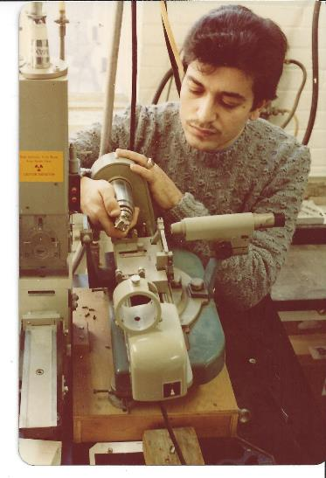
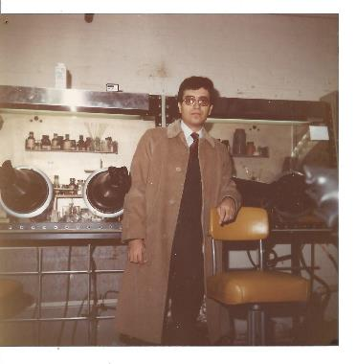
University of Michigan
Graduate student 1982-1983
University of Michigan
Graduate student 1982-1983
On a Nicolet X-ray single crystal diffractometer
University of Iowa
Graduate student 1980-1981
Mounting crystal on Weissenberg camera for X-ray diffraction

Slide 8
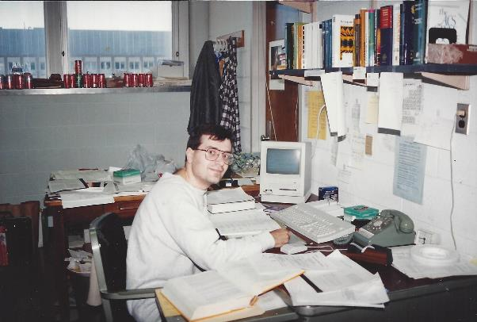
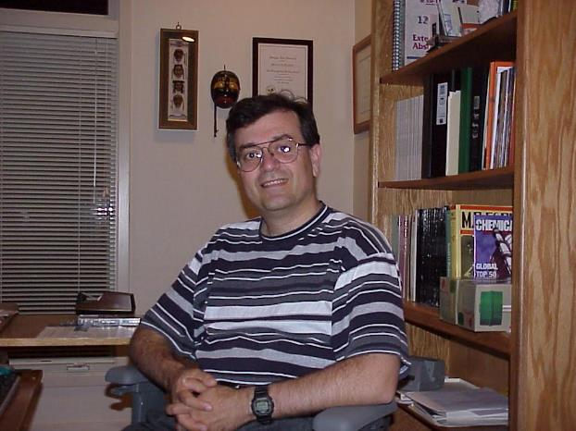
Michigan State University years
Circa 1992 in MSU Chemistry Department office
Circa 2000 in home office

Slide 9
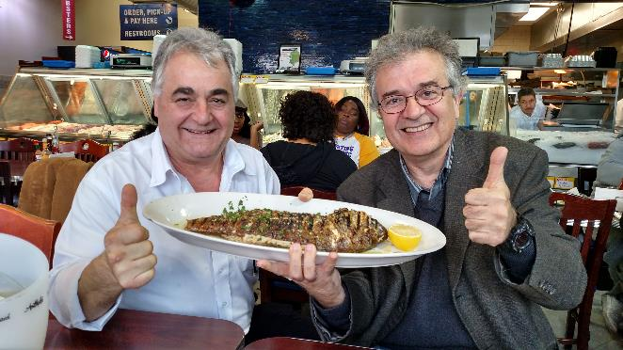
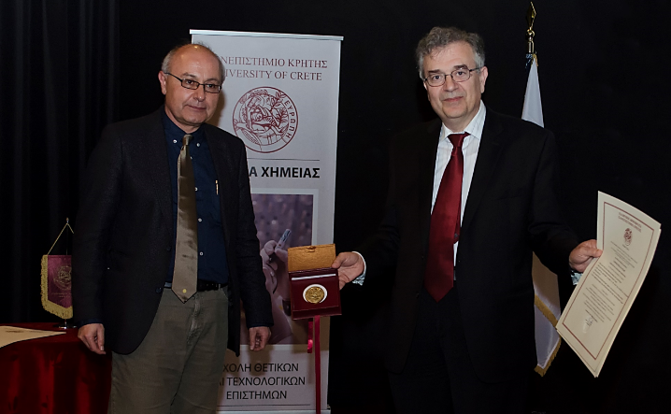
Best Greek fish taverna in Chicago
“The Boston Fish Market” ca. 2017
Honorary PhD degree
University of Crete 2017

Slide 10
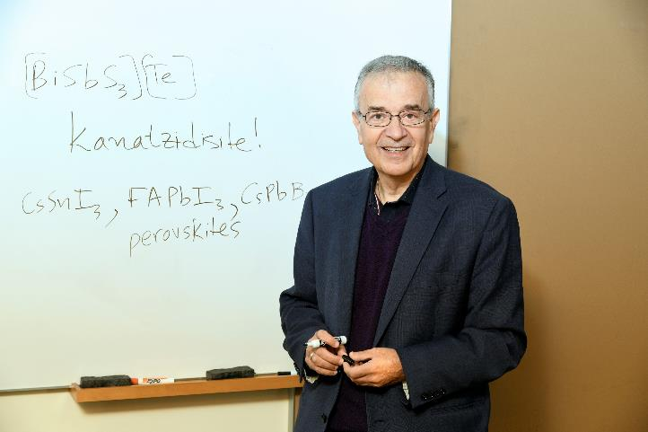
Samson Prime Minister's Prize for Innovation in Alternative Fuels for Transportation, 2016. Tel Aviv, Israel
New mineral called kanatzidisite! 2023

Slide 11
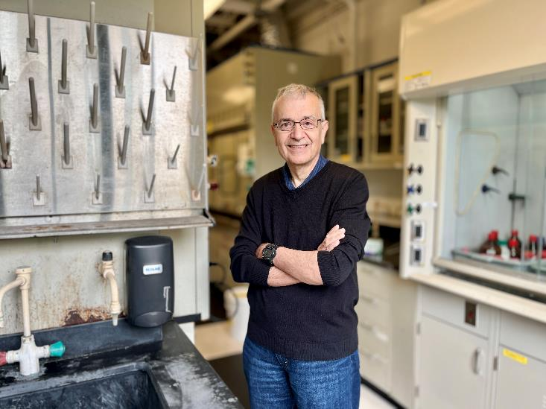
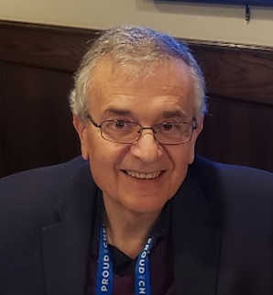
Northwestern 2023

Slide 12
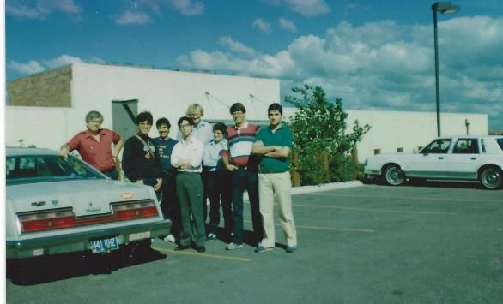
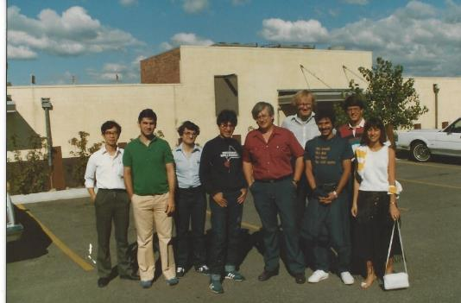
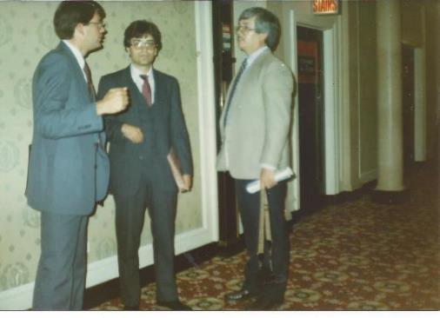
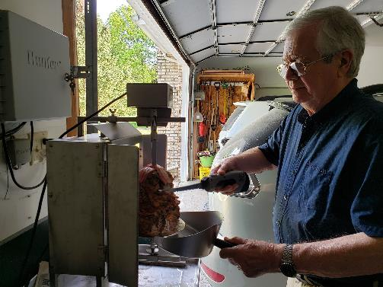
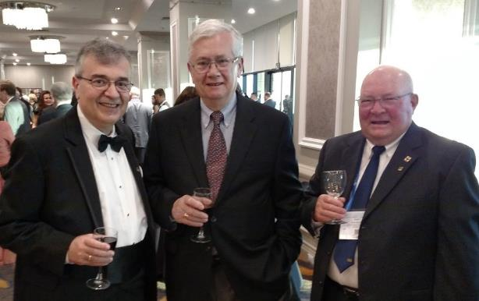
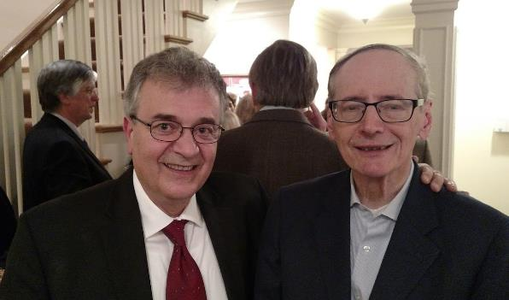
Tribute to my PhD mentor: Dimitri Coucouvanis (ret 2012) and my postdoctoral advisor Tobin J. Marks
1985
1985
Driving to a Midwest ACS meeting, 1985
2016
Coucouvanis preparing gyros in his home
D. Coucouvanis, John Fackler (academic grandfather…)
Postdoctoral mentor: Tobin Marks

Slide 13
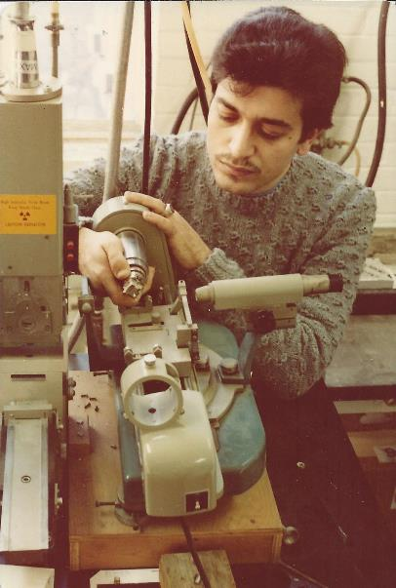
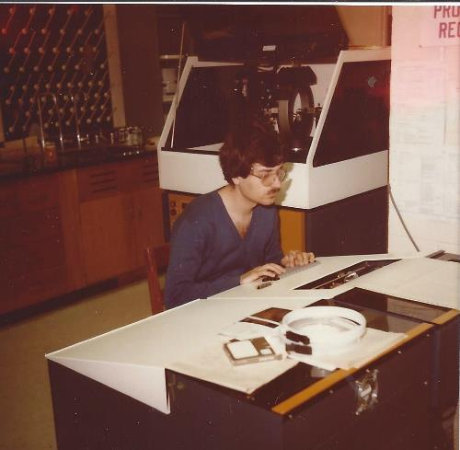
University of Michigan
Graduate student 1982-1983
University of Michigan
Graduate student 1982-1983
On a state of the art Nicolet X-ray single crystal diffractometer (Coucouvanis group, University of Iowa)
University of Iowa
Graduate student 1980-1981
Mounting crystal on Weissenberg camera for X-ray diffraction

Slide 14
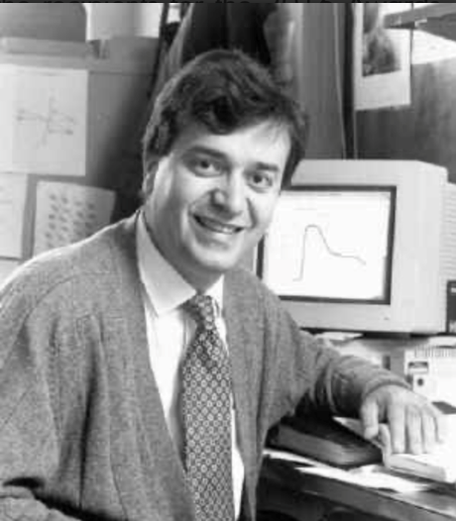
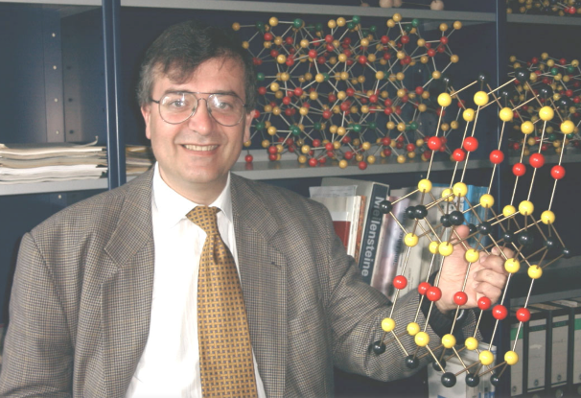
Previous Positions as a Principal Investigator
Previous Positions
07/87-06/91: Assistant Professor at Michigan State University
09/91-06/93: Associate Professor at Michigan State University
07/93-08/06: Full Professor at Michigan State University
Michigan State University years
Circa 1992 in MSU Chemistry Department office

Slide 15
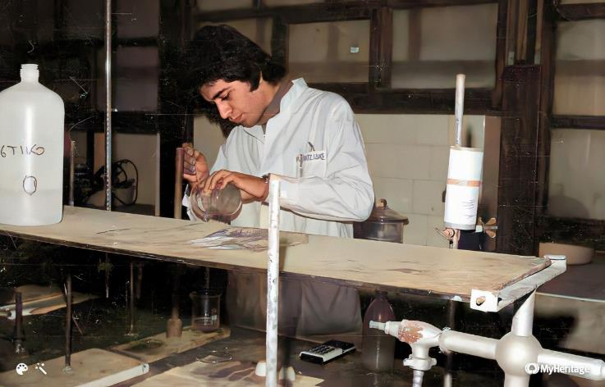
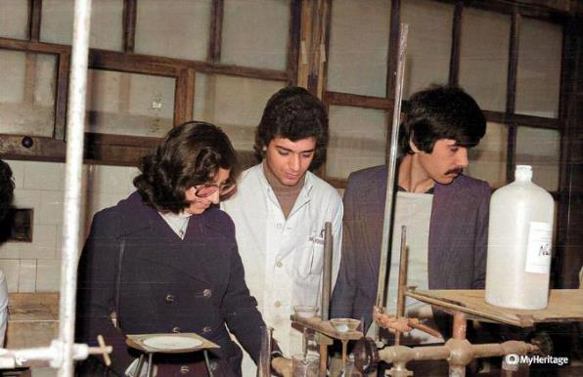
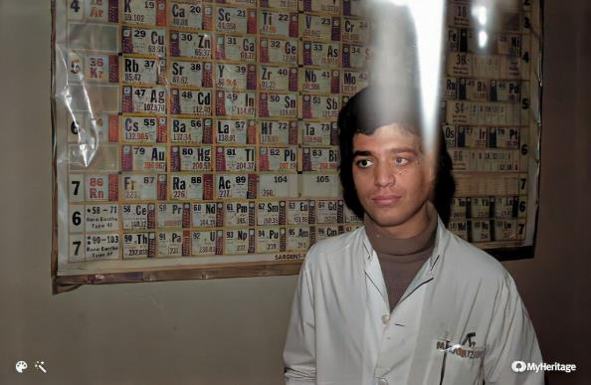
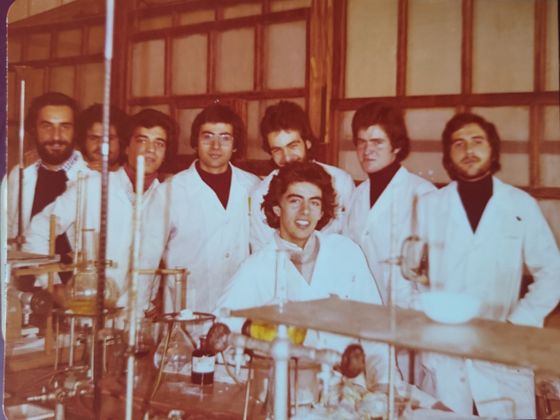
My years at AUTH Chemistry 1975-1979

Slide 16
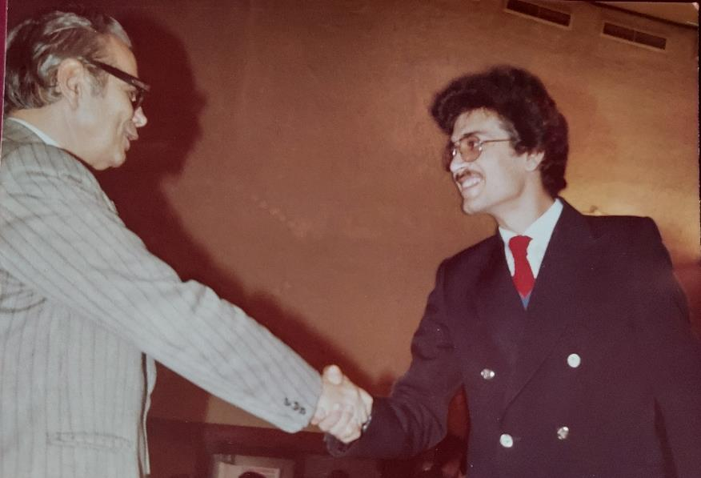
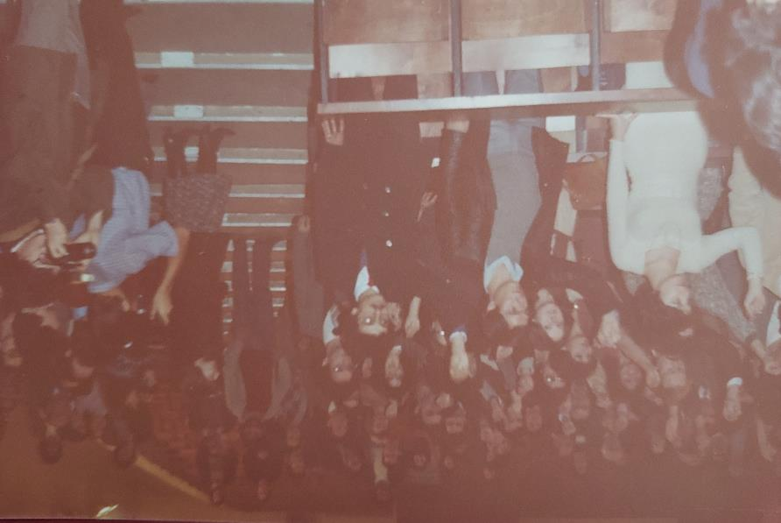
Graduation day Fall 1979
Professor Giannakoudakis (Physical Chemistry)
Taking the Oath to serve the chemistry profession with honor (required)

Slide 17
Tribute to my PhD mentor: Dimitri Coucouvanis (ret 2012) and my postdoctoral advisor Tobin J. Marks
1985
1985
Driving to a Midwest ACS meeting, 1985
2016
Coucouvanis preparing gyros in his home
D. Coucouvanis, John Fackler (academic grandfather…)
Postdoctoral mentor: Tobin Marks

Slide 18
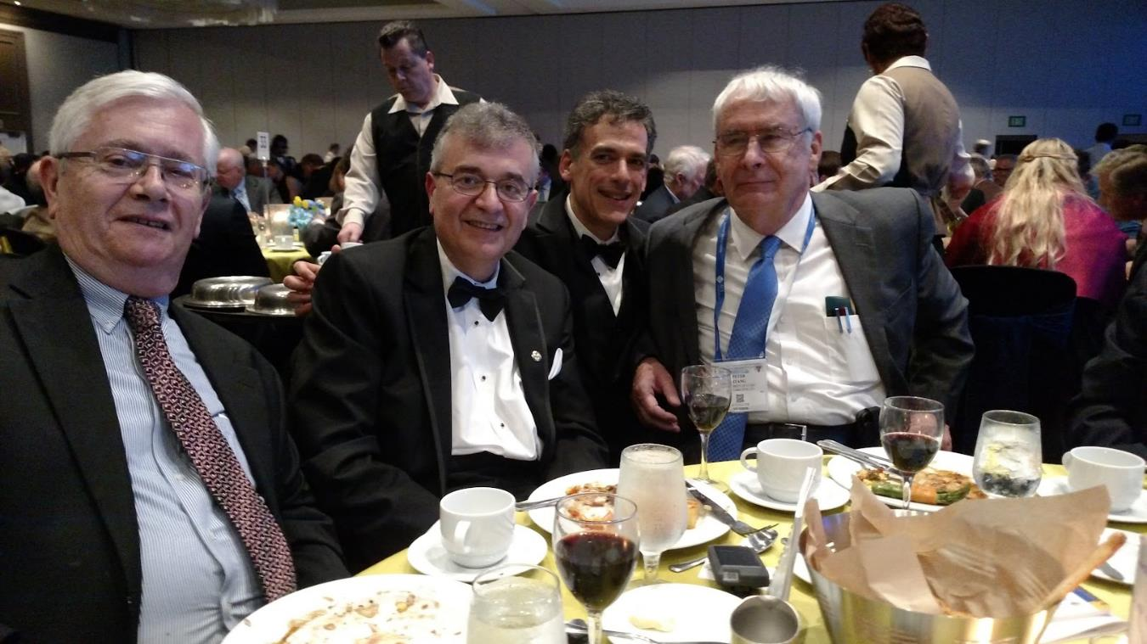
ACS Award in Inorganic Chemistry 2016
With Dimitri Coucouvanis and Peter Stang

Slide 19
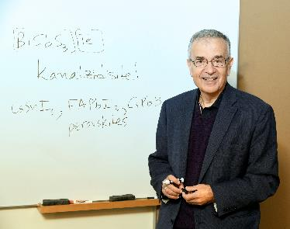
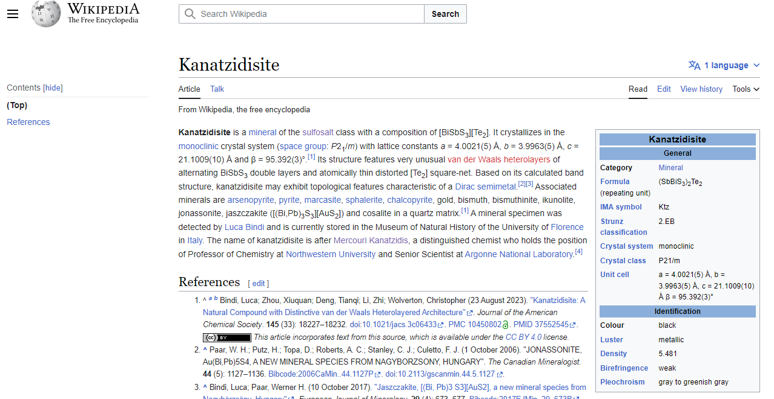
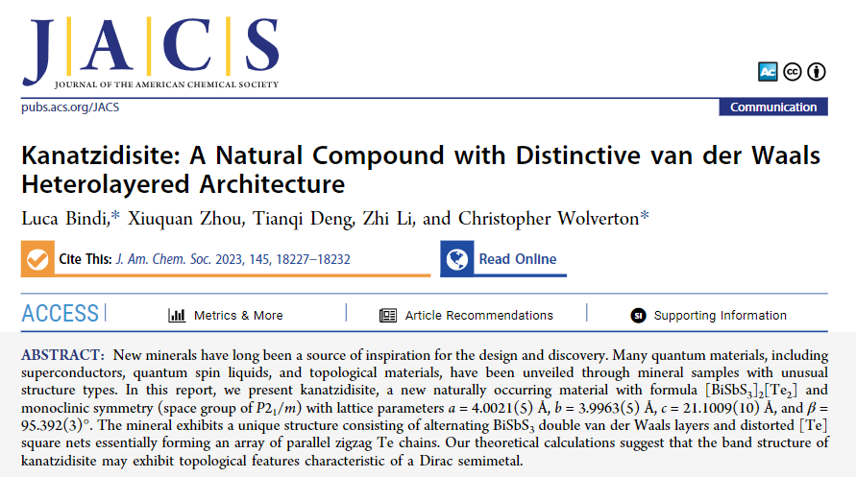
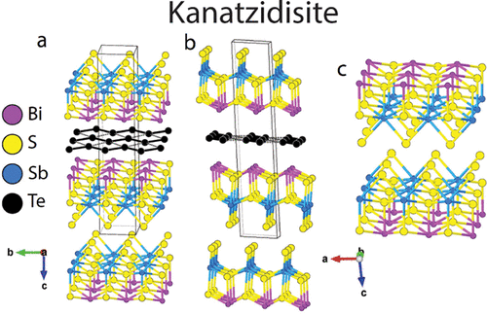
The new mineral kanatzidisite…

Slide 20
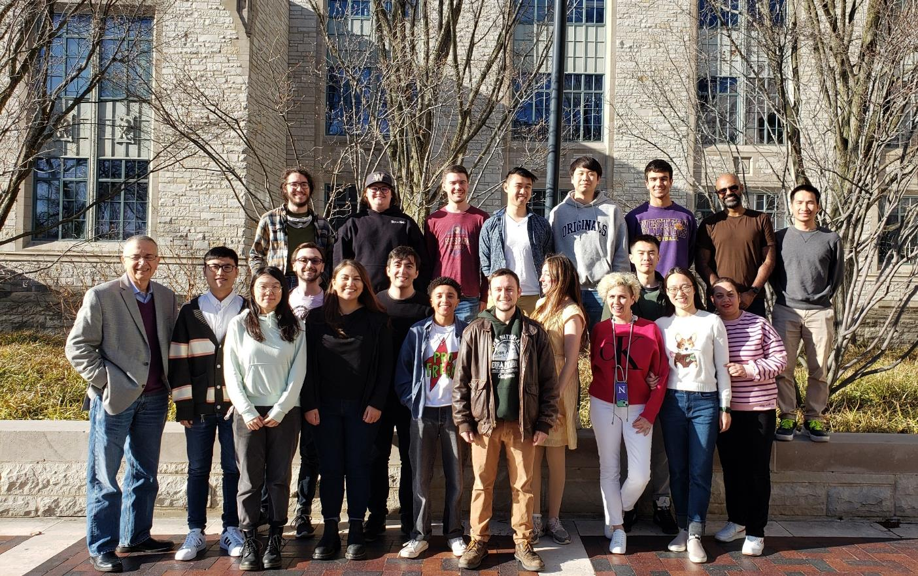
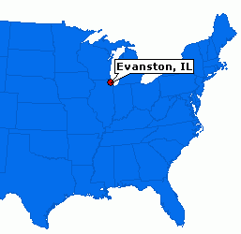
Kanatzidis Group Northwestern…2023-2024
https://chemgroups.northwestern.edu/kanatzidis/

