Slide 1
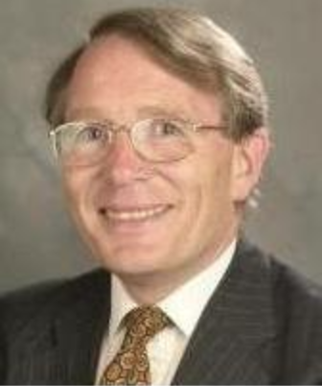
Fray International Sustainability Award
In honor of the distinguished work and lifetime achievements of Dr. Derek J. Fray, Emeritus Professor, University of Cambridge, UK whose illustrious biography includes among others almost 400 scientific papers, approximately 179 patents arising from 62 families of patents and several Fellowships of some of the most prestigious professional societies around the world.
Citation:
Politics : "For Leadership in developing new advanced public policy frameworks related to the efficiency of mineral and metal resources for a global sustainable development"
Corporations: "For Leadership in developing and applying new innovative business plans and operation technologies for a sustainable development of the company in the environment, economy and social points of view"
Academia: " For Leadership in developing new technologies that contribute to a global sustainable development as per FLOGEN Sustainability Framework in the environment, economy and social points of view "

Slide 2
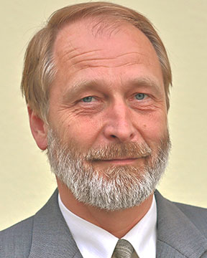
Sustainable Industrial Processing Summit
2024 STARS:
Michael Stelter
Professor
TU Bergakademie Freiberg, Germany
Field: Non-ferrous Smelting & Hydro/Electrochemical & Processing
FRAY INTERNATIONAL SUSTAINABILITY AWARD
FLOGEN STARS OUTREACH

Slide 3
Dr. Michael Stelter receiving the Fray International Sustainability Award from Dr. Florian Kongoli at FLOGEN SIPS 2024

Slide 4
Dr. Florian Kongoli congratulating Dr. Michael Stelter during the FLOGEN SIPS 2024 award ceremony

Slide 5
Dr. Michael Stelter delivering an acceptance speech during the FLOGEN SIPS 2024 award ceremony

Slide 6
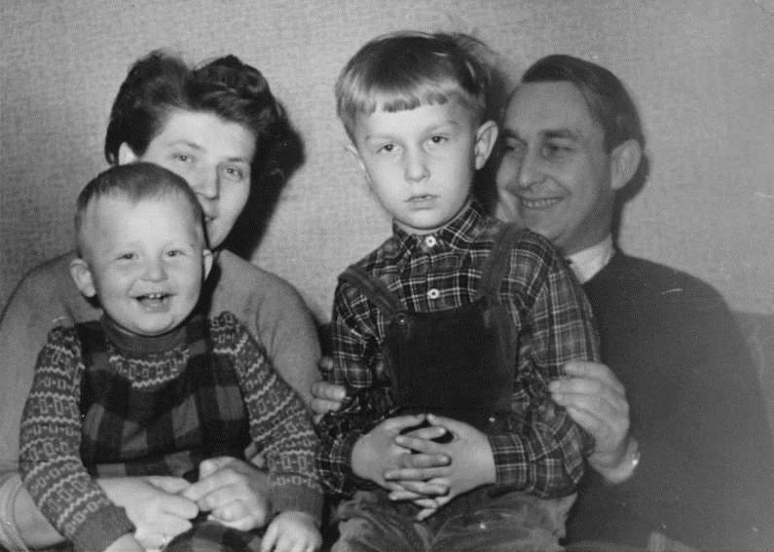
A happy day
with my family.
(1958)

Slide 7
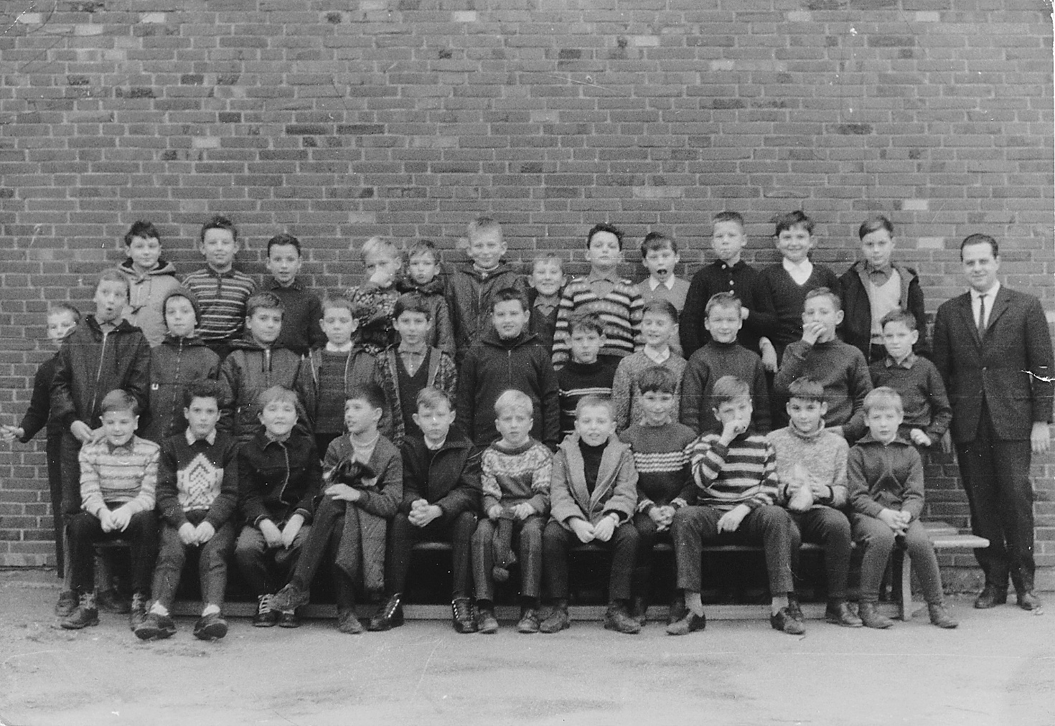
Life gets more
complicated at
grammer-school
(1967)

Slide 8
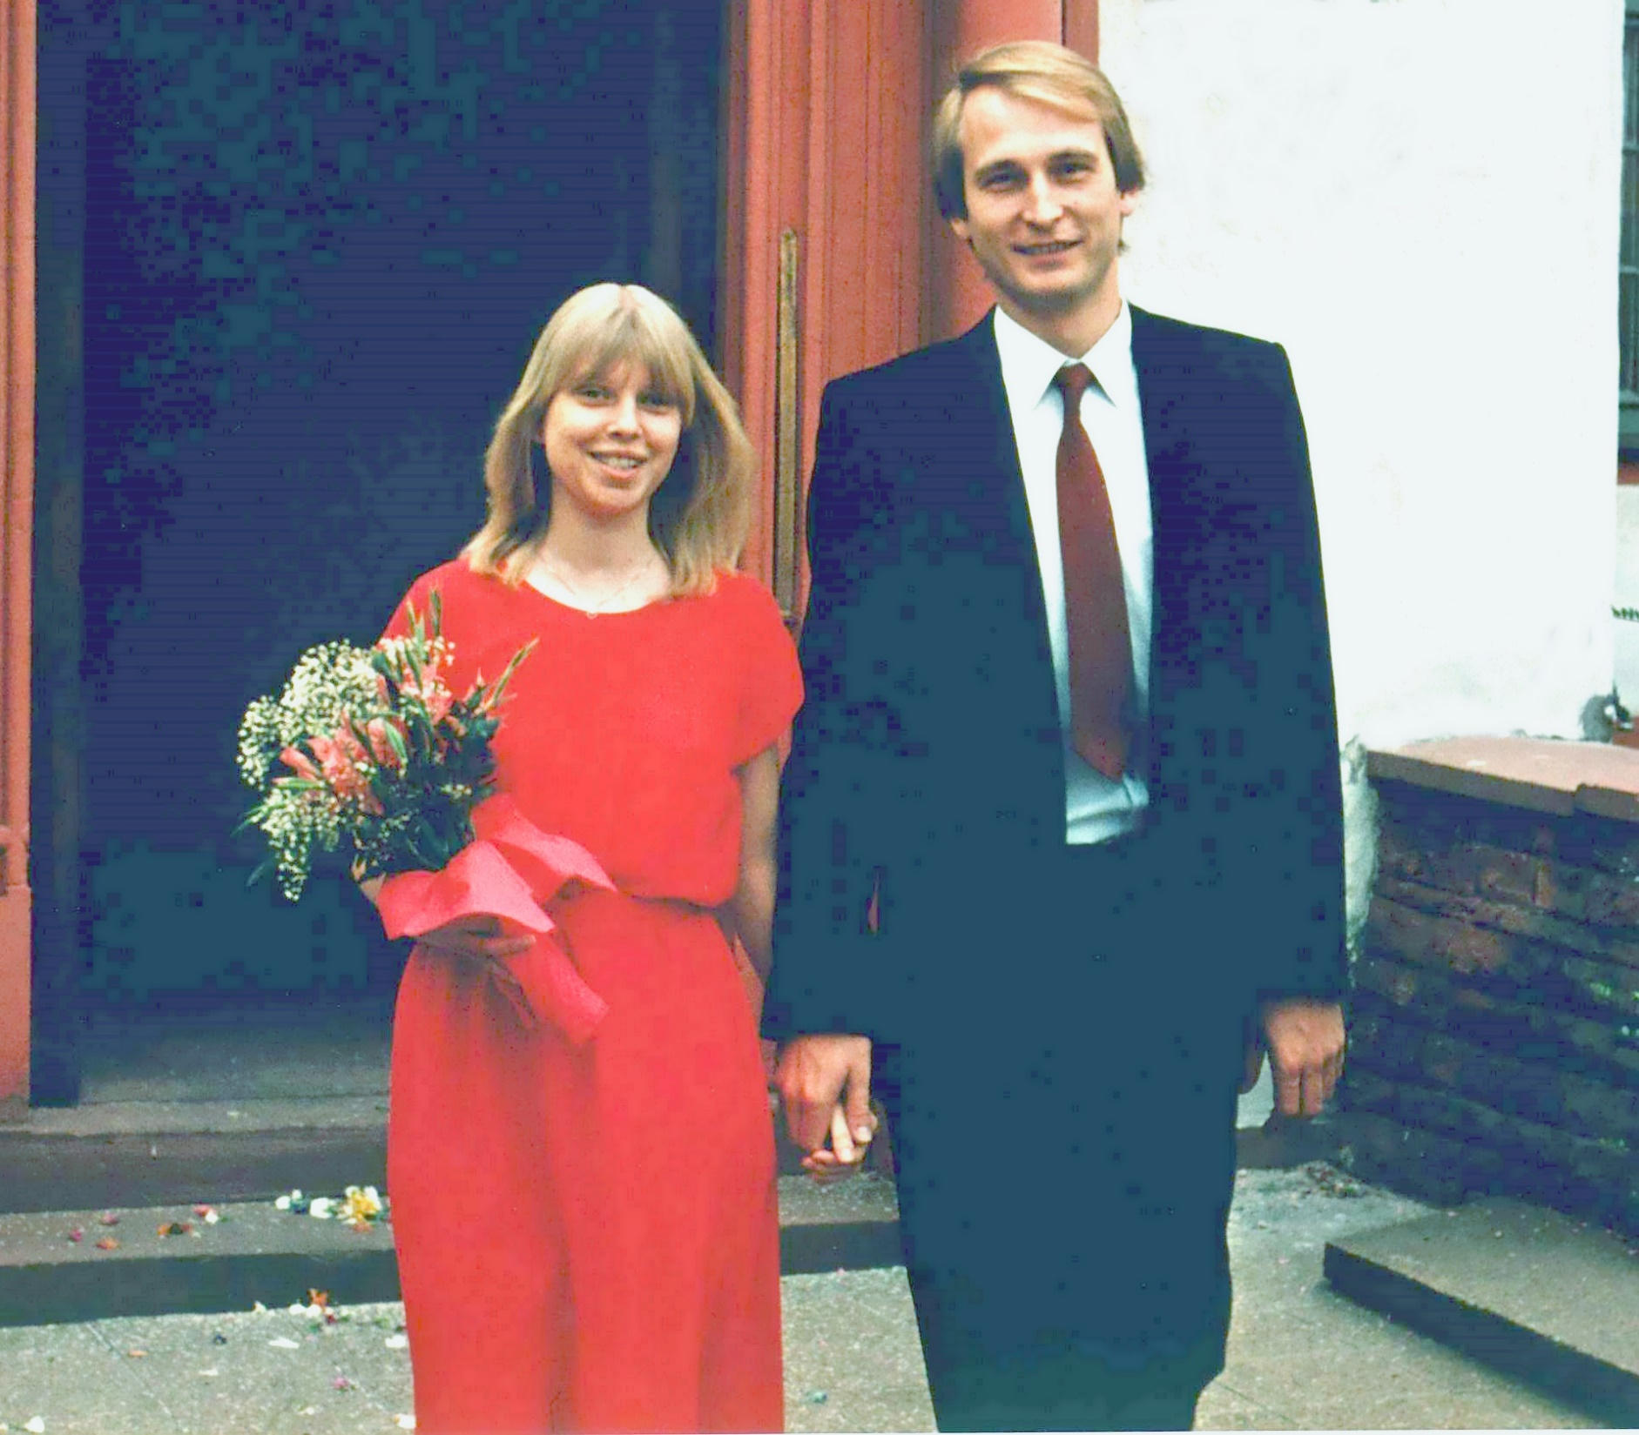
Married my
lovely Lady in 1983.
She is still with me.

Slide 9
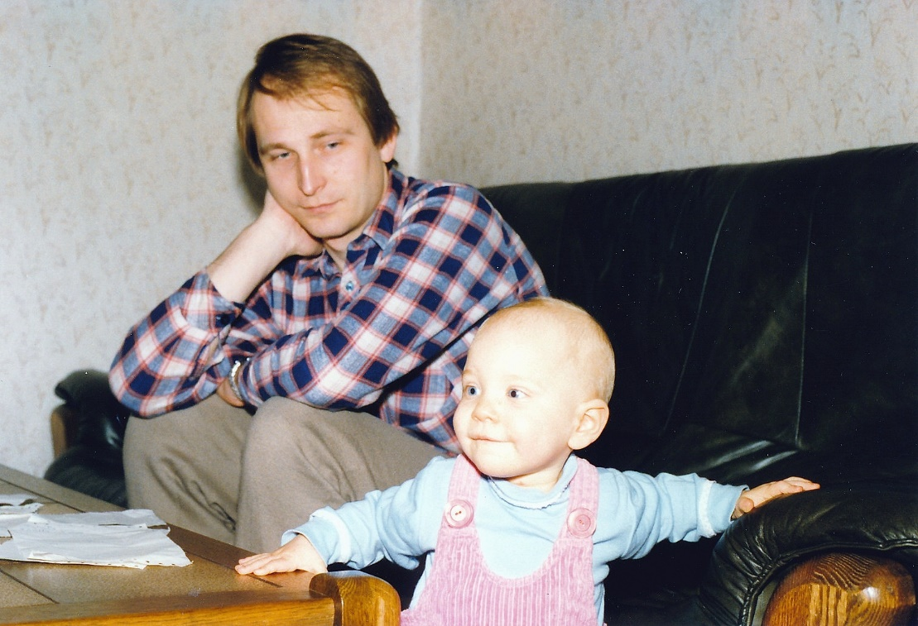
In 1986
our daugther
was born,
changing life
completely.

Slide 10
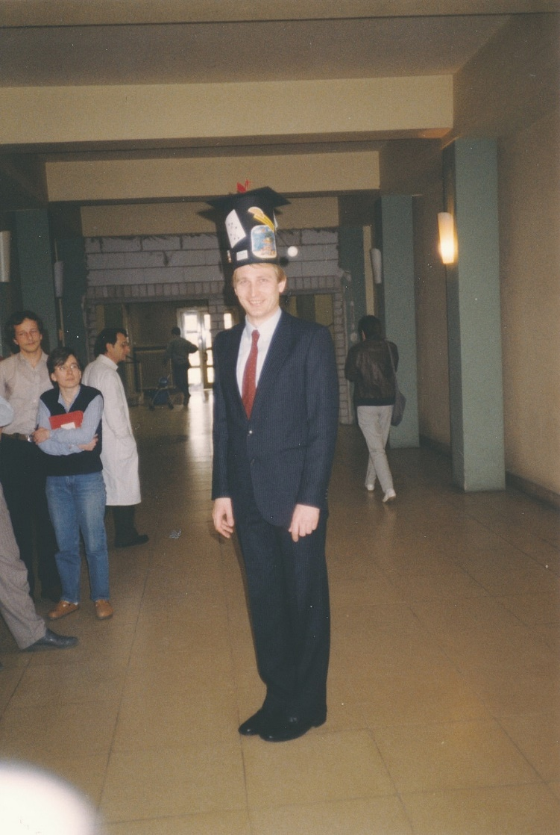
After finishing my thesis,
now the day of graduation
to a Dr.-Ing. in 1987

Slide 11
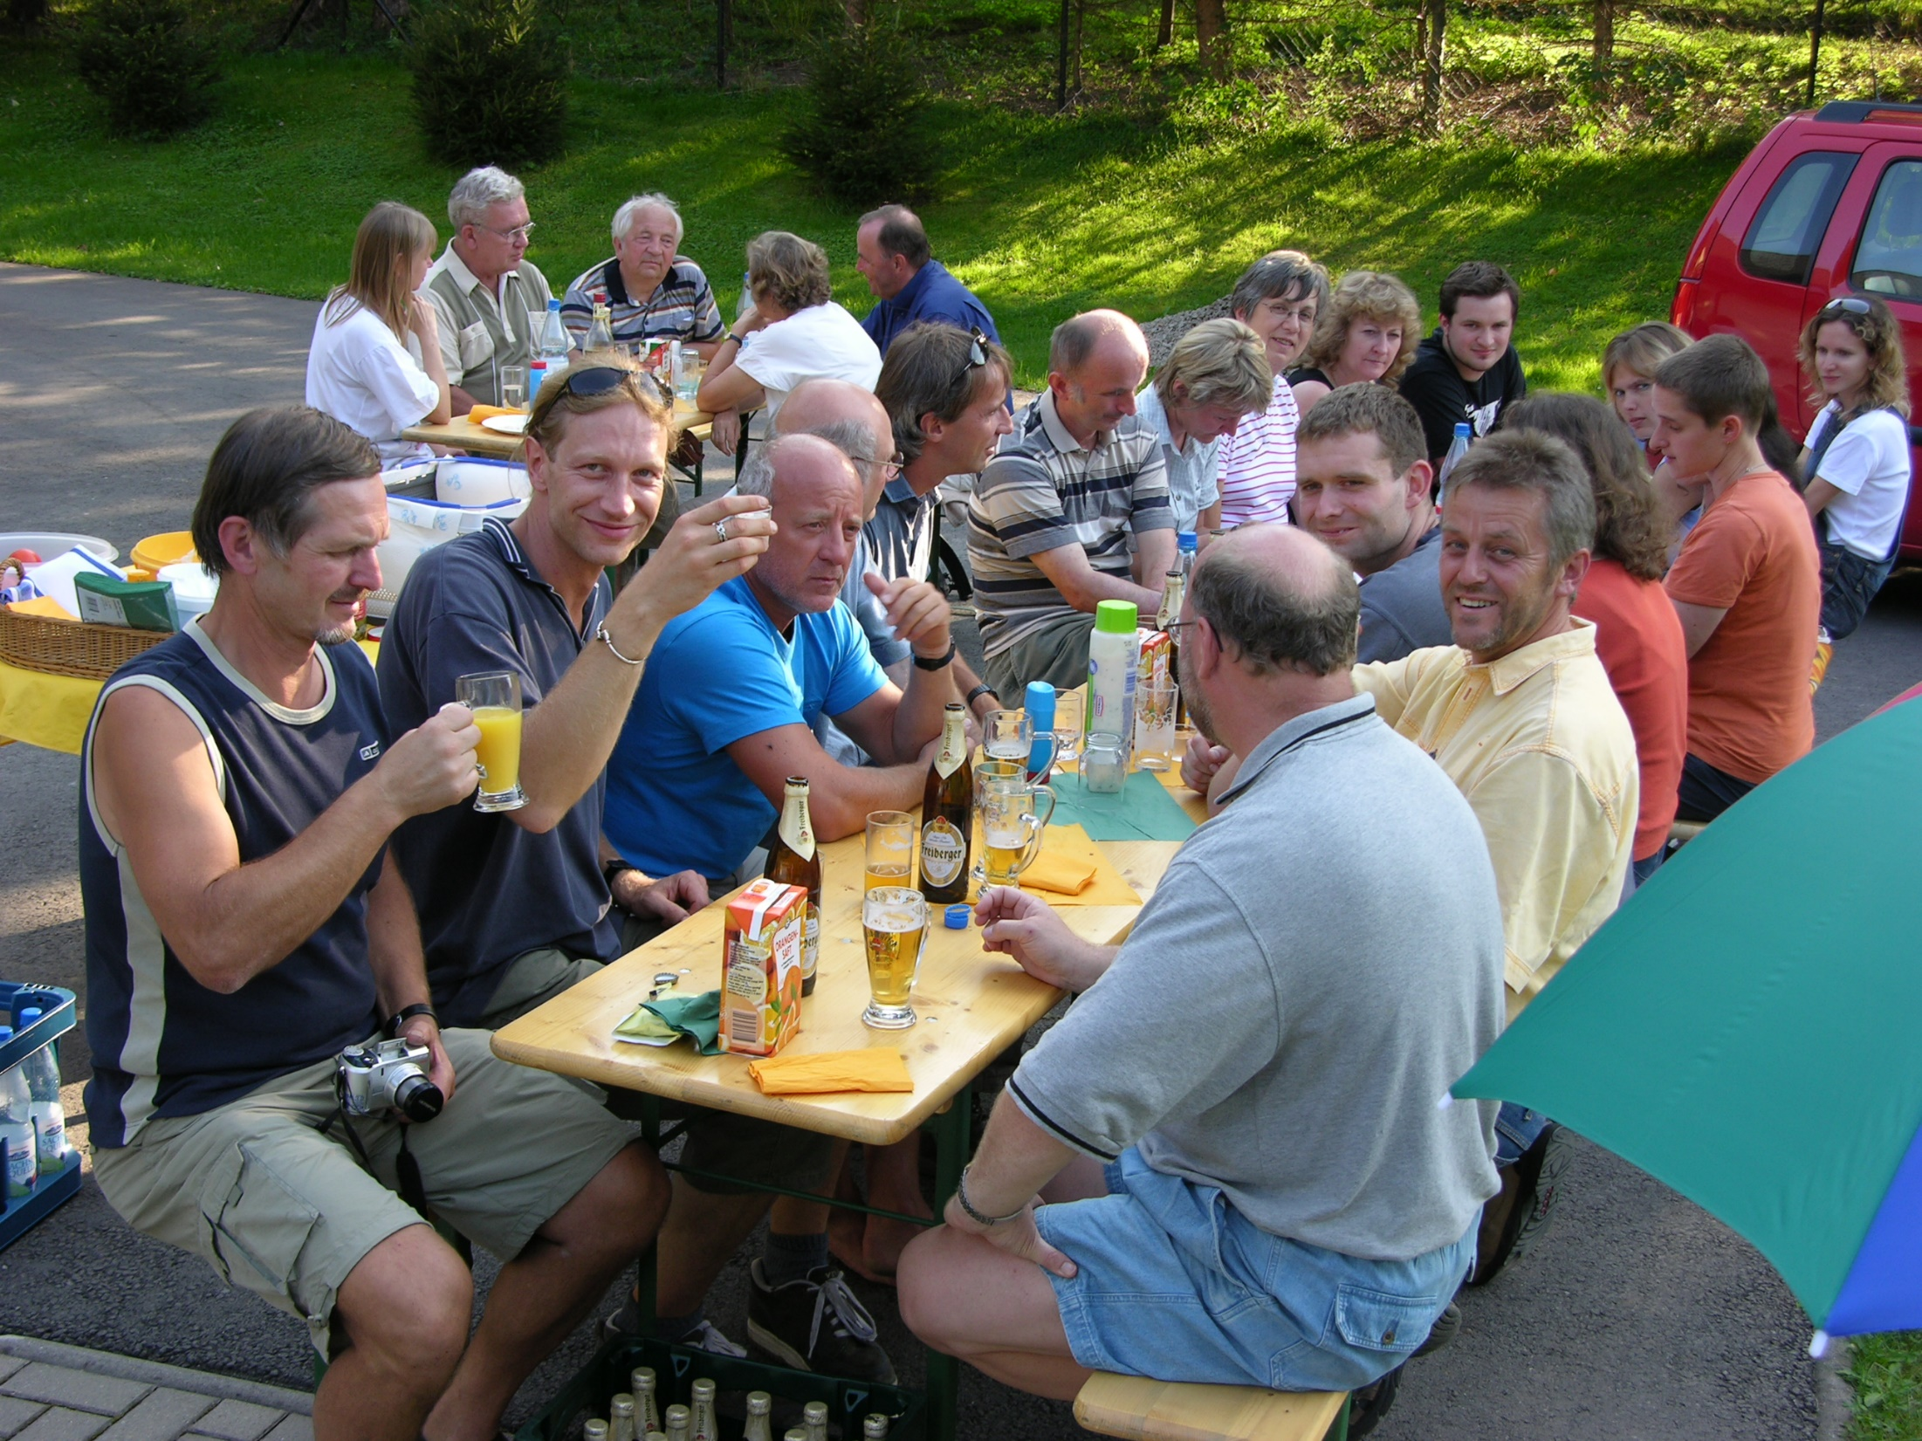
My colleagues
from the Institute
are my guests
(2004)

Slide 12
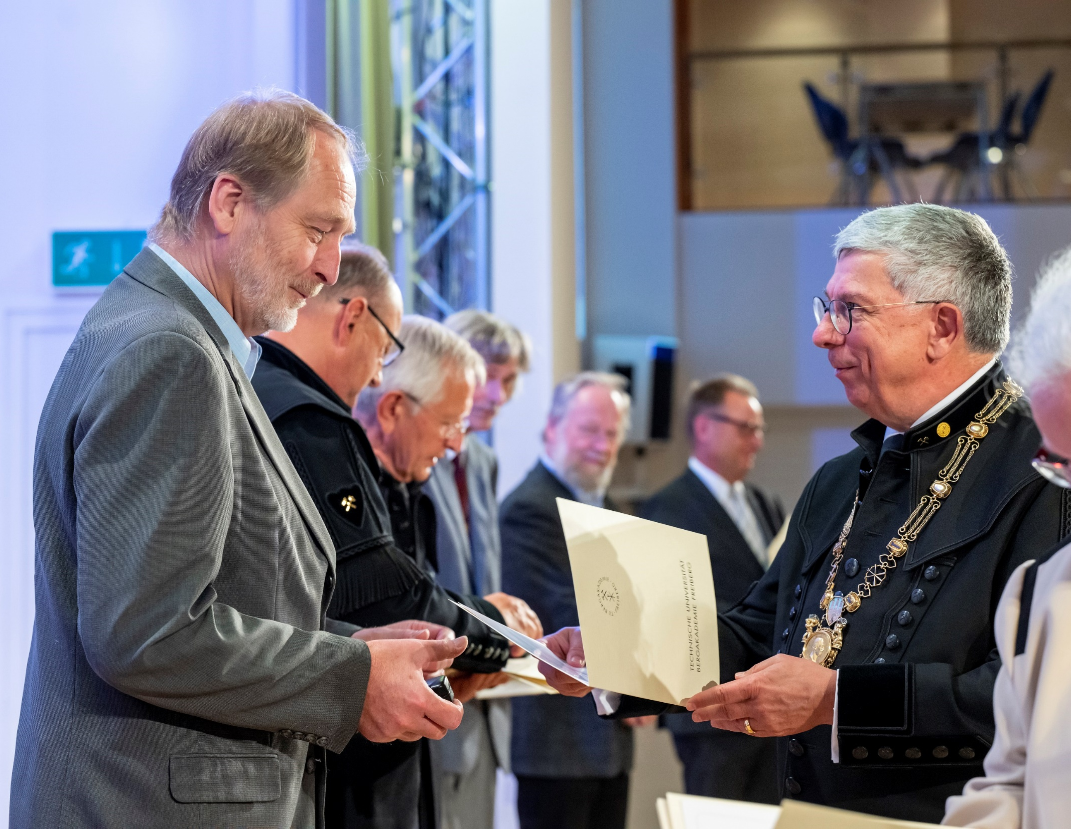
Goodbye party and
my retirement with
thanks of our Rector
Prof. Barbknecht
in 2020

