Slide 1
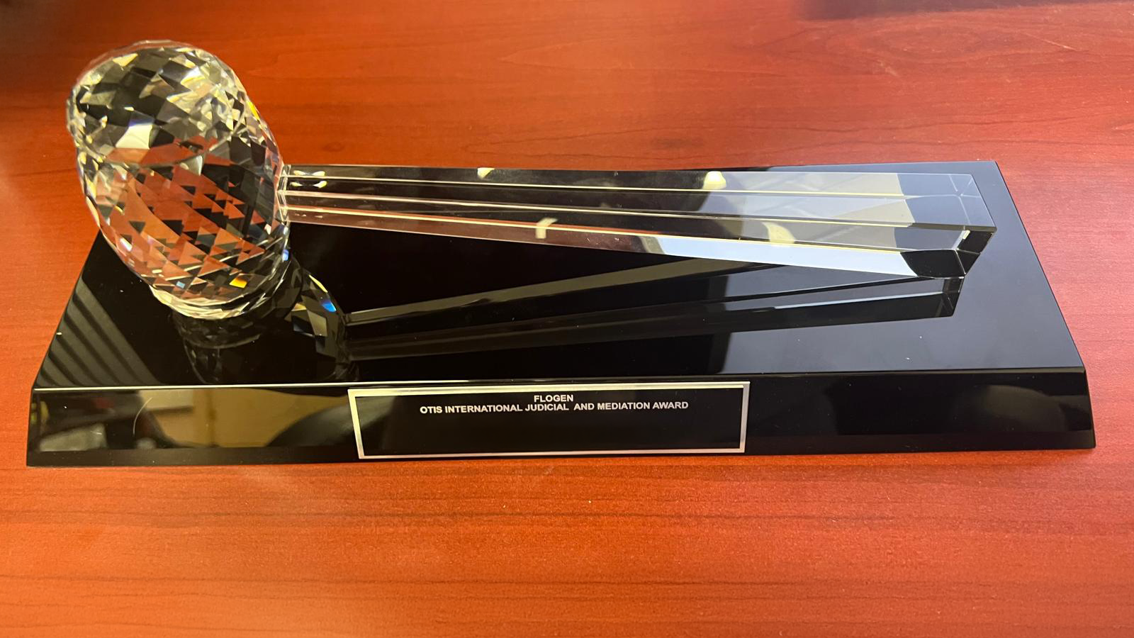
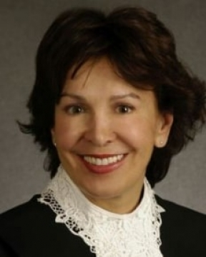
Otis International Judicial and Mediation Award
In honor of the distinguished work and lifetime achievements of Honorable Louise Otis and her contribution to Judiciary and Mediation
Citation:
“For Leadership in developing and applying new judicial and mediation standards as per FLOGEN Sustainability Framework in the environmental, economic, and social points of view”

Slide 2
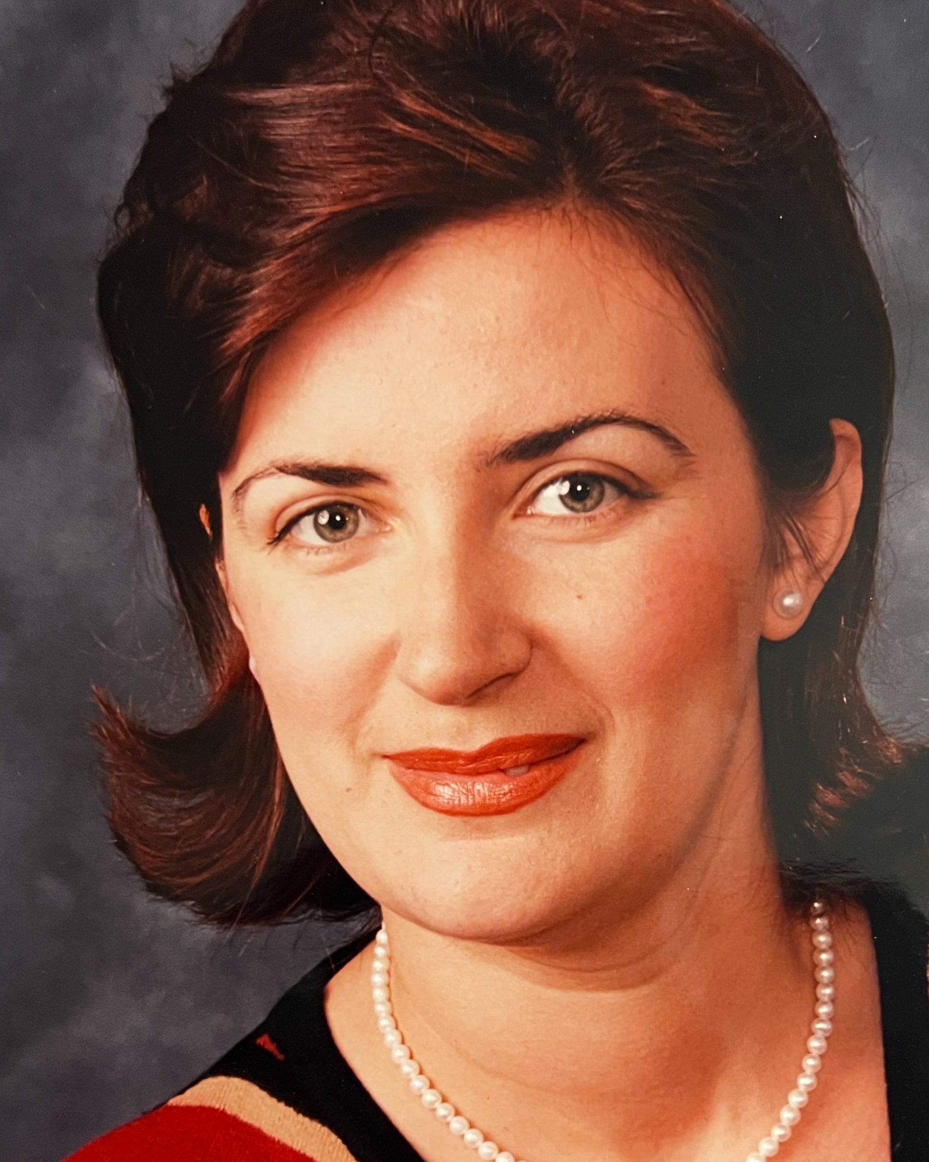
Sustainable Industrial Processing Summit
2024 STARS:
Migen Dibra
LL.B., J.D., LL.M, LL.D
Attorney at Law
Migen Dibra Law Office, Canada
Field: Law
OTIS INTERNATIONAL JUDICIAL AND MEDIATION AWARD
FLOGEN STARS OUTREACH

Slide 3
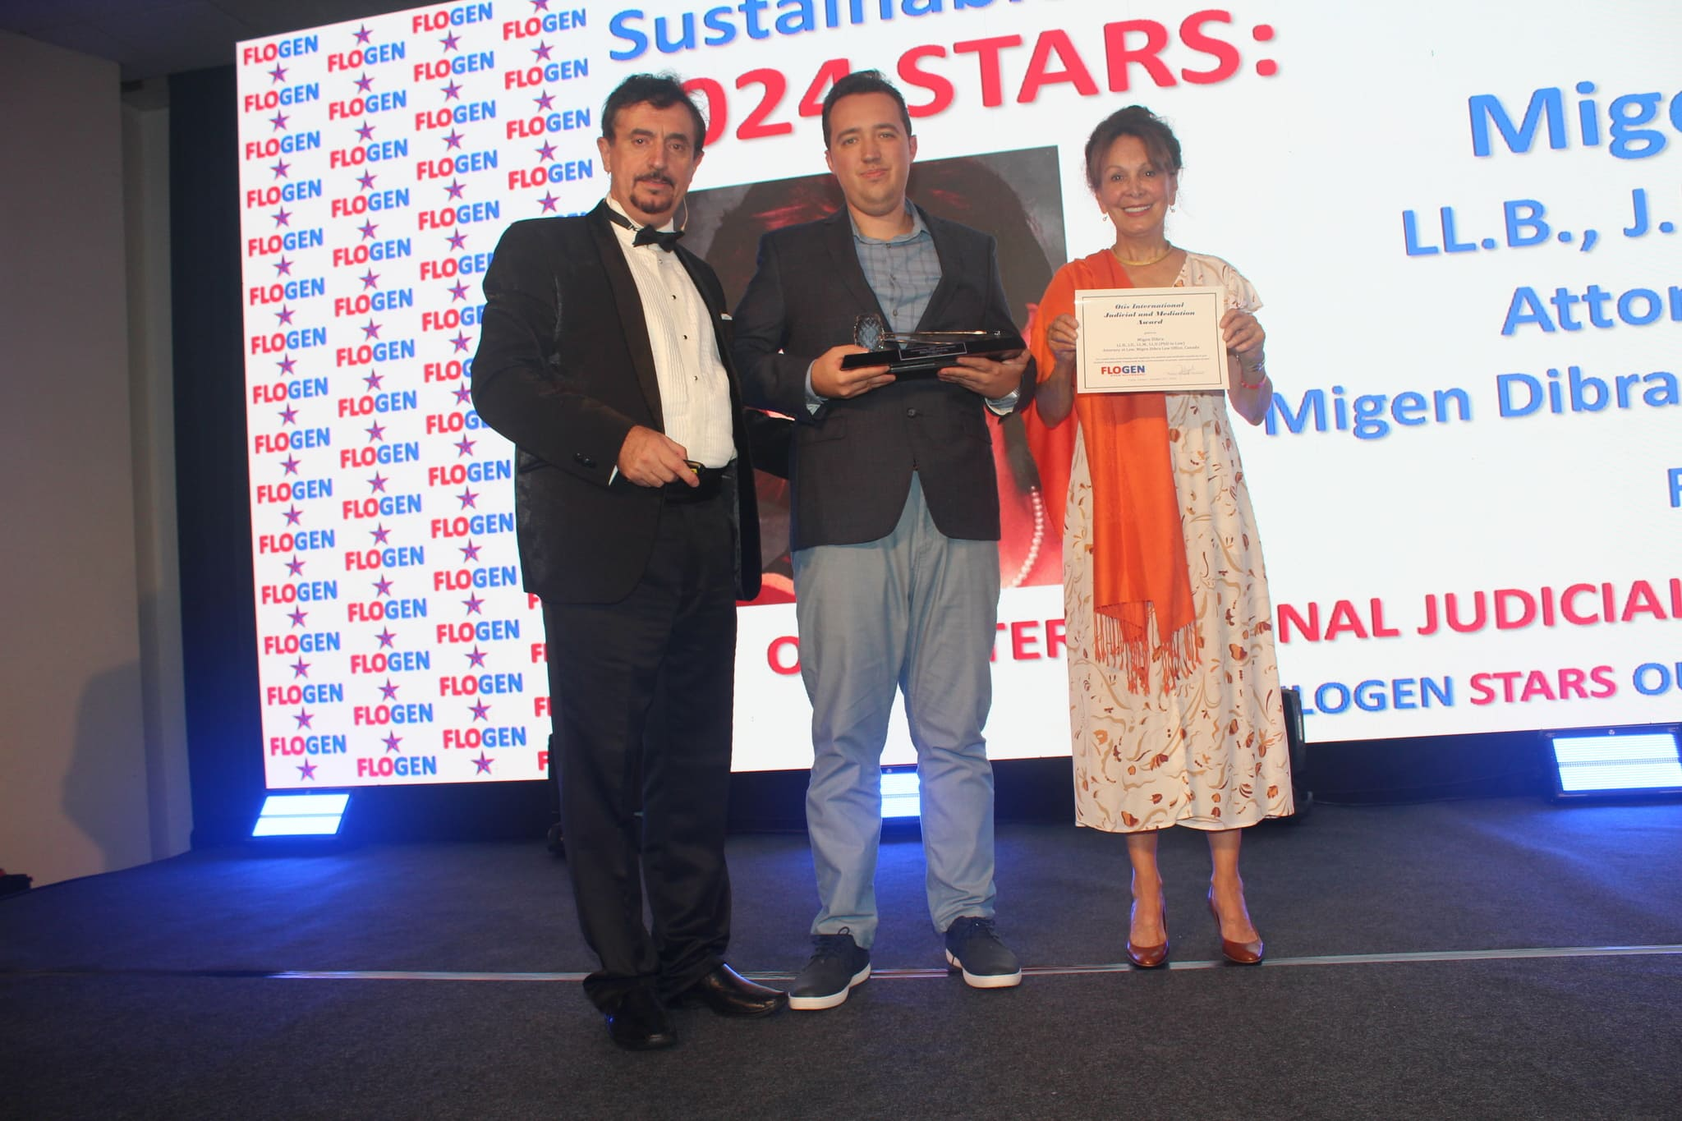
Davis Joseph receiving the Otis International Judicial and Mediation Award on behalf of Me. Migen Dibra from Honorable Louise Otis at FLOGEN SIPS 2024

Slide 4
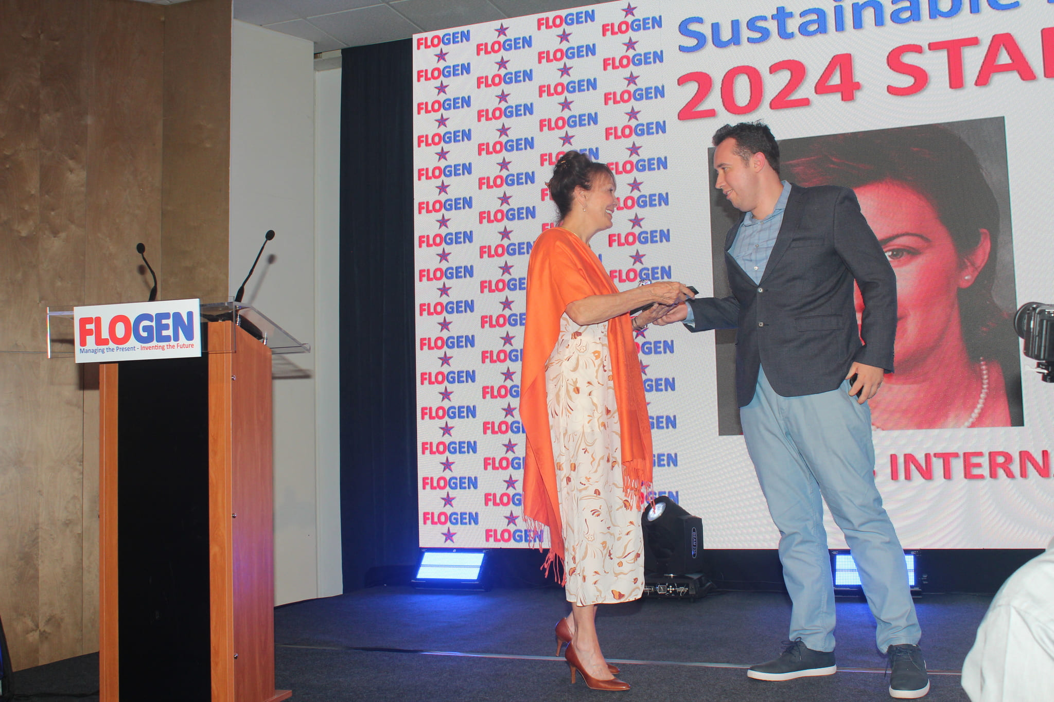
Honorable Louise Otis congratulating Davis Joseph on behalf of Me. Migen Dibra during the FLOGEN SIPS 2024 award ceremony

Slide 5
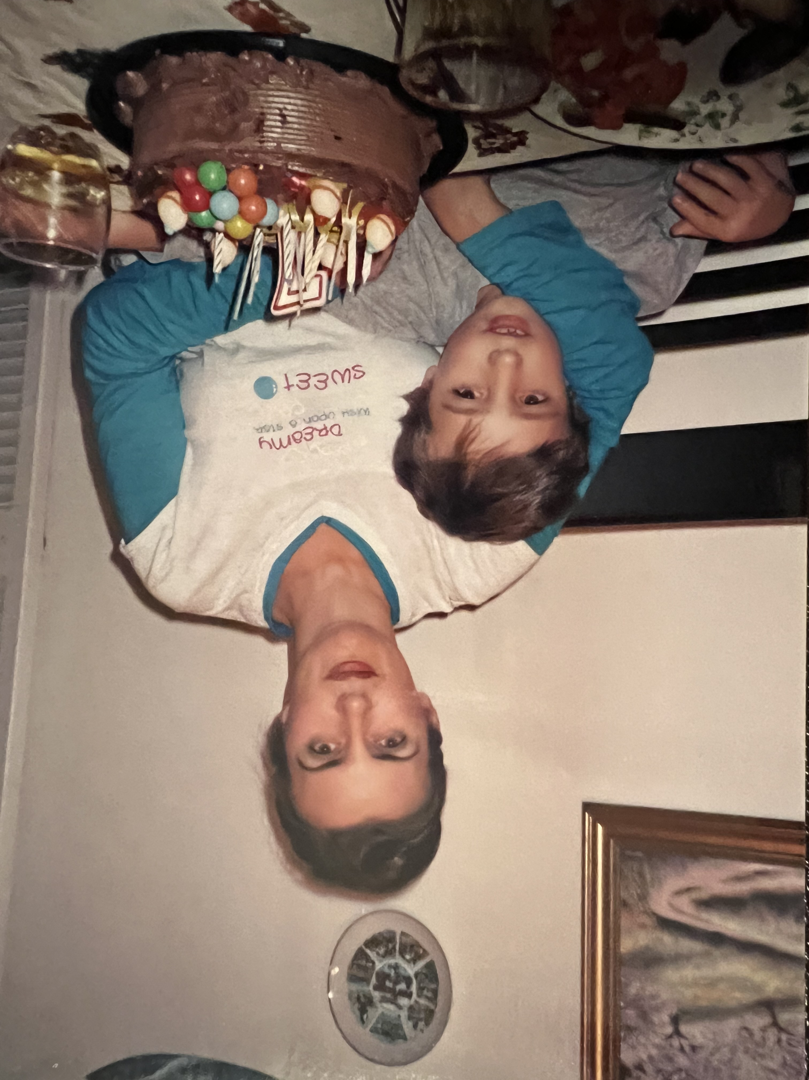
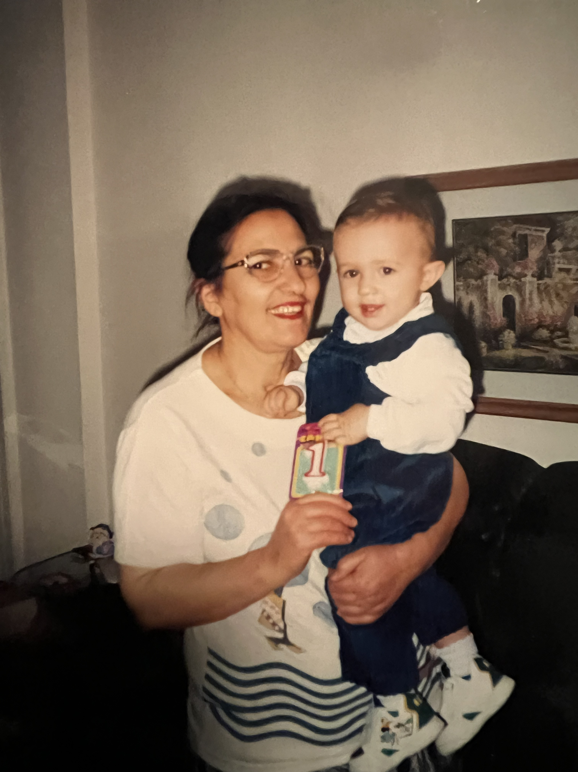

Slide 6
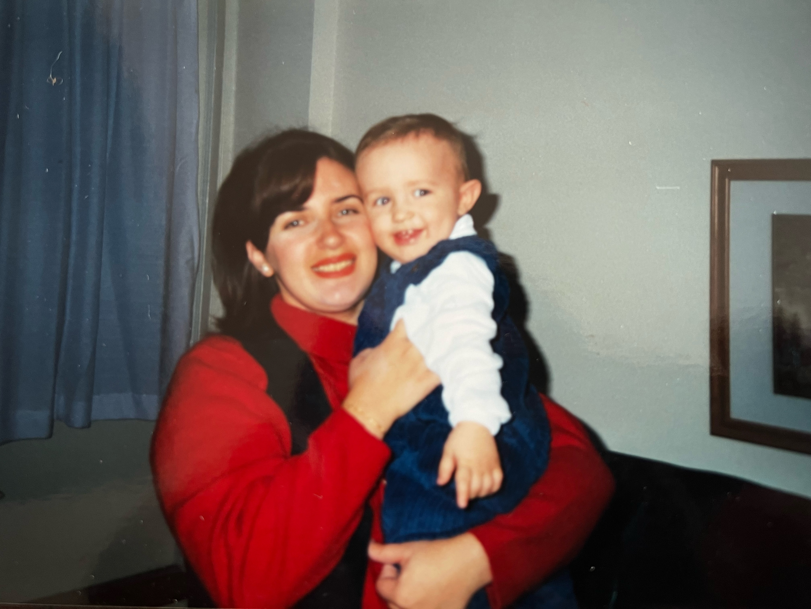

Slide 7
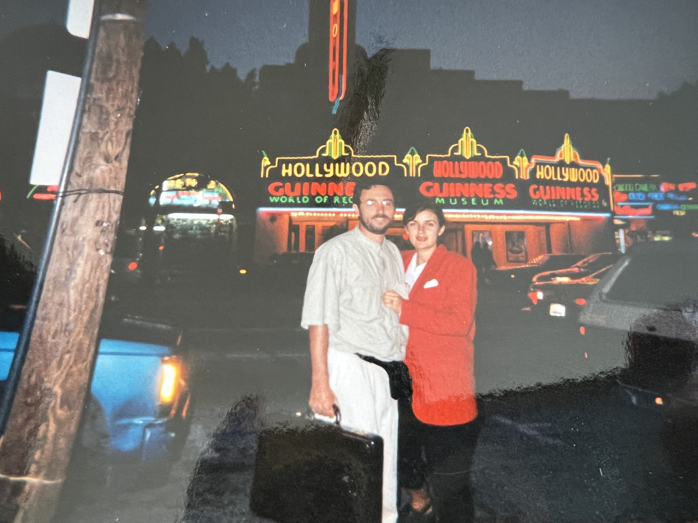
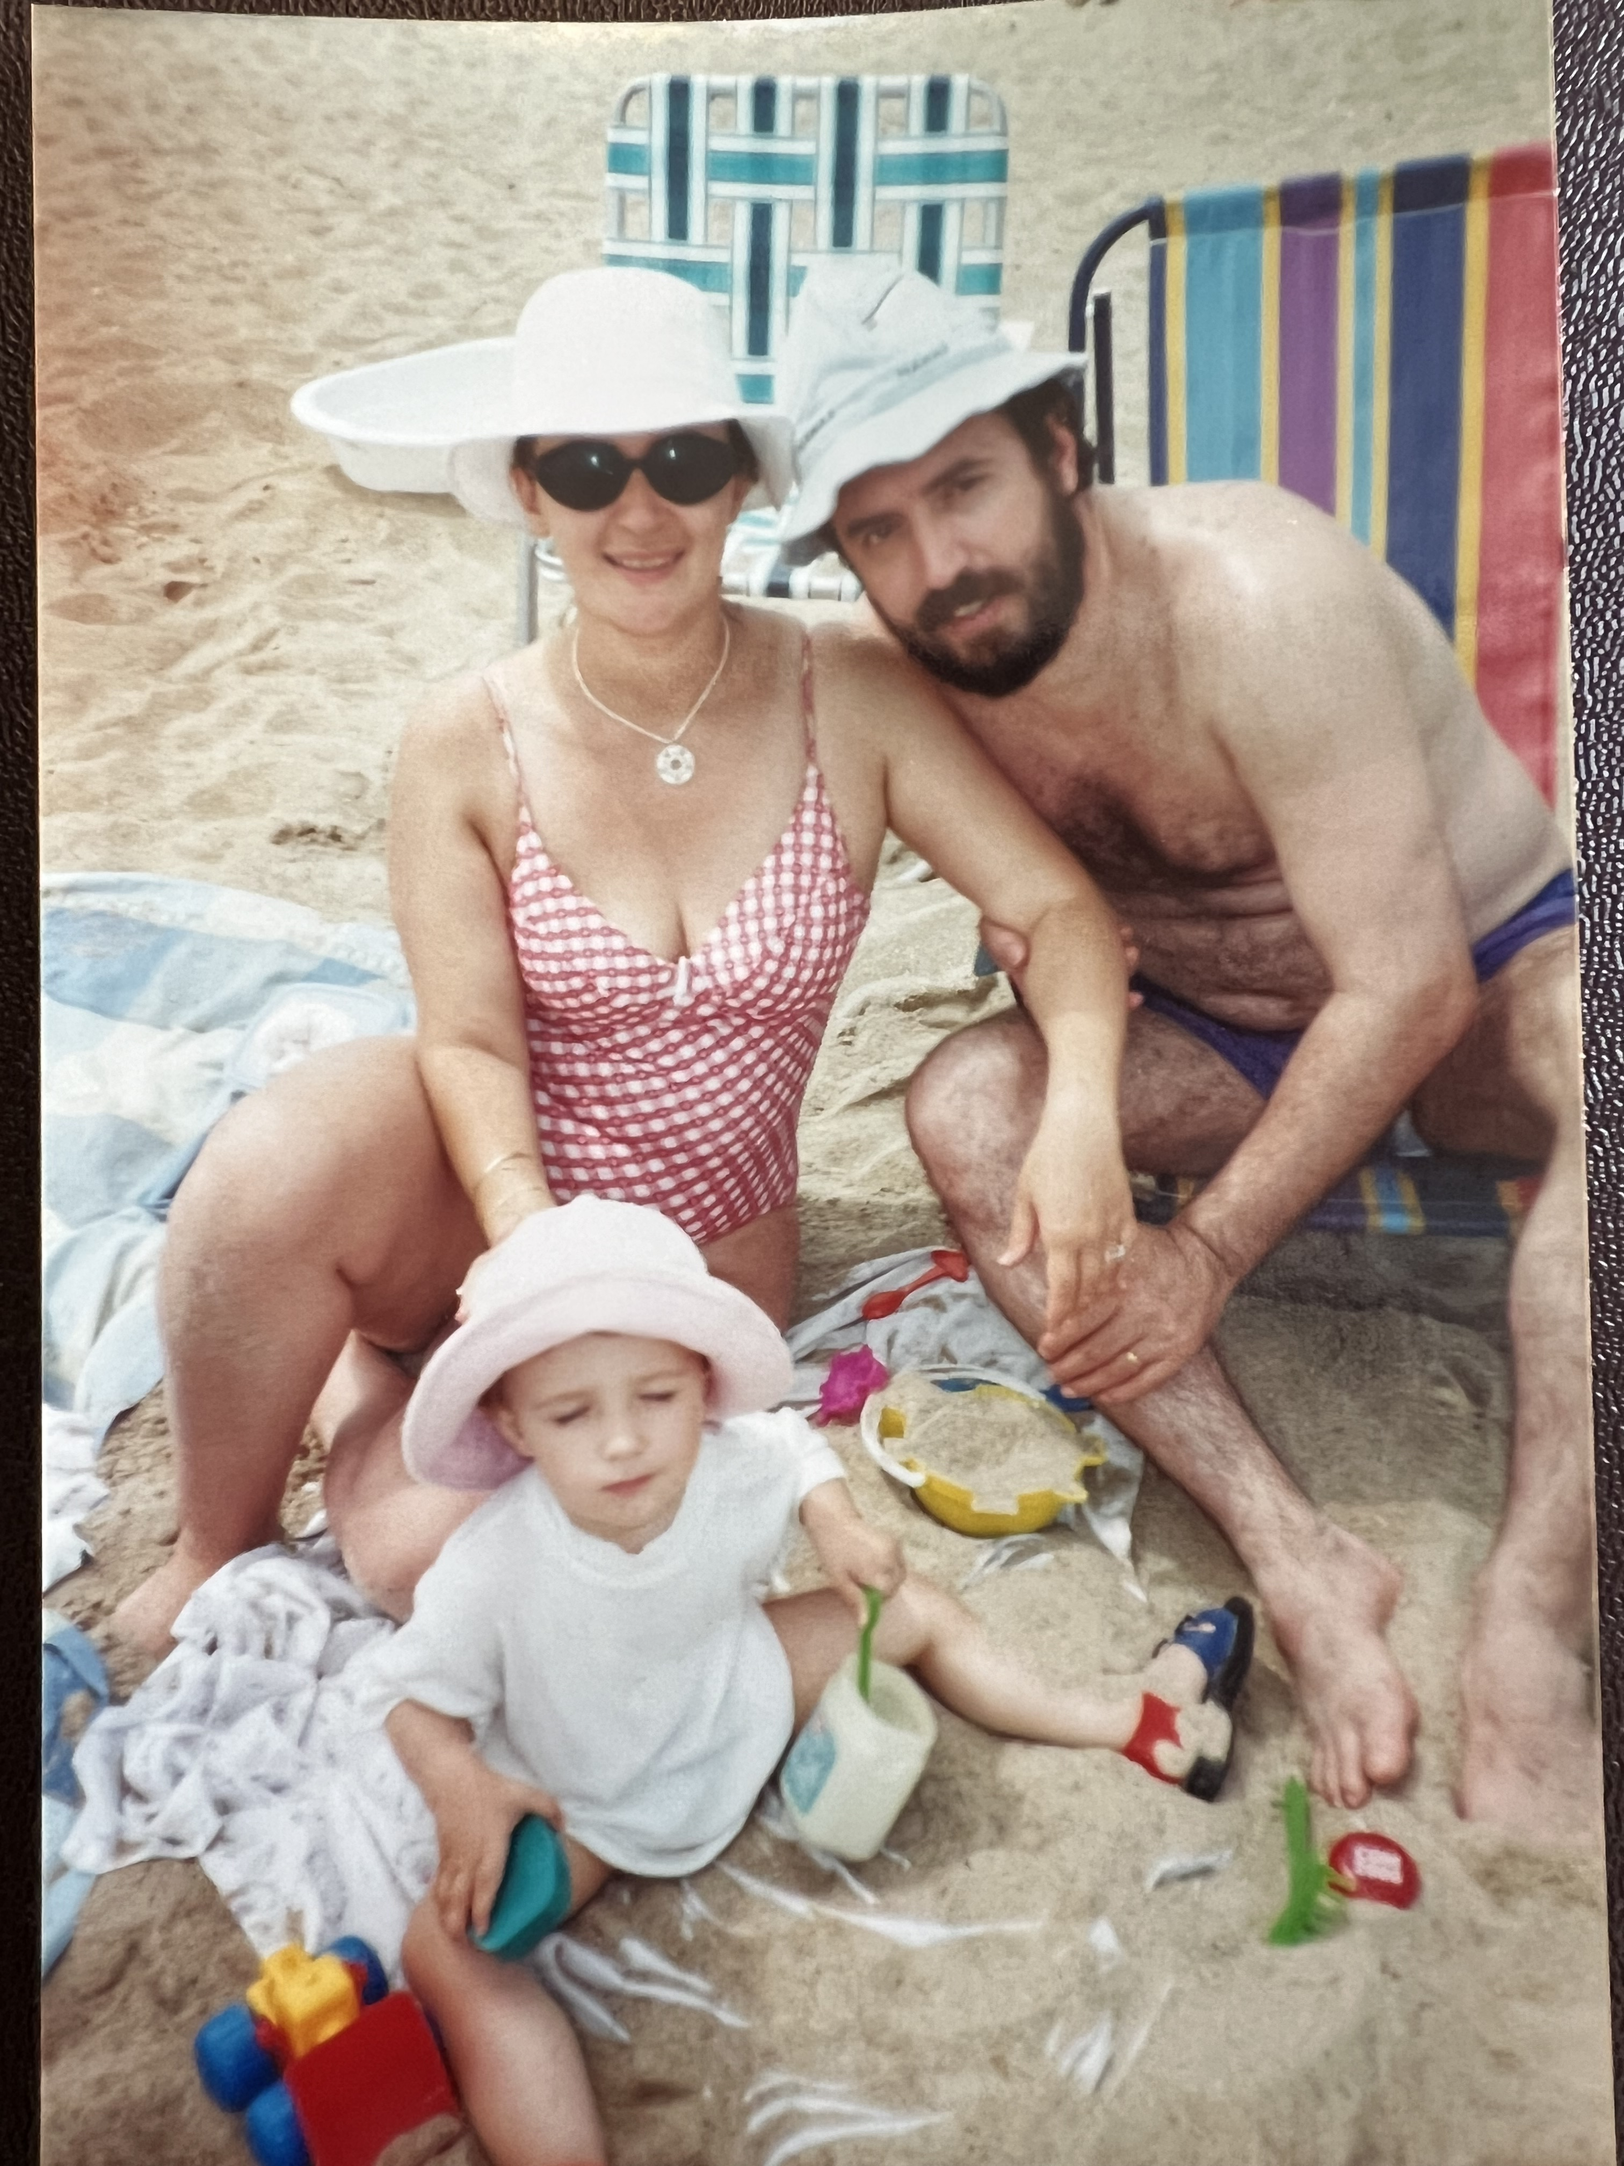

Slide 8
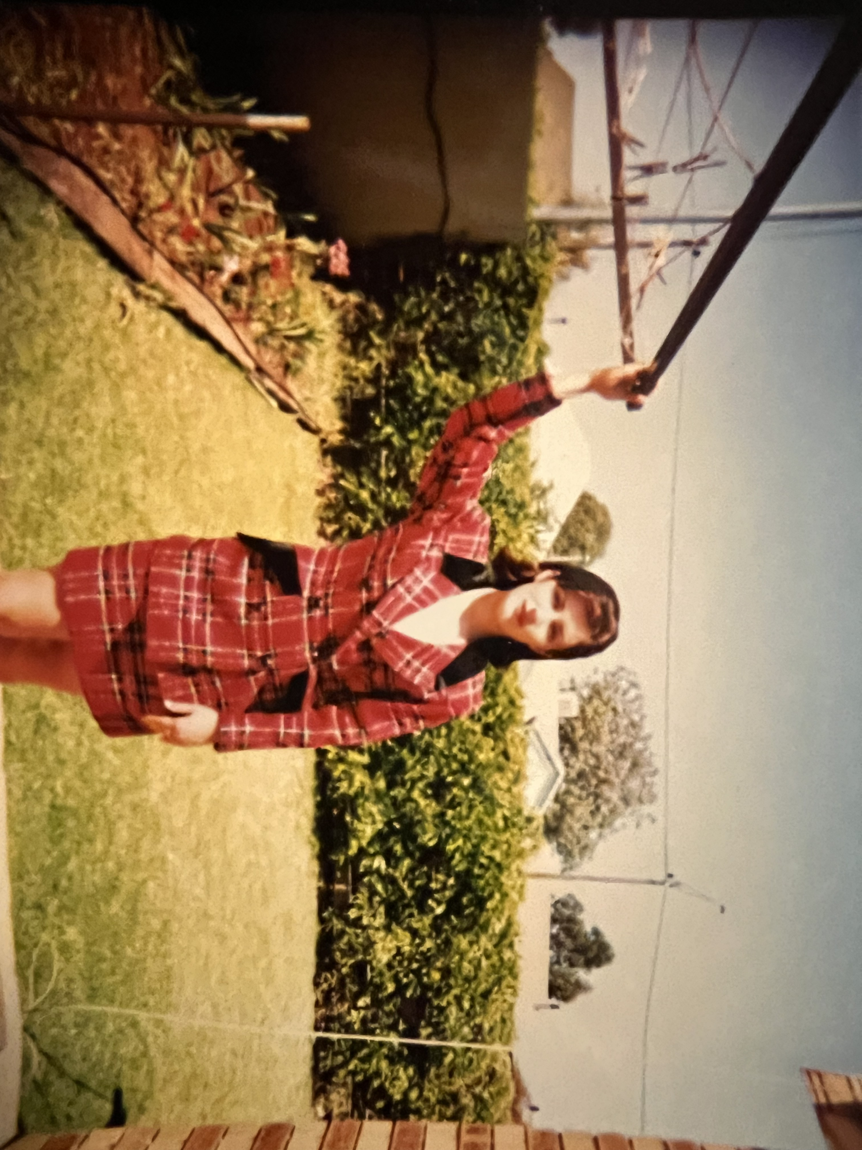

Slide 9
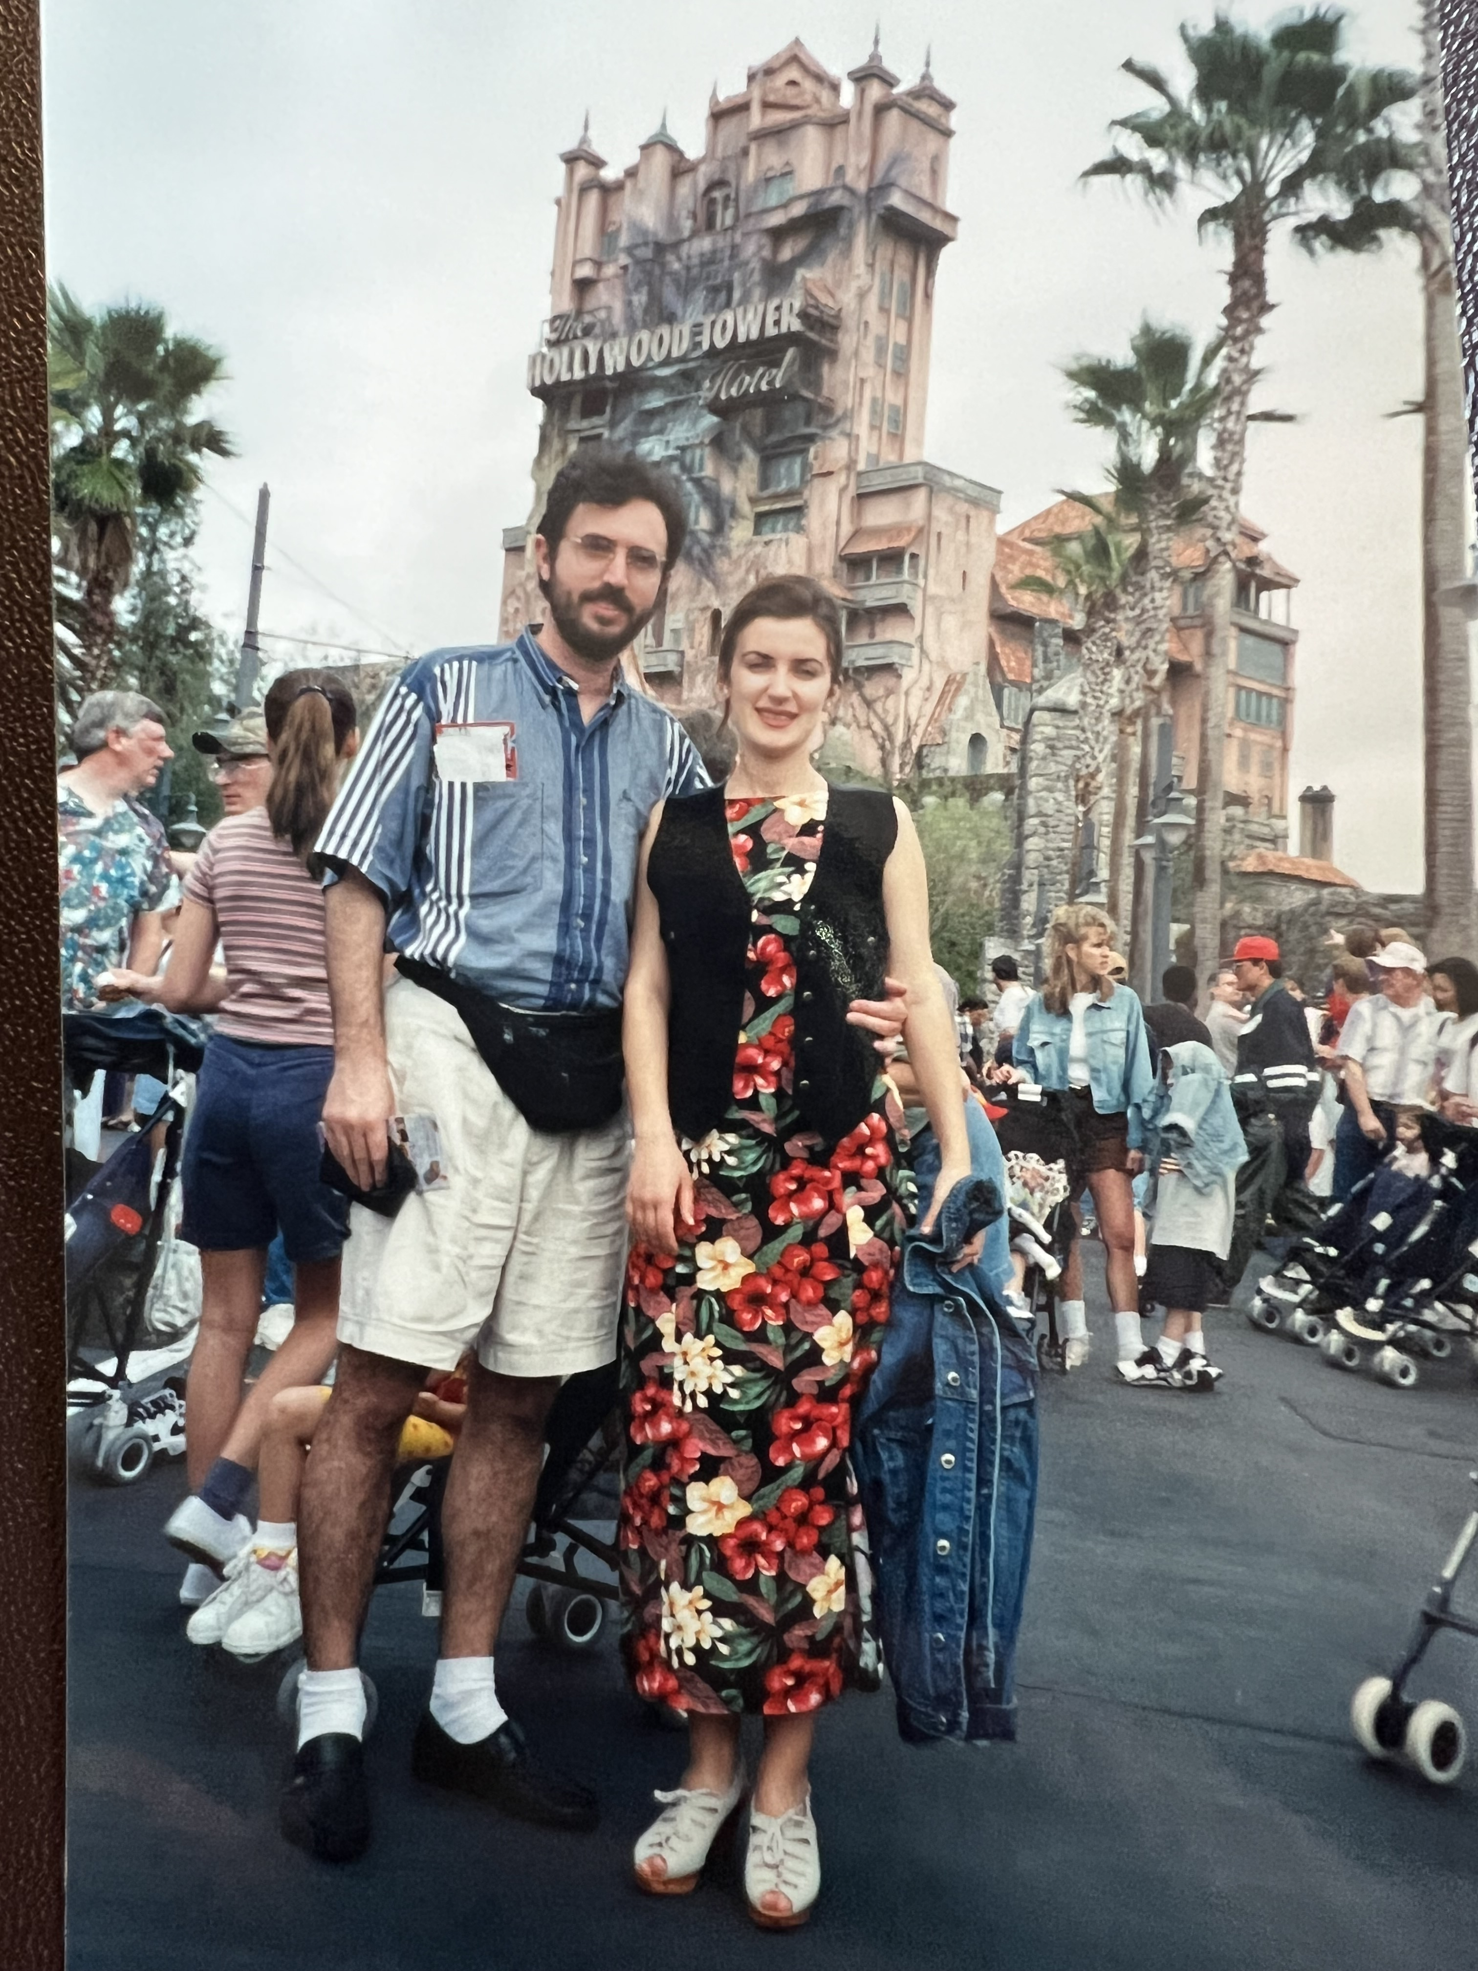
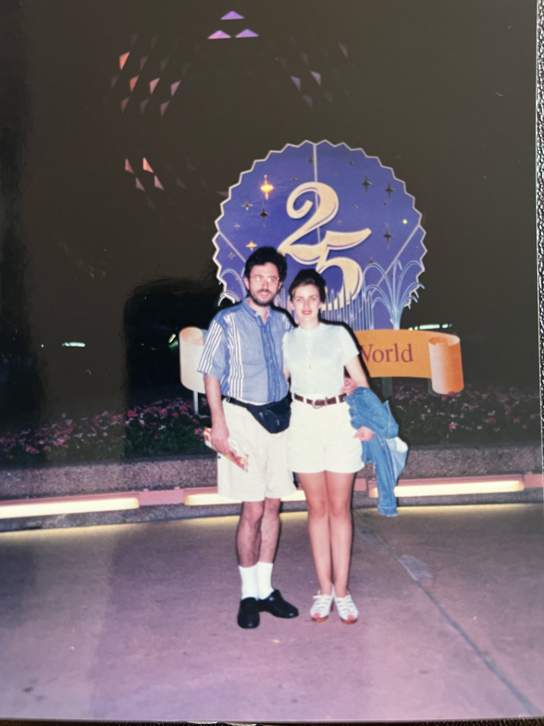

Slide 10
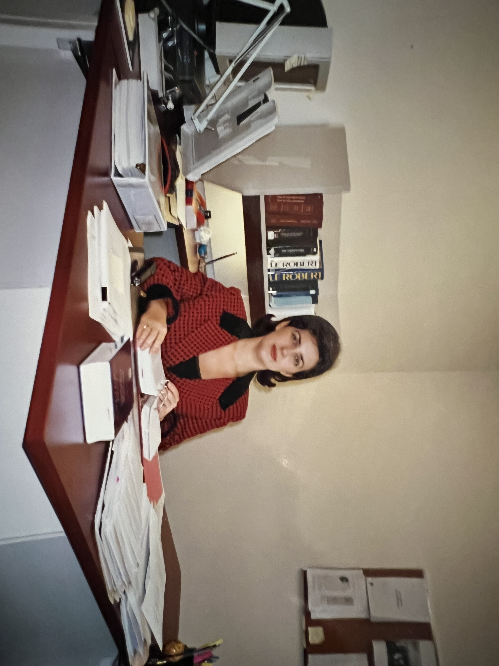

Slide 12
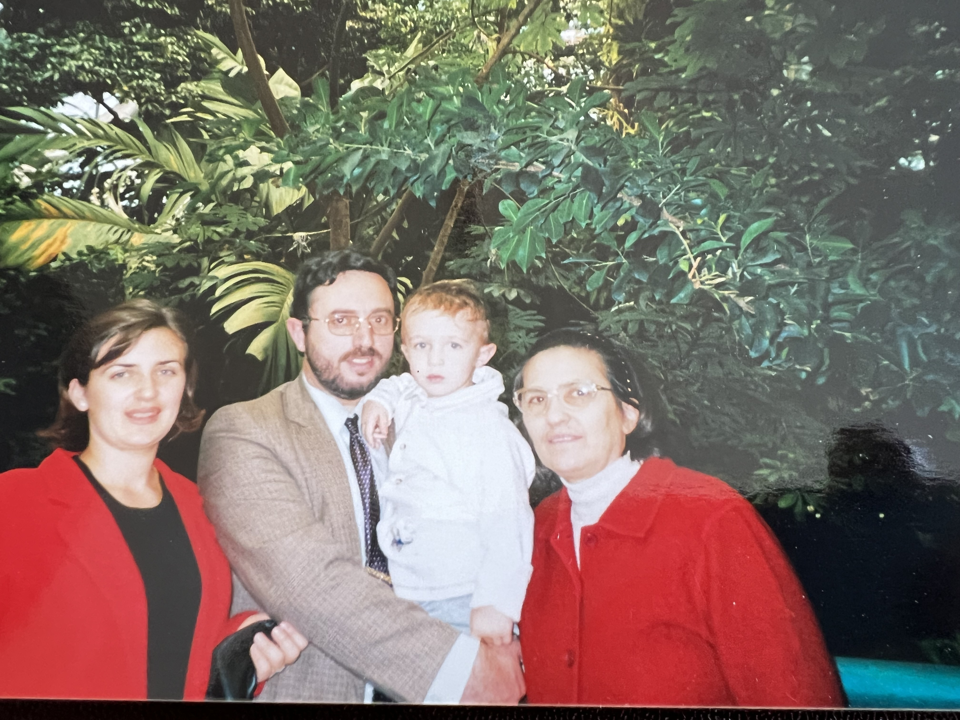

Slide 13
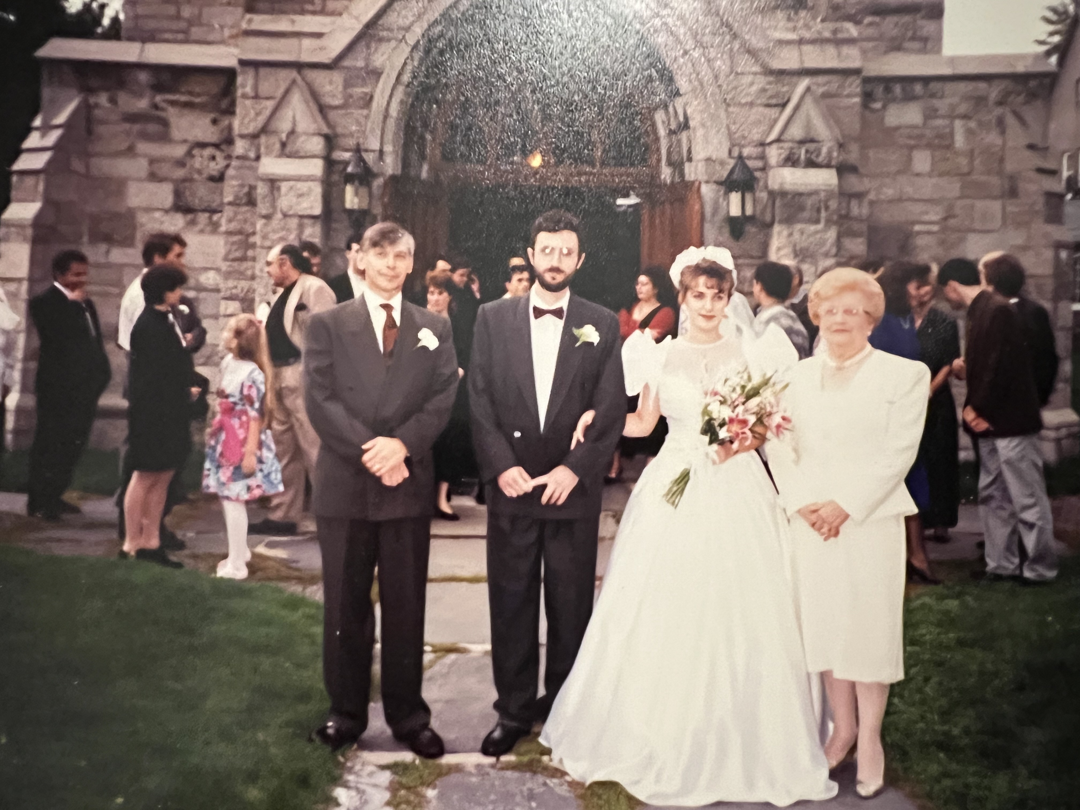

Slide 14
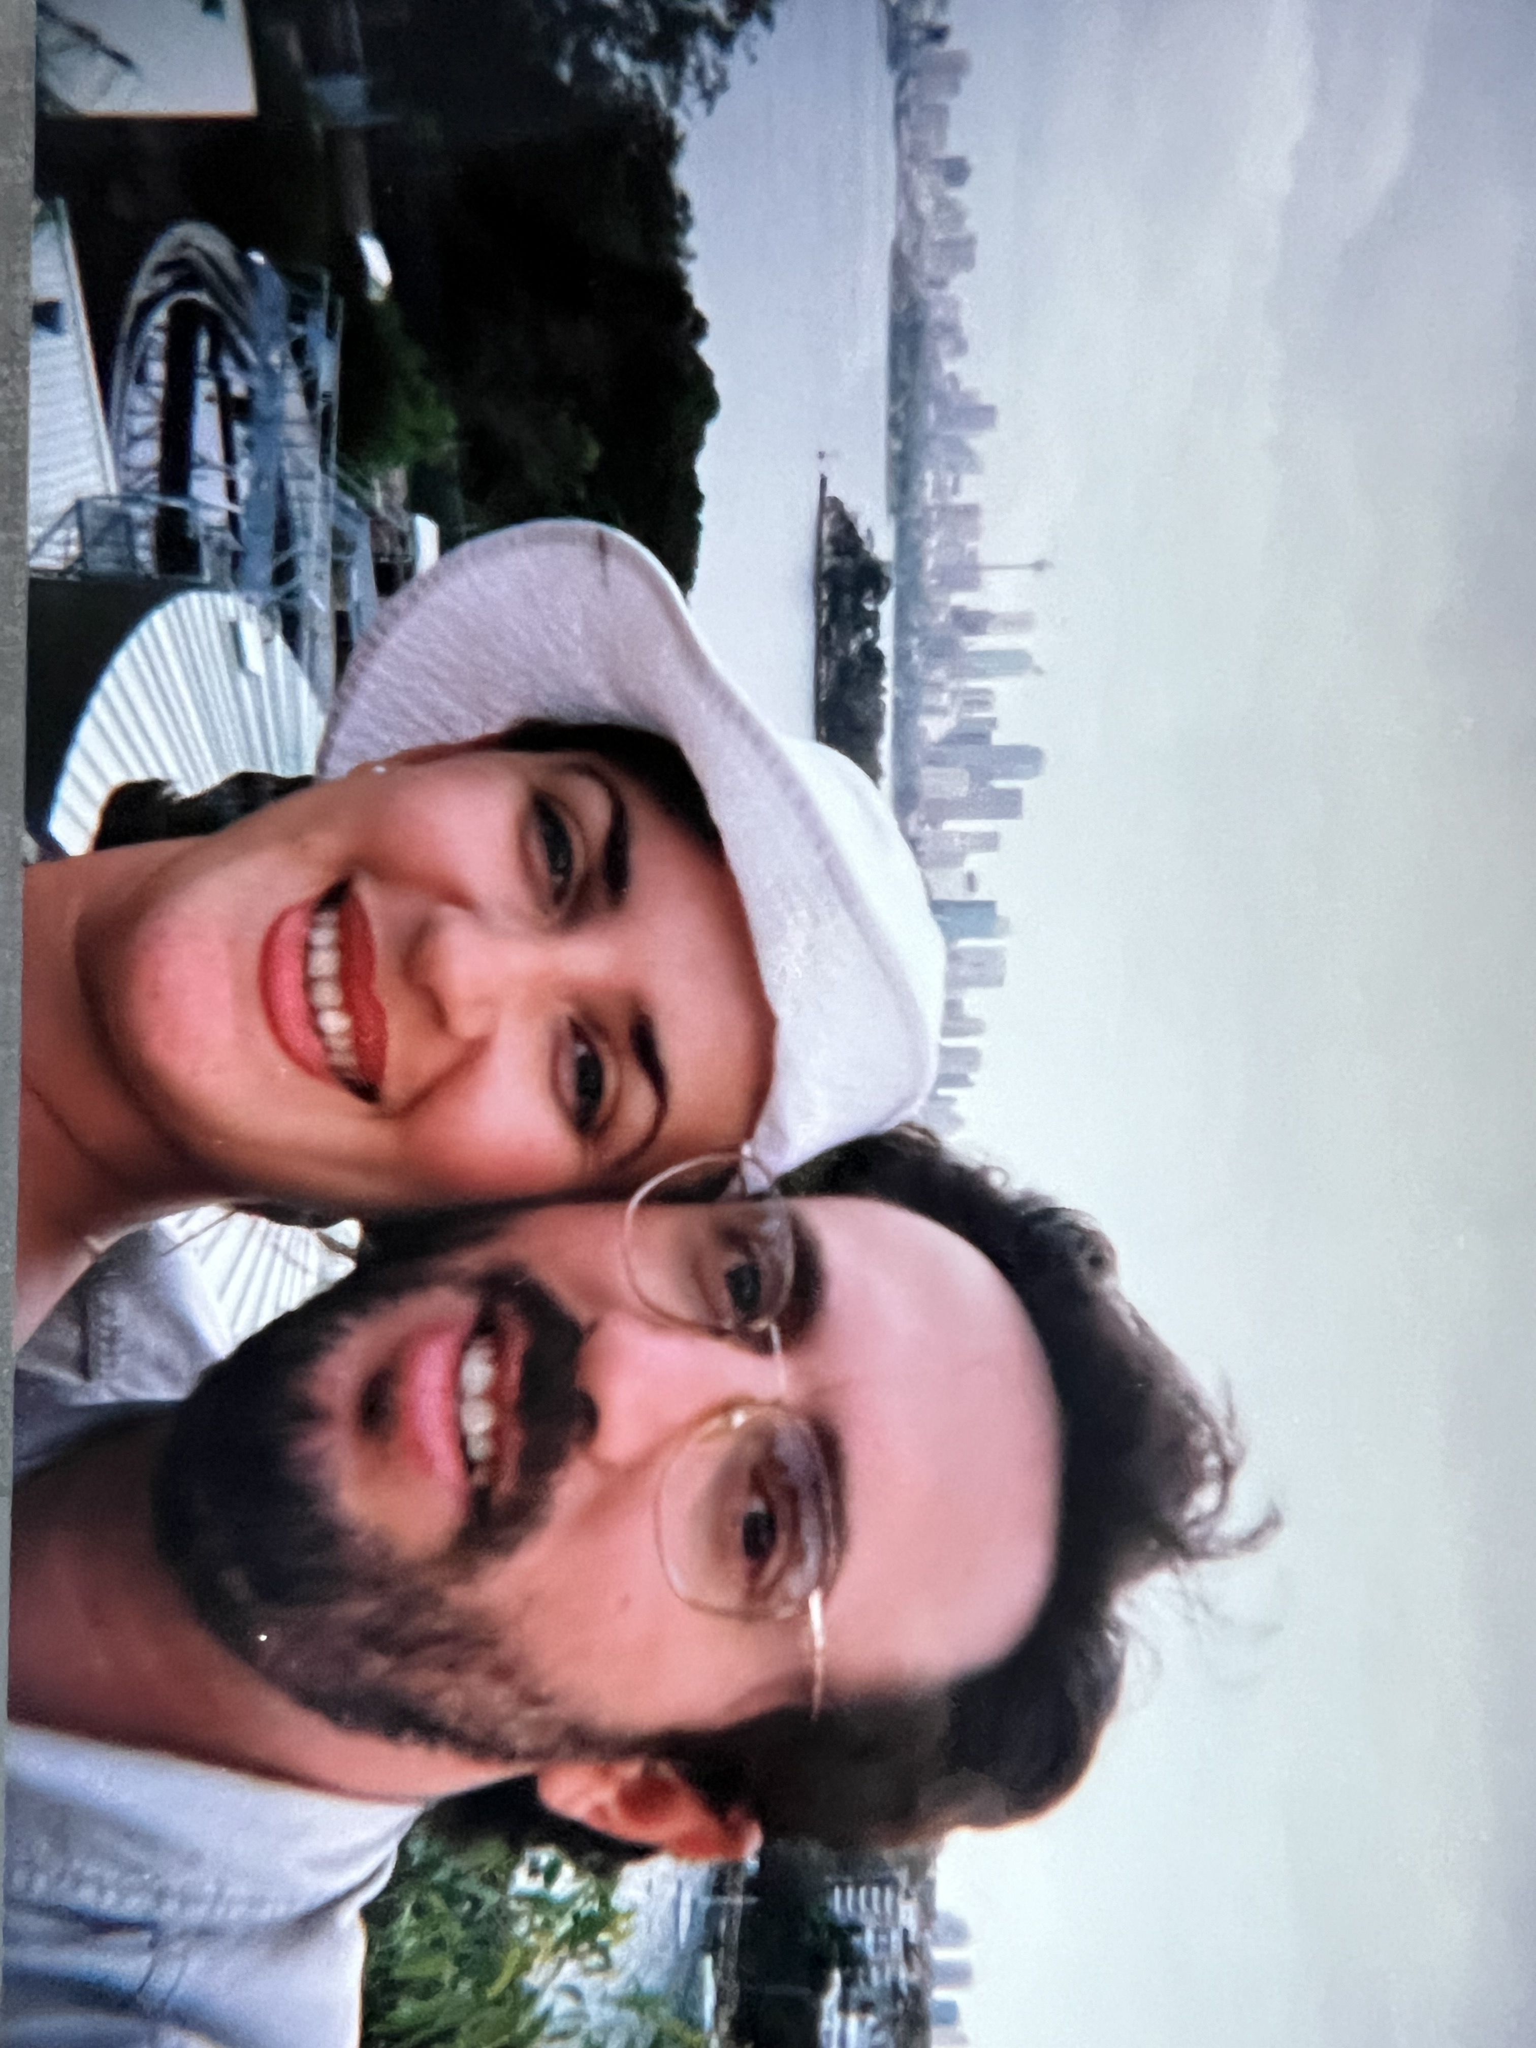
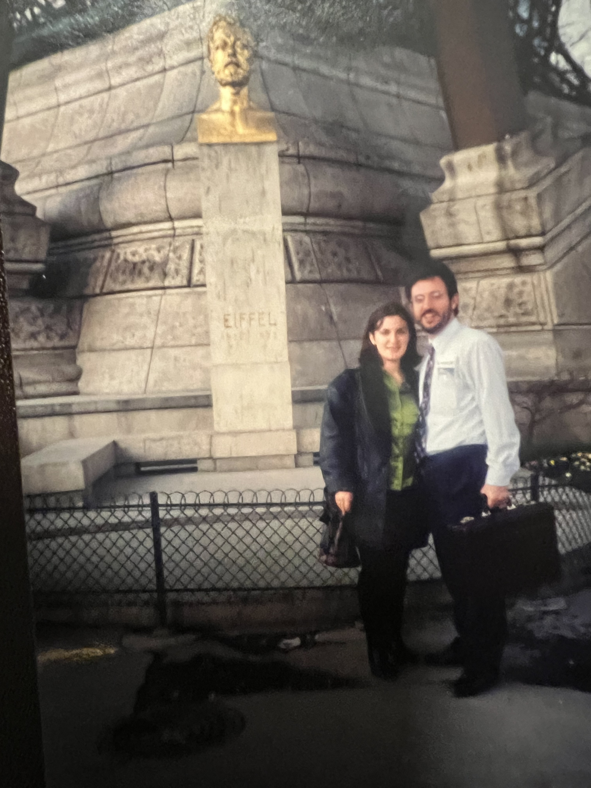

Slide 15
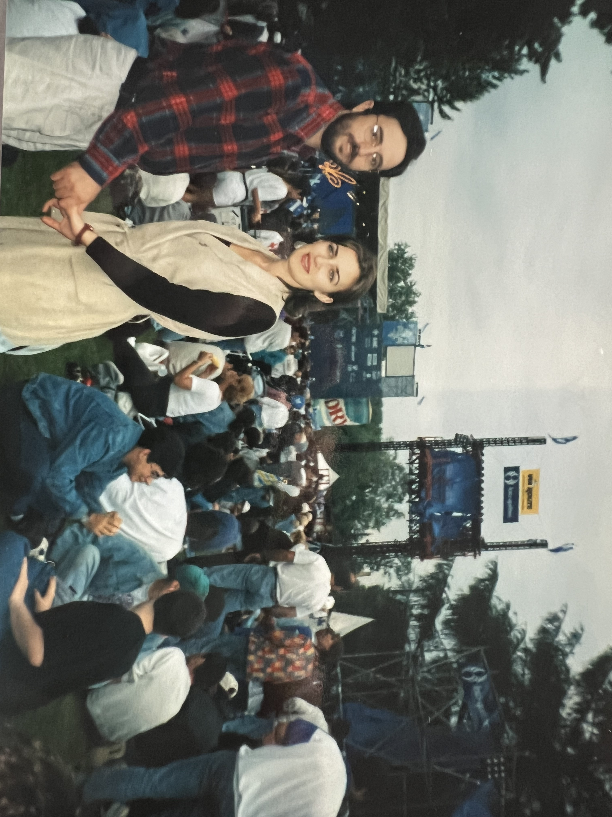
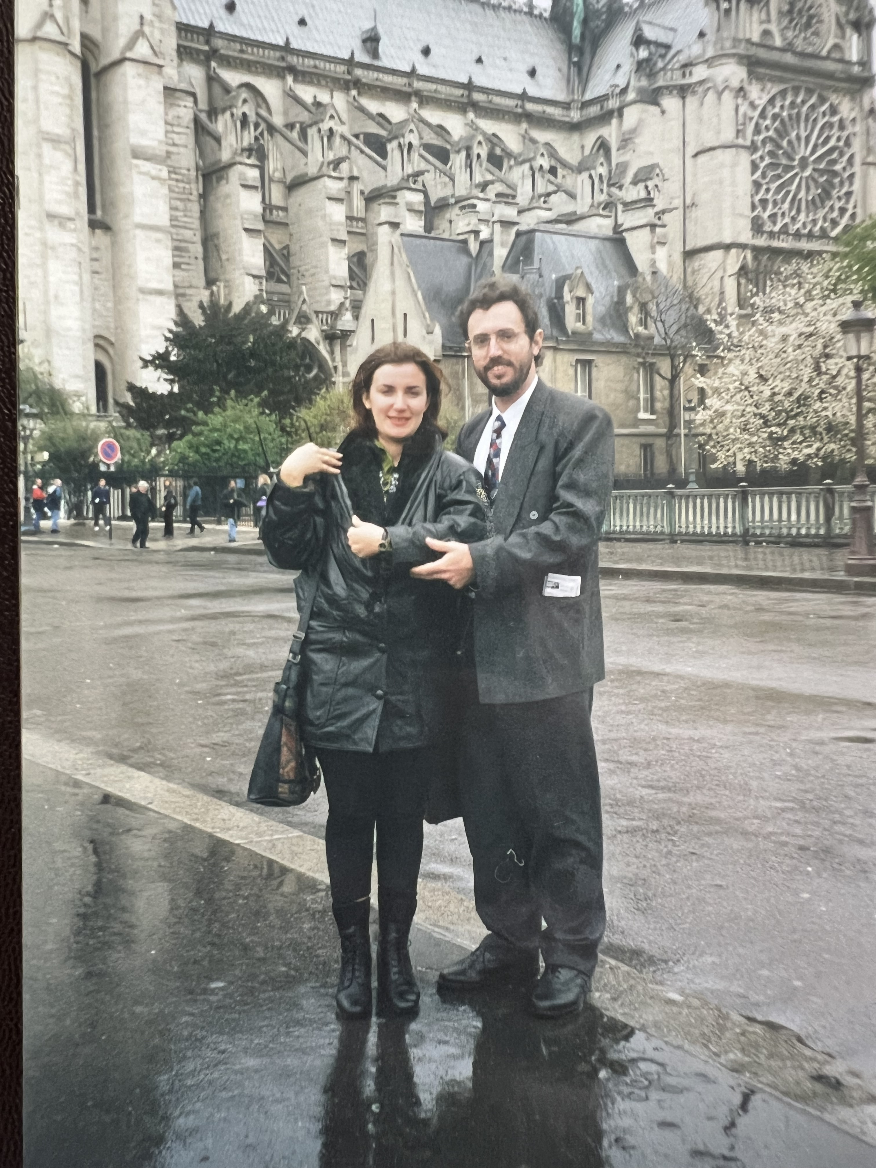

Slide 16
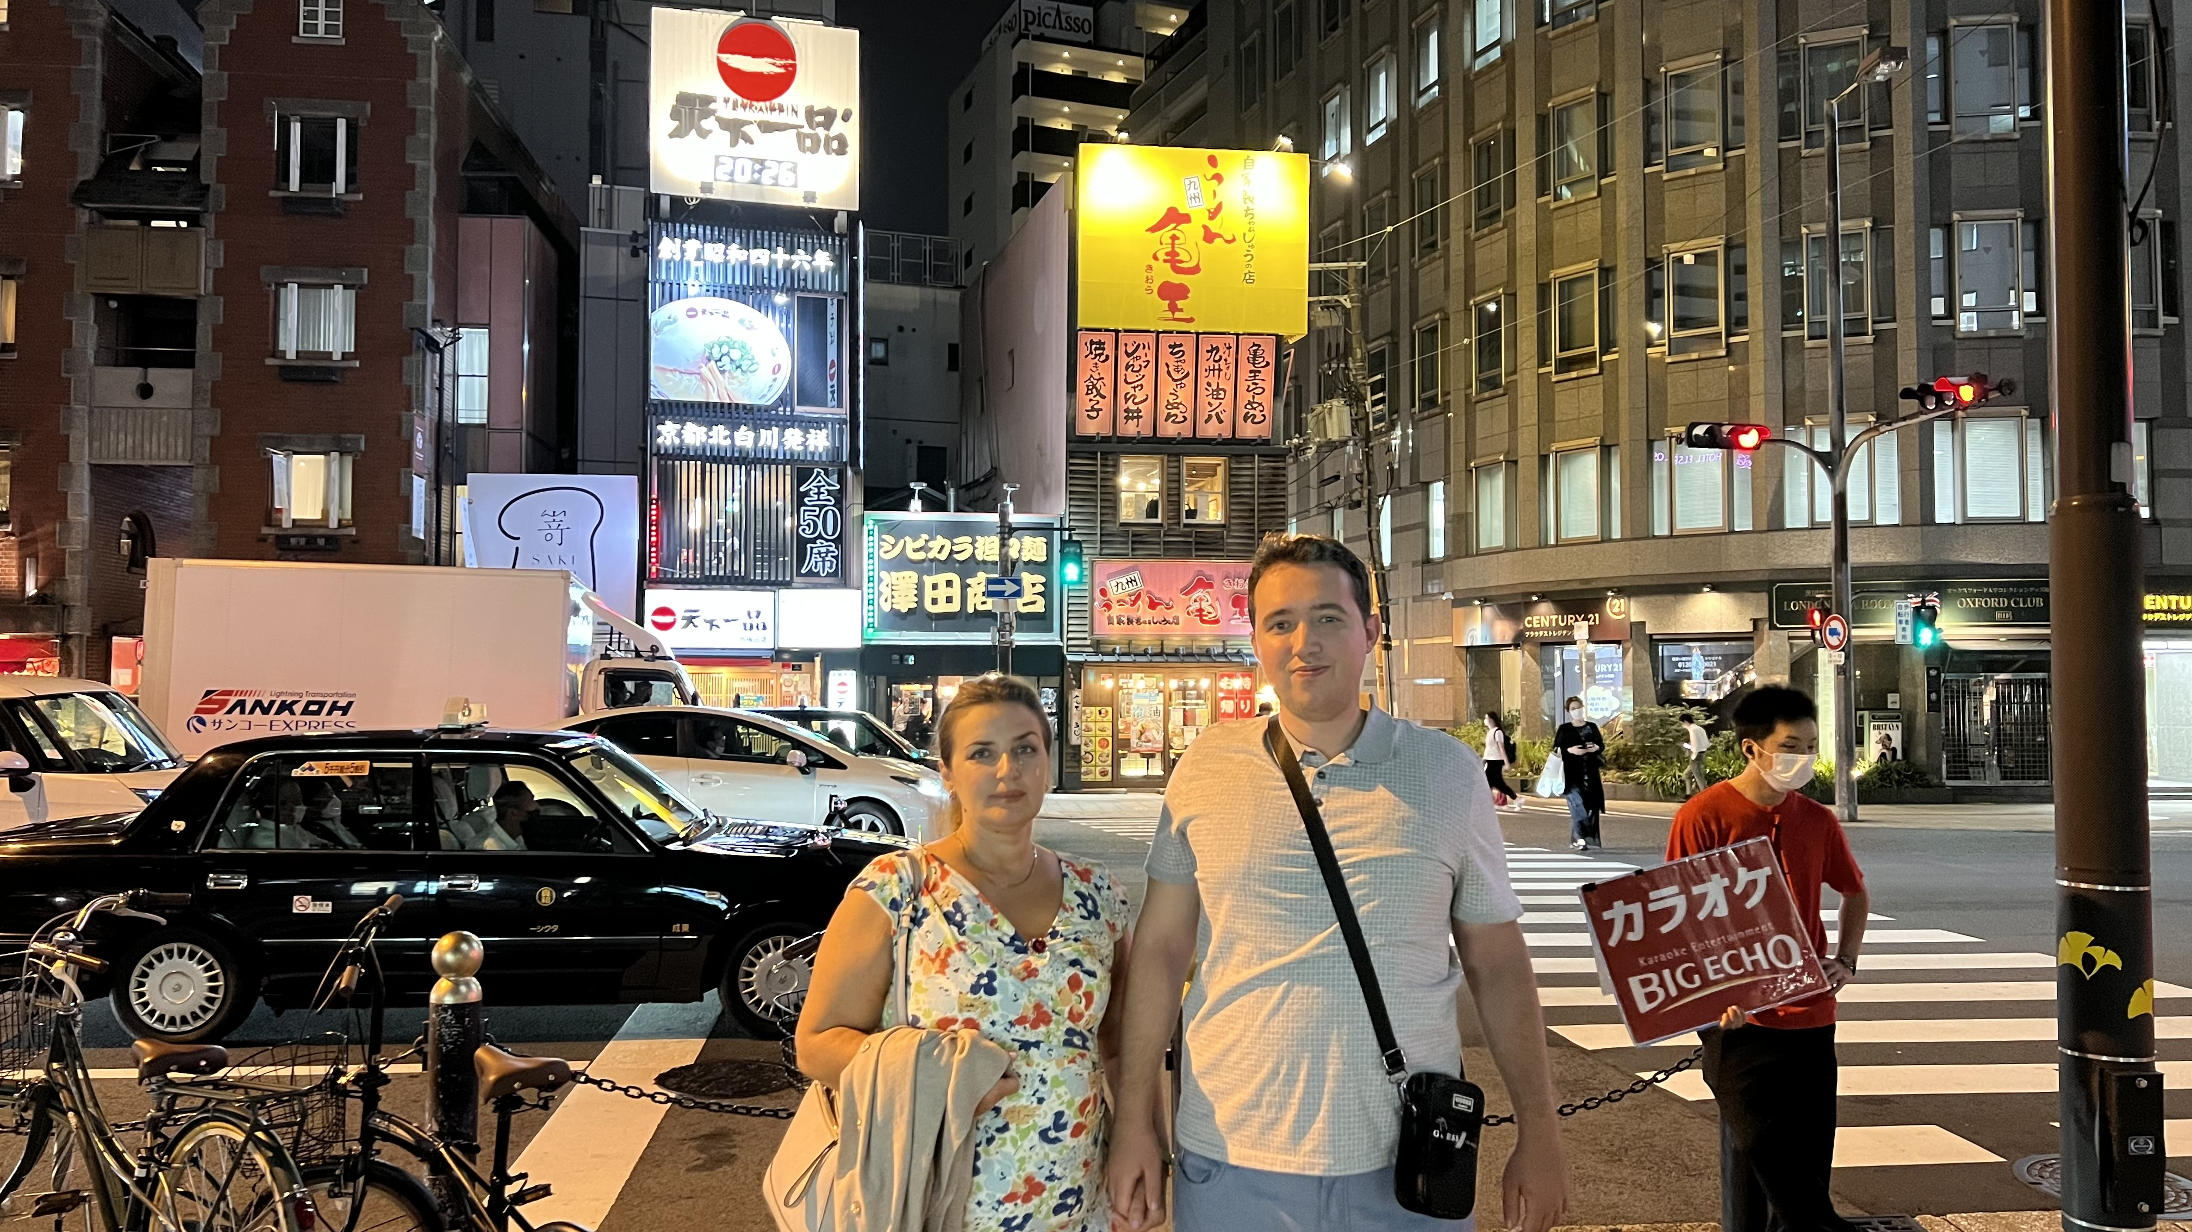

Slide 17
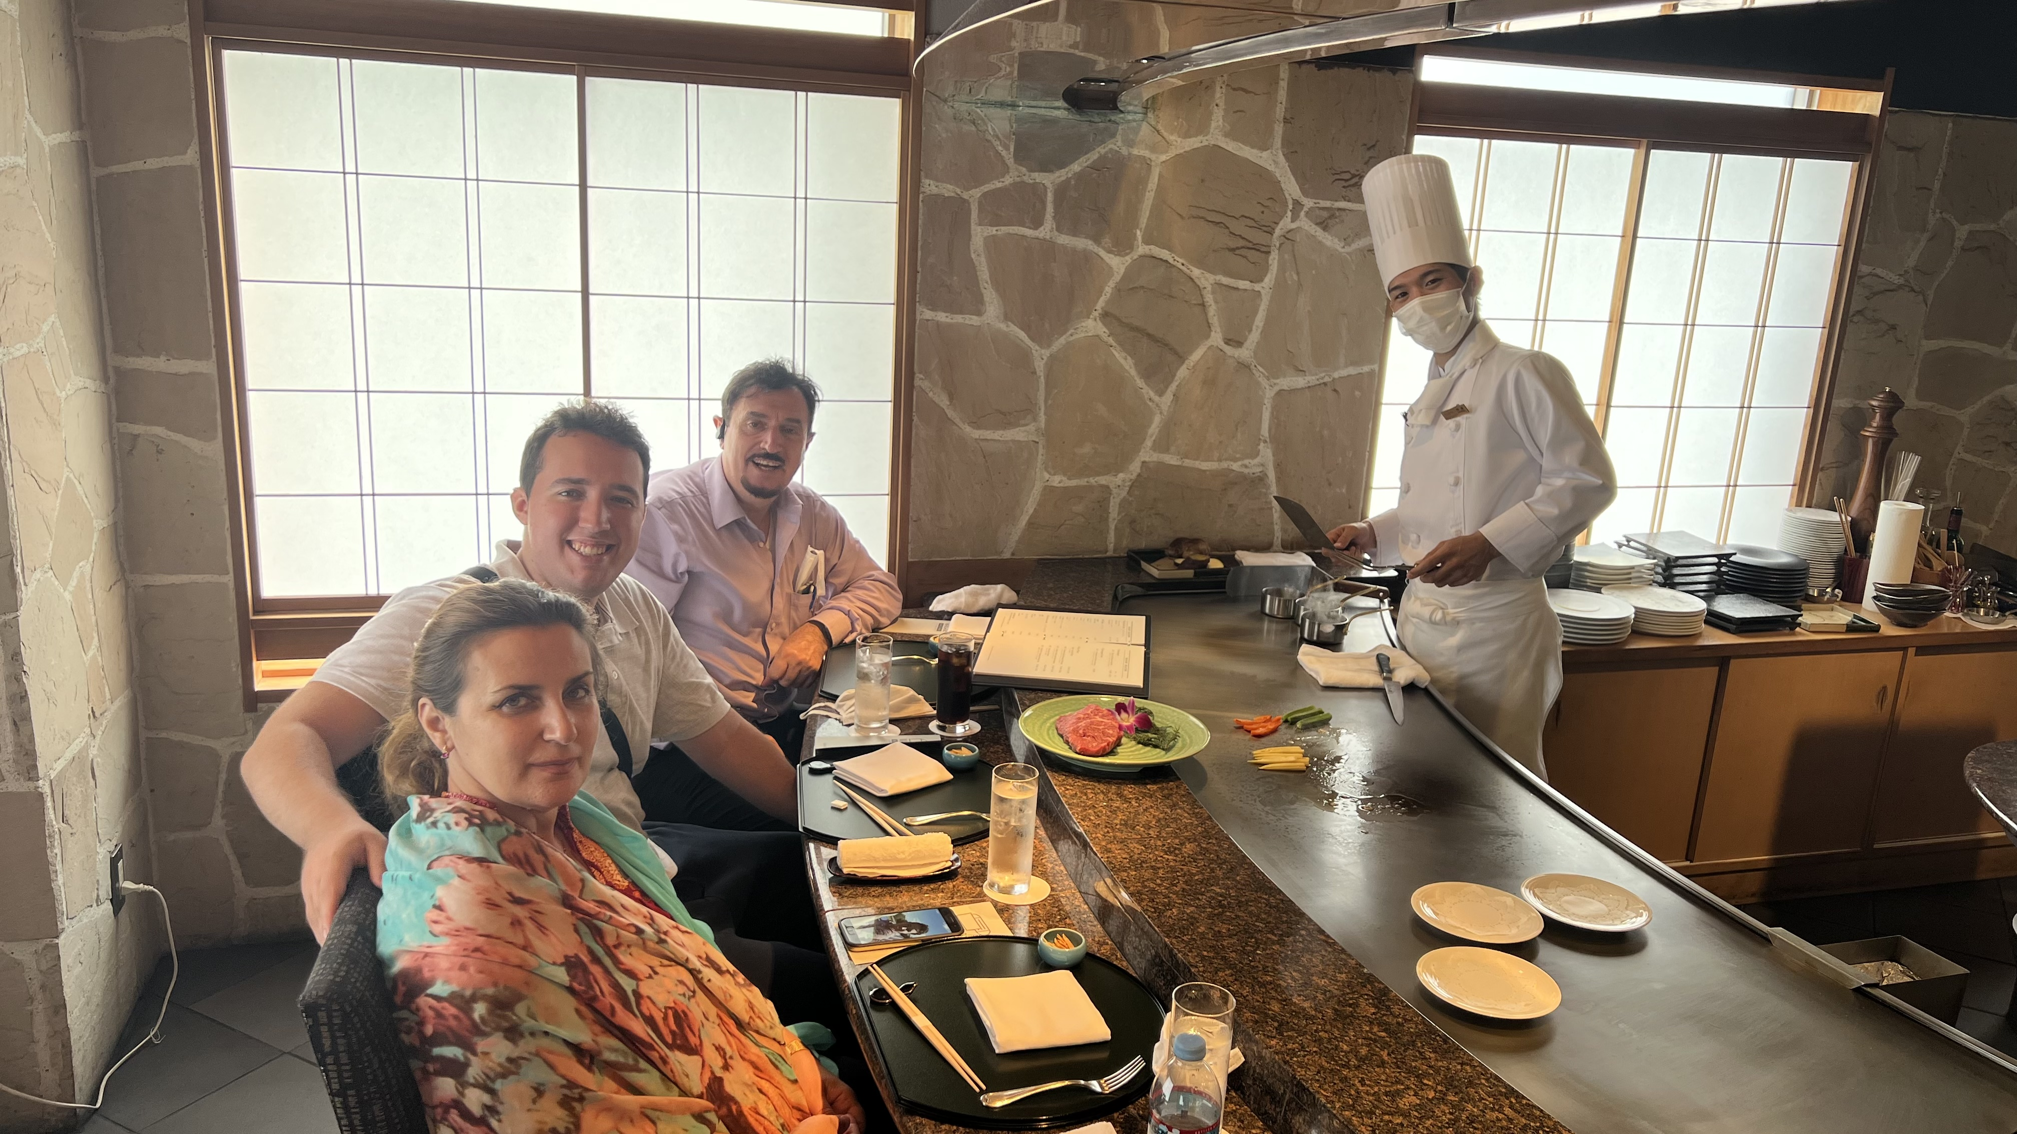

Slide 18
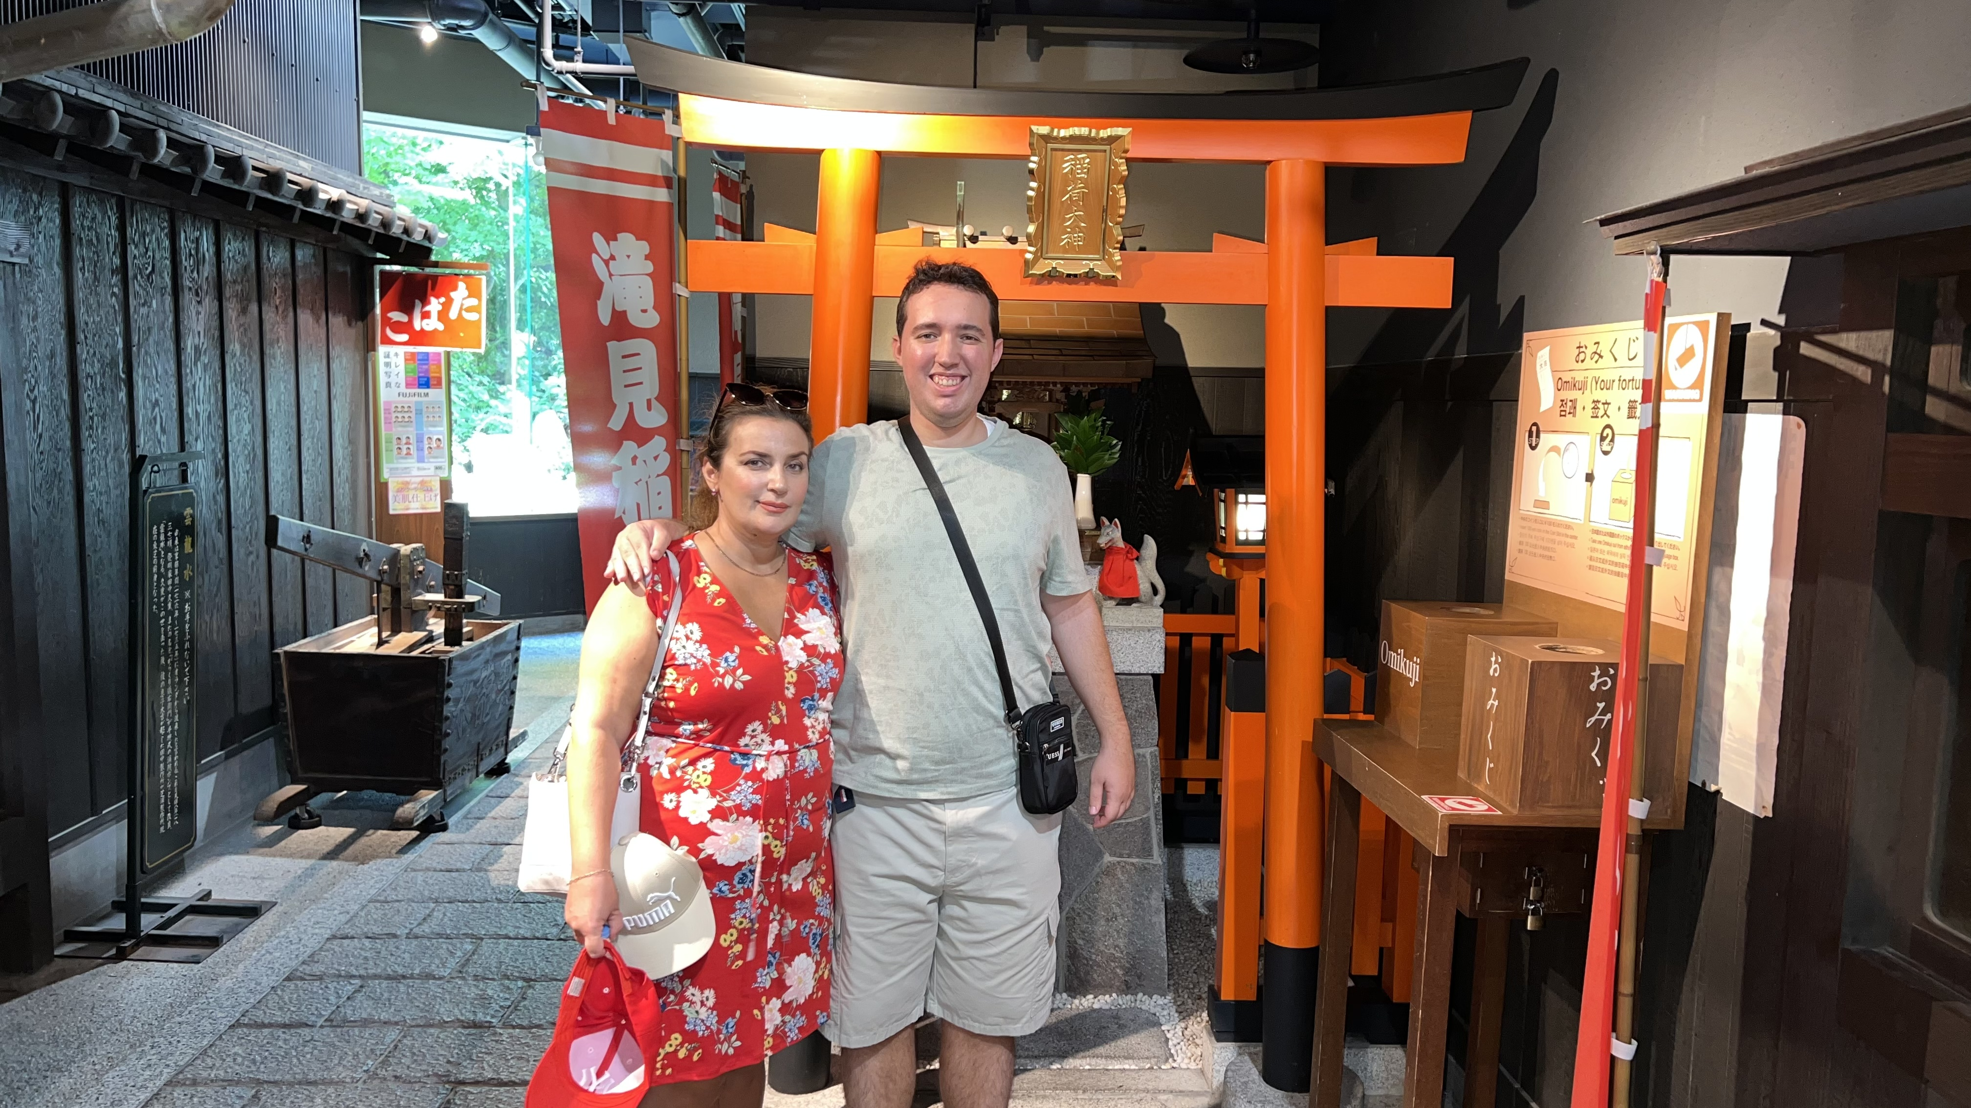

Slide 19
