Slide 1
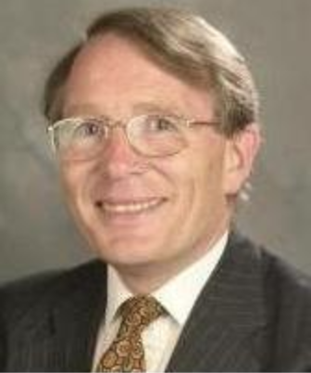
Fray International Sustainability Award
In honor of the distinguished work and lifetime achievements of Dr. Derek J. Fray, Emeritus Professor, University of Cambridge, UK whose illustrious biography includes among others almost 400 scientific papers, approximately 179 patents arising from 62 families of patents and several Fellowships of some of the most prestigious professional societies around the world.
Citation:
Politics :
"For Leadership in developing new advanced public policy frameworks related to the efficiency of mineral and metal resources for a global sustainable development"
Corporations:
"For Leadership in developing and applying new innovative business plans and operation technologies for a sustainable development of the company in the environment, economy and social points of view"
Academia:
" For Leadership in developing new technologies that contribute to a global sustainable development as per FLOGEN Sustainability Framework in the environment, economy and social points of view "

Slide 2
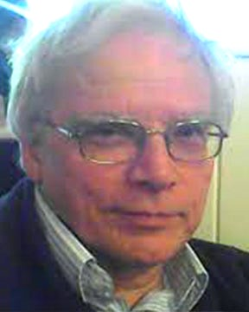
Sustainable Industrial Processing Summit
2024 STARS:
Peter Rowlands
Professor
University of Liverpool, UK
Field: Mathematics Applications
FRAY INTERNATIONAL SUSTAINABILITY AWARD
FLOGEN STARS OUTREACH

Slide 3
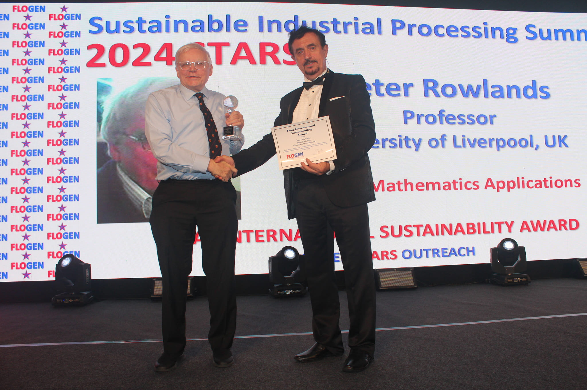
Dr. Peter Rowlands receiving the Fray International Sustainability Award from Dr. Florian Kongoli at FLOGEN SIPS 2024

Slide 4
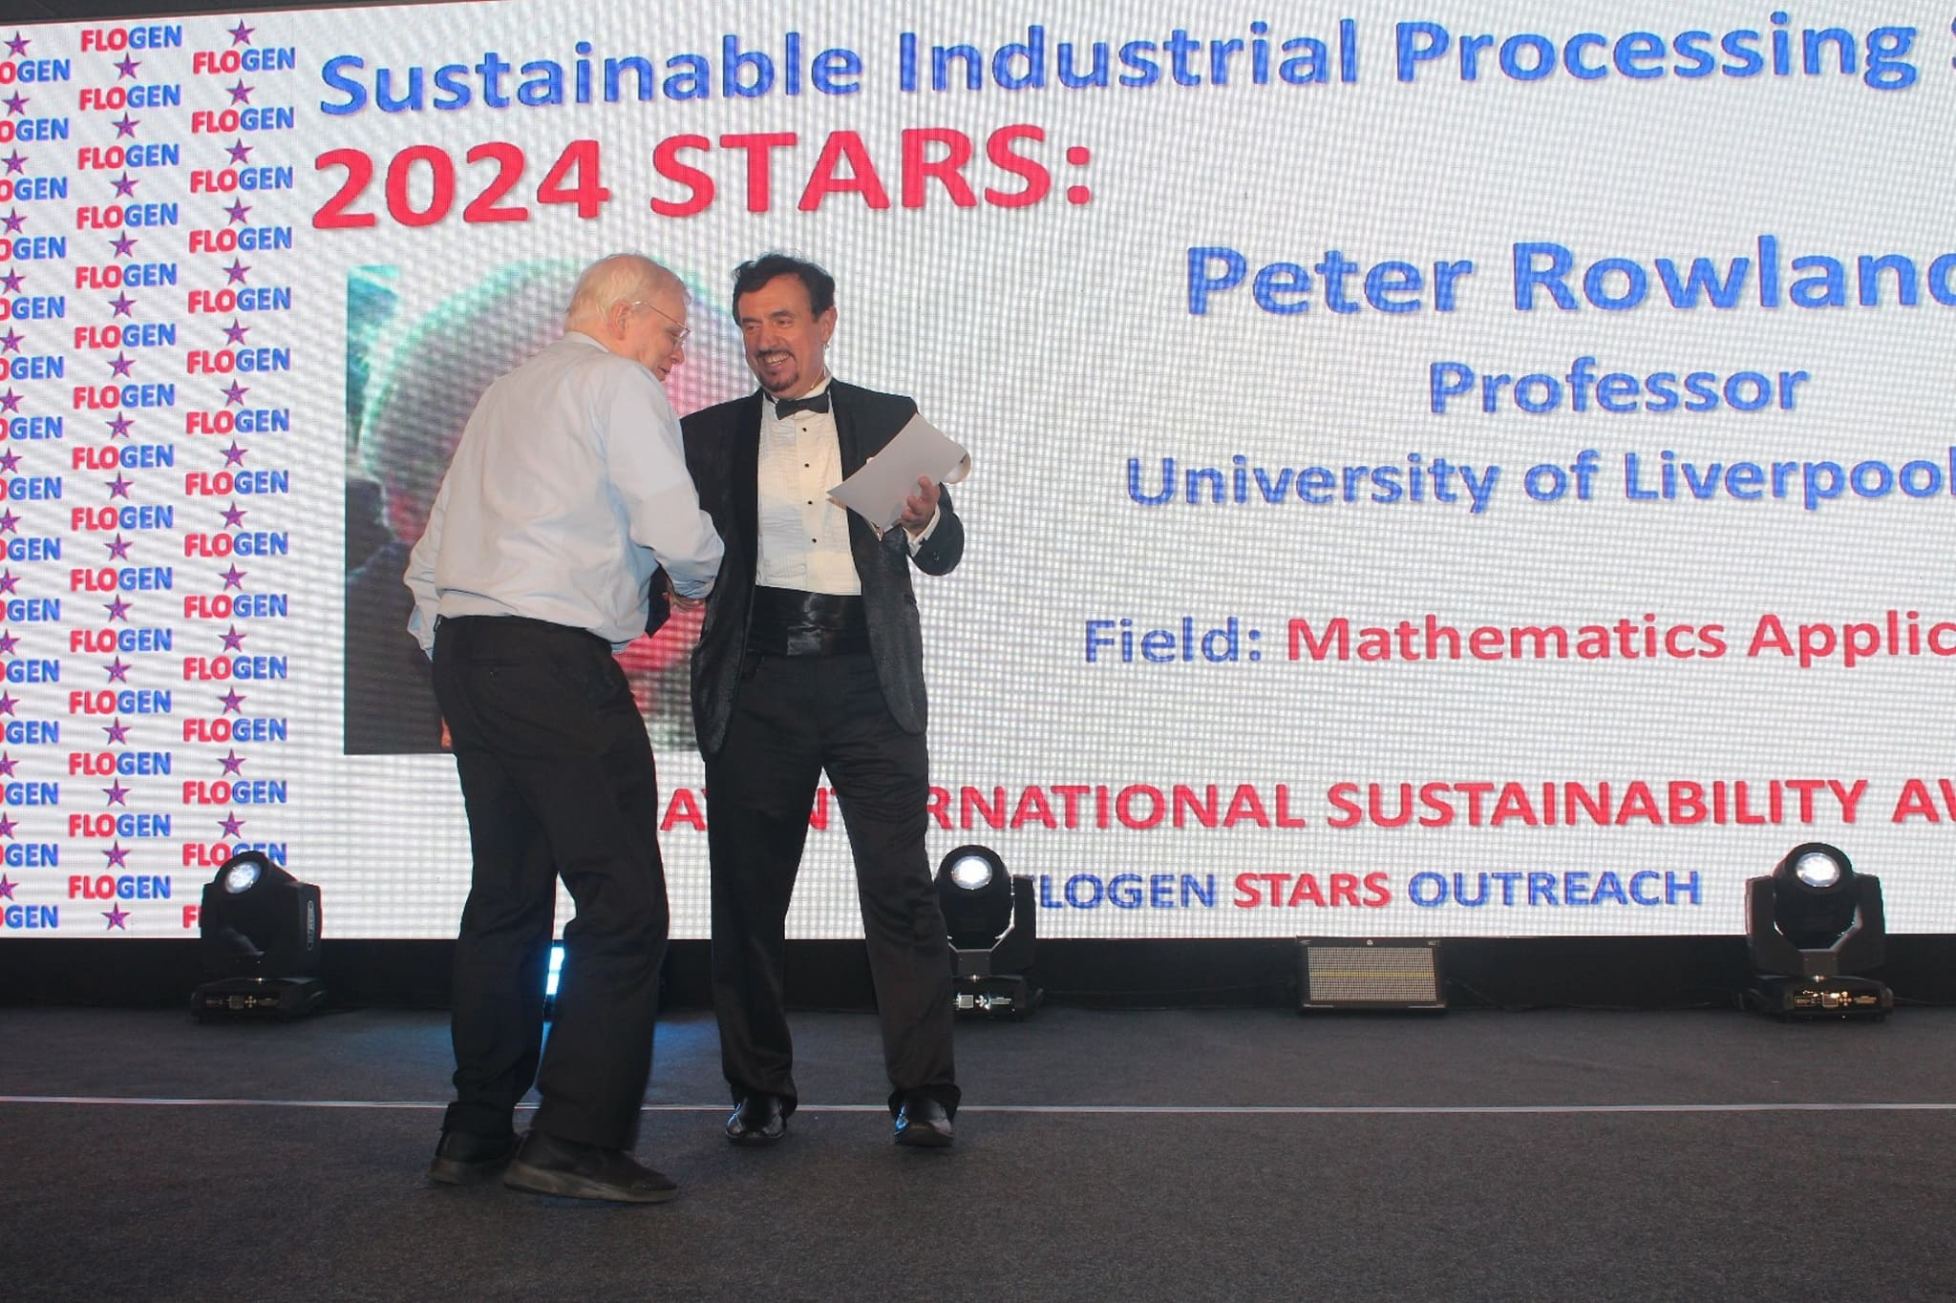
Dr. Florian Kongoli congratulating Dr. Peter Rowlands during the FLOGEN SIPS 2024 award ceremony

Slide 5
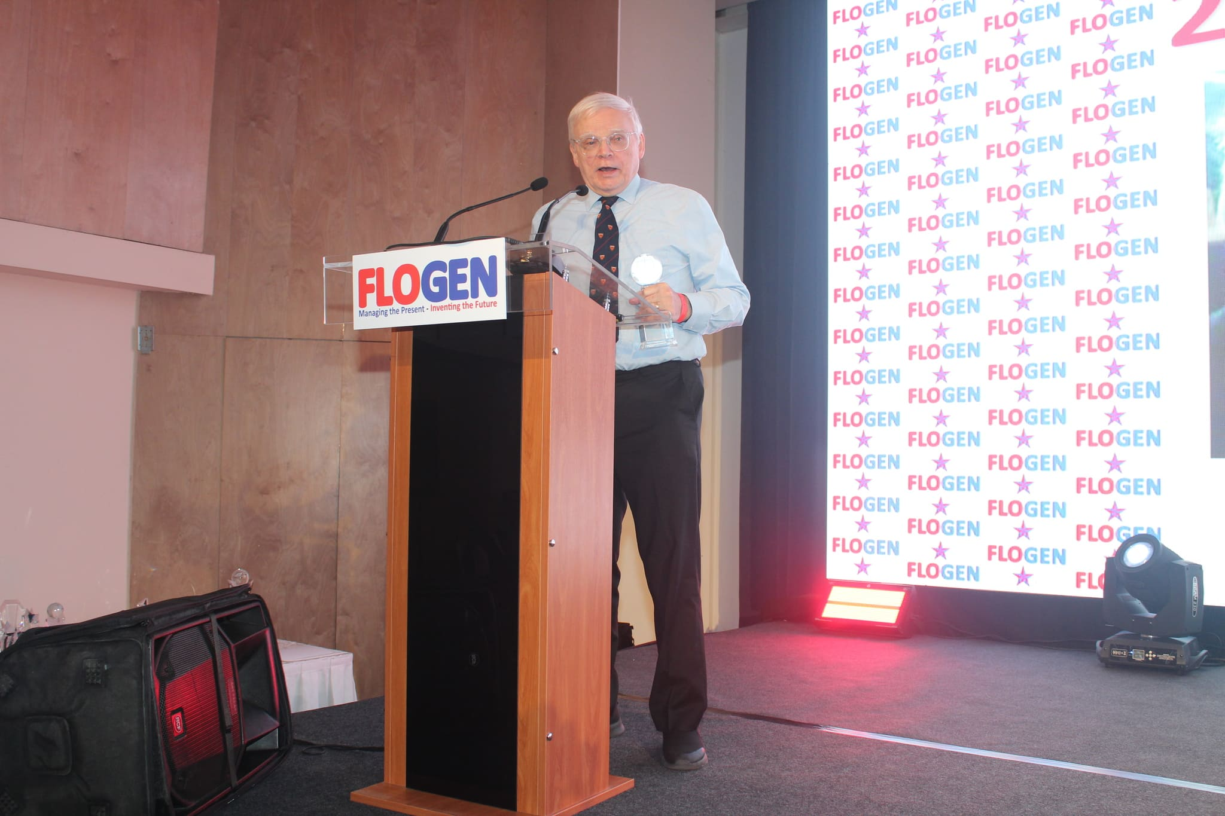
Dr. Peter Rowlands delivering an acceptance speech during the FLOGEN SIPS 2024 award ceremony

Slide 6
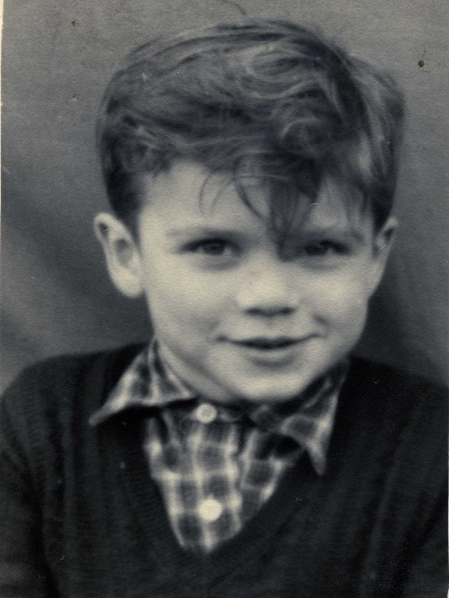
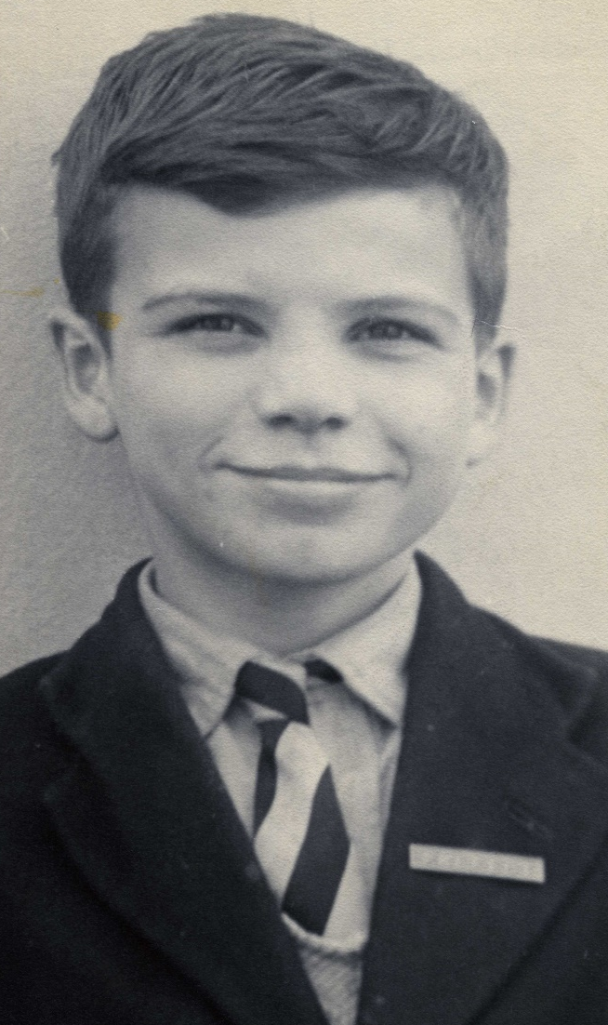
Aged about 4
Schoolboy aged about 10

Slide 7
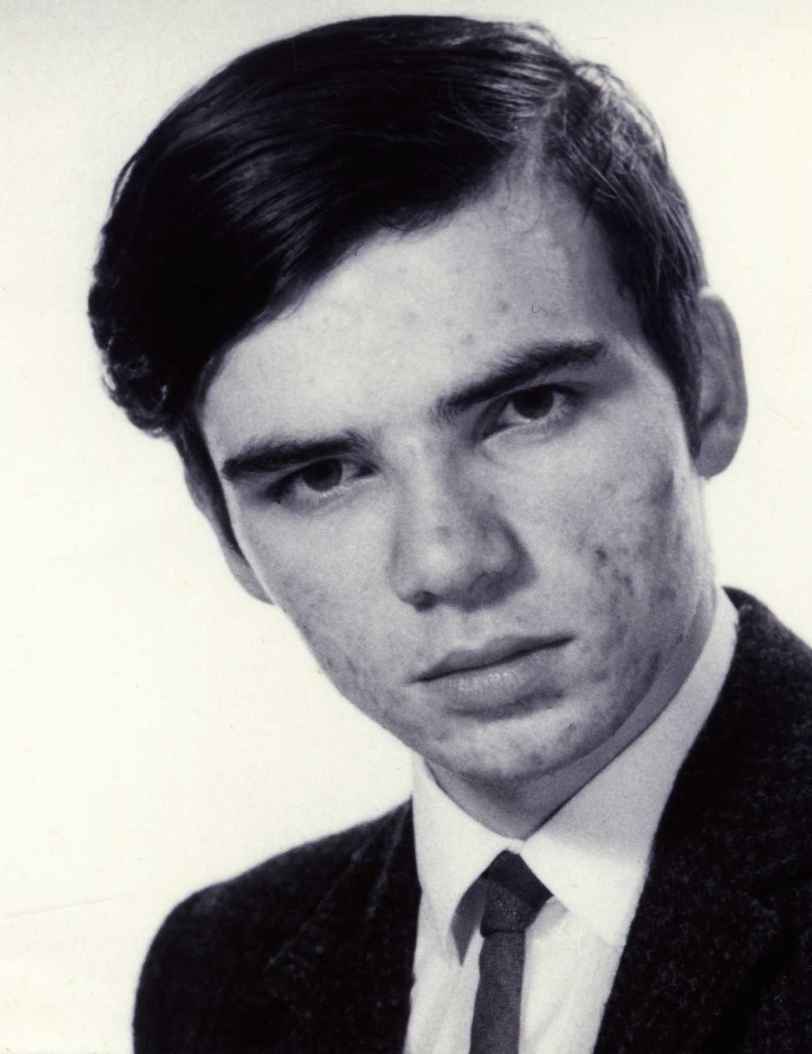
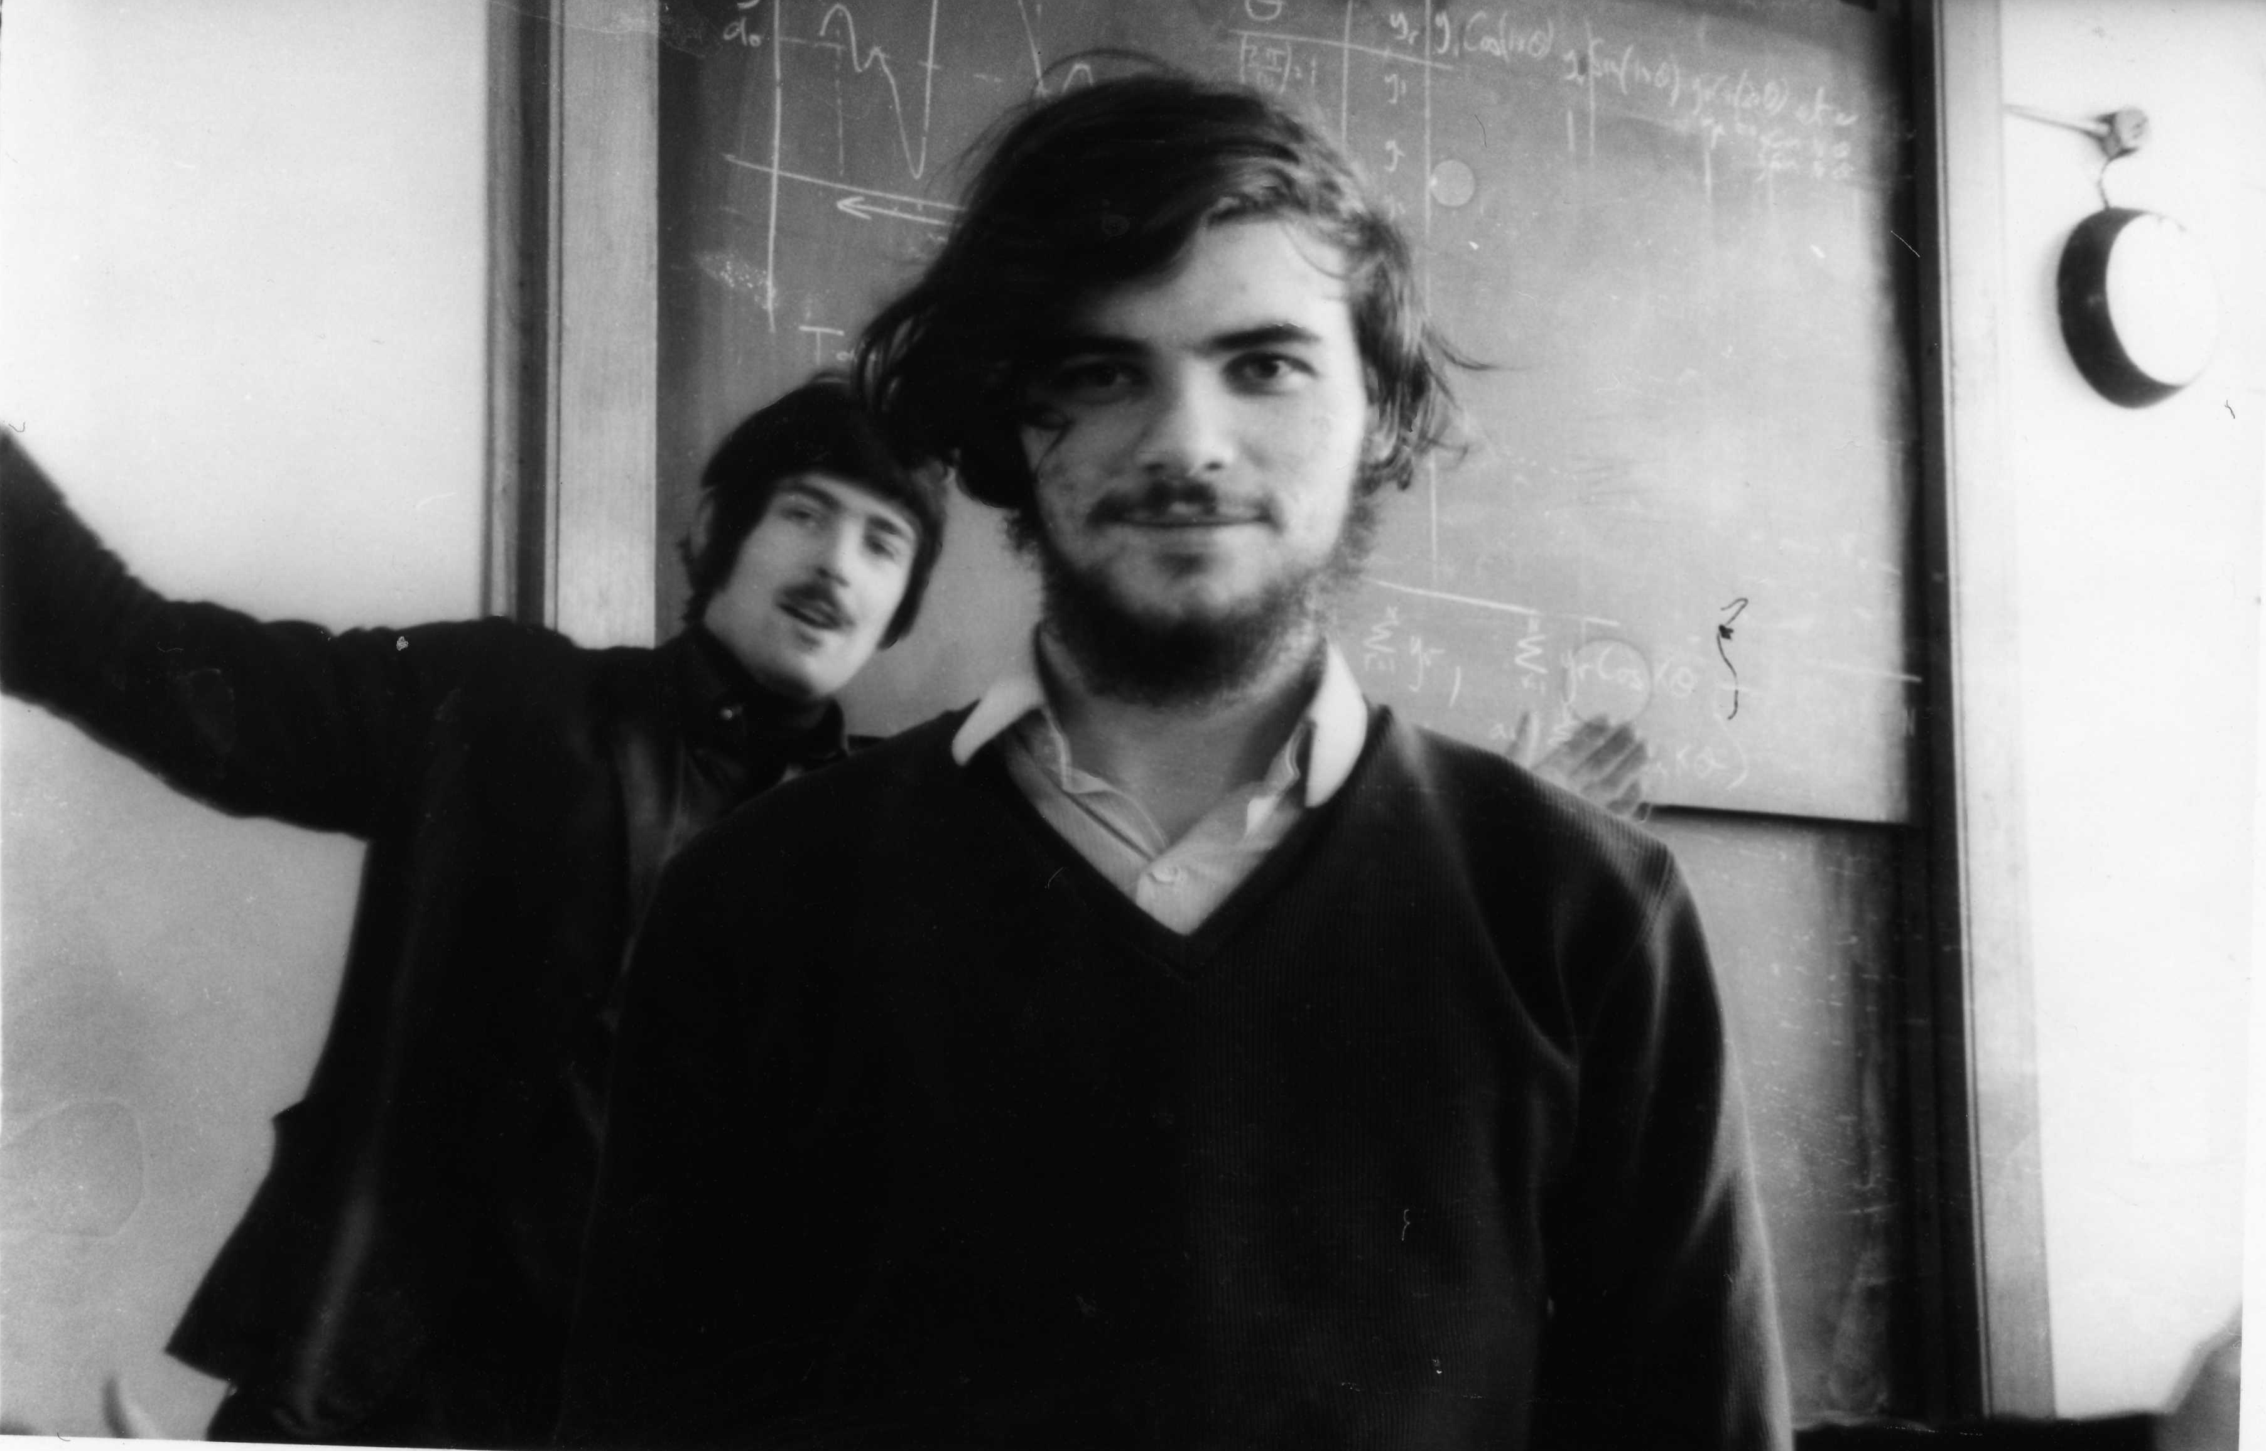
At University, experimenting with photography
About to enter University aged 18

Slide 8
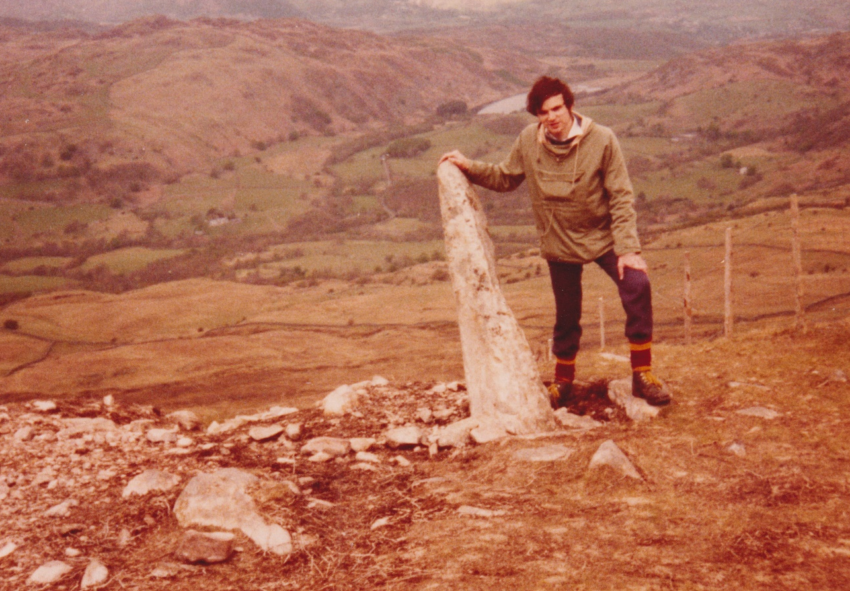
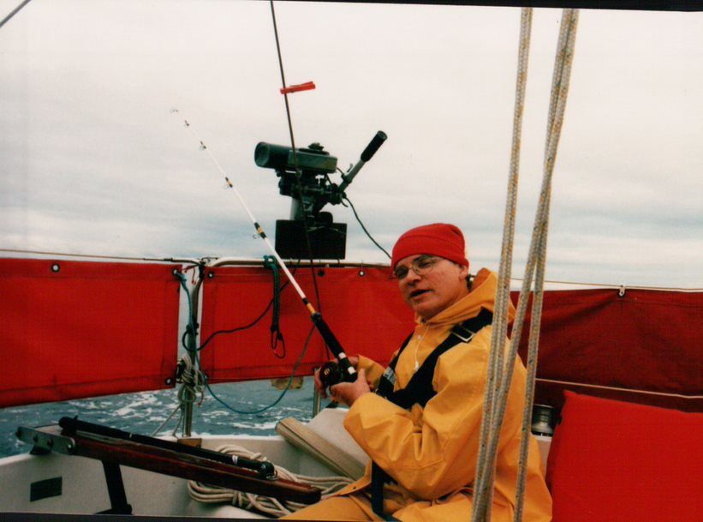
A lifetime passion – fell walking
Another lifetime passion - fishing

Slide 9
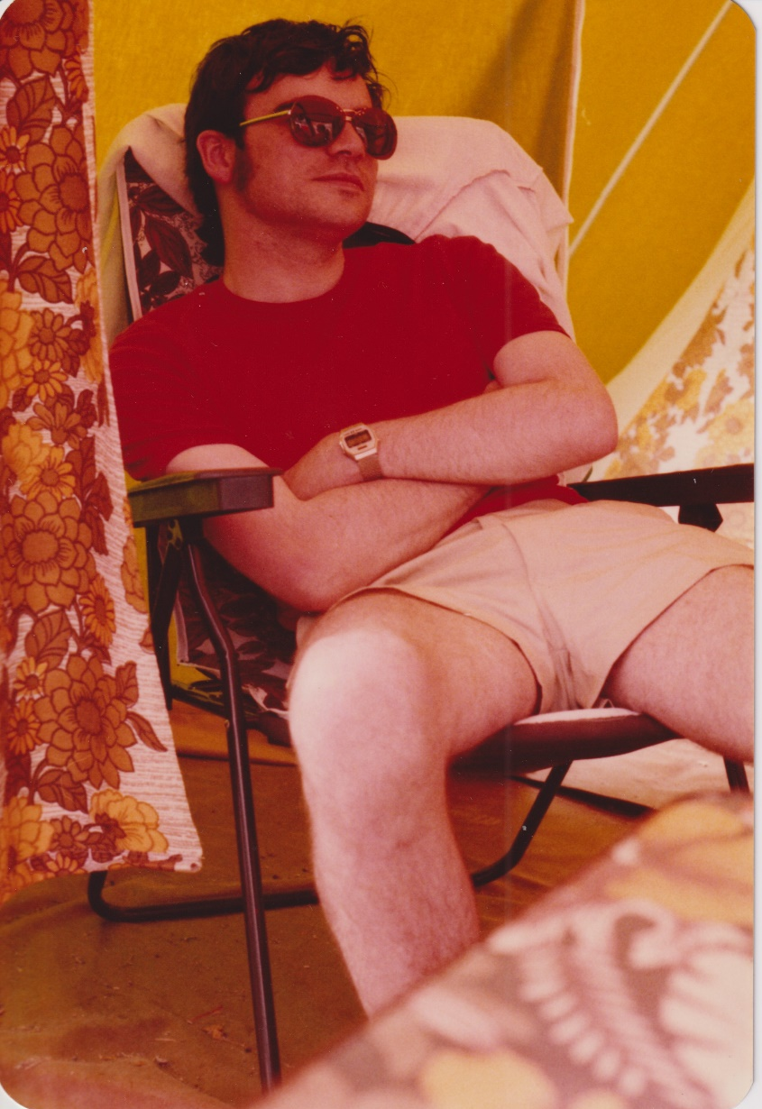
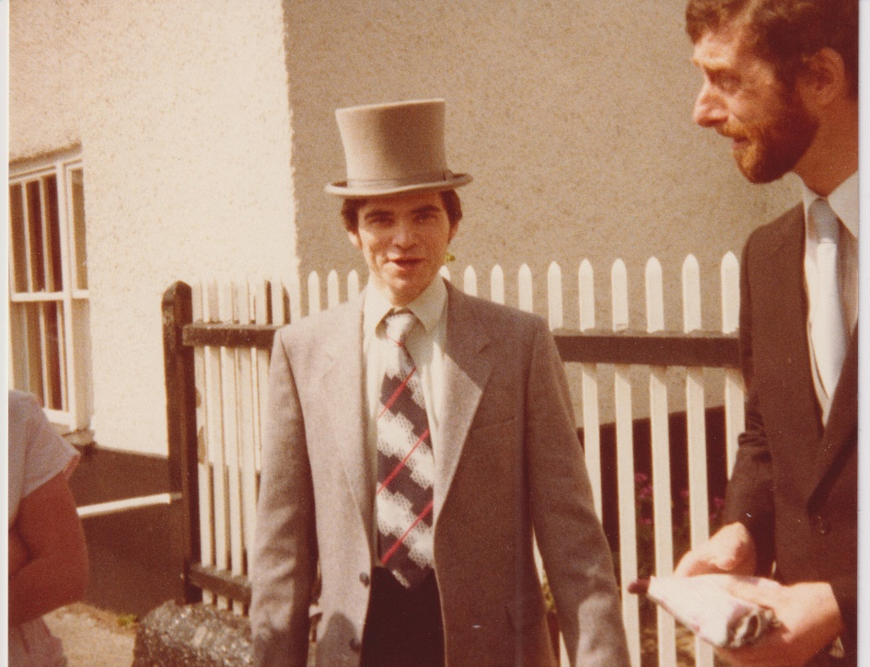
Summer in the South of France
At a friend’s wedding – hat borrowed

Slide 10
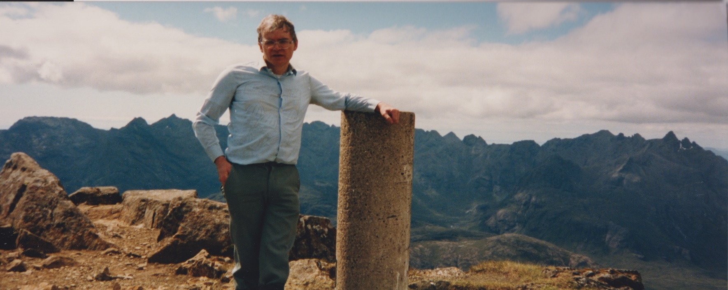
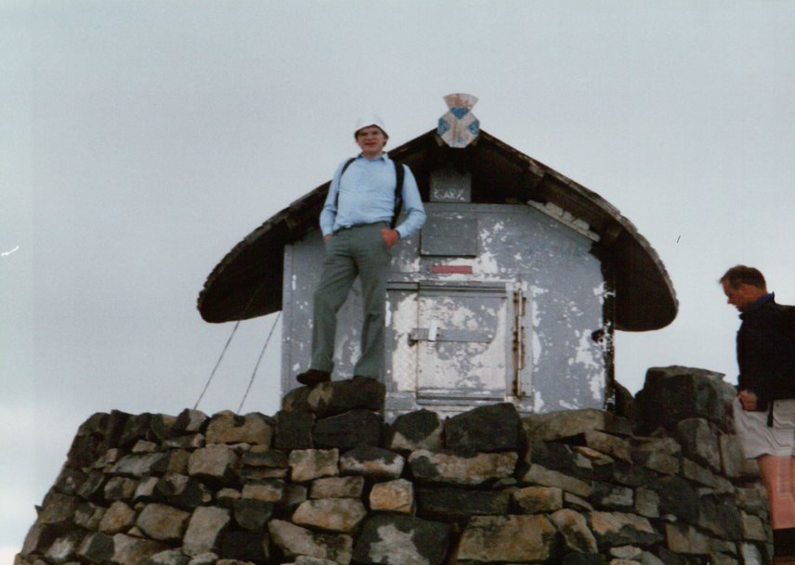
The top of mountain in Skye
On top of Ben Nevis

Slide 11
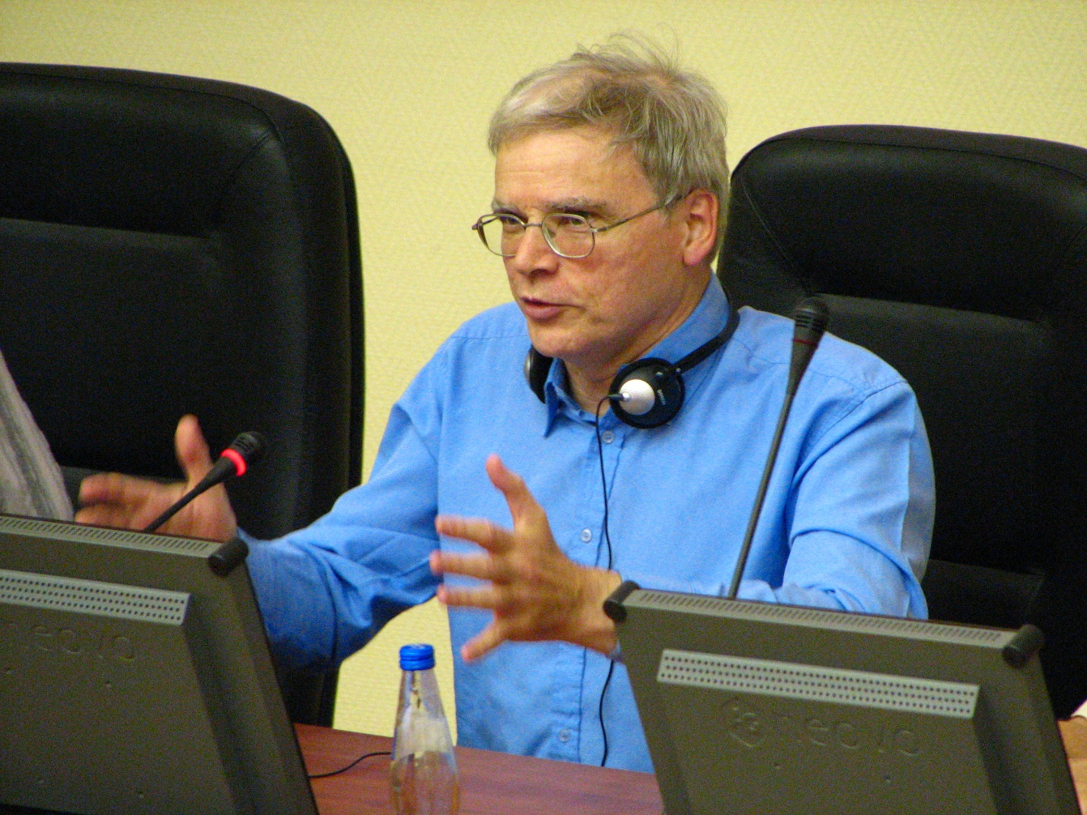
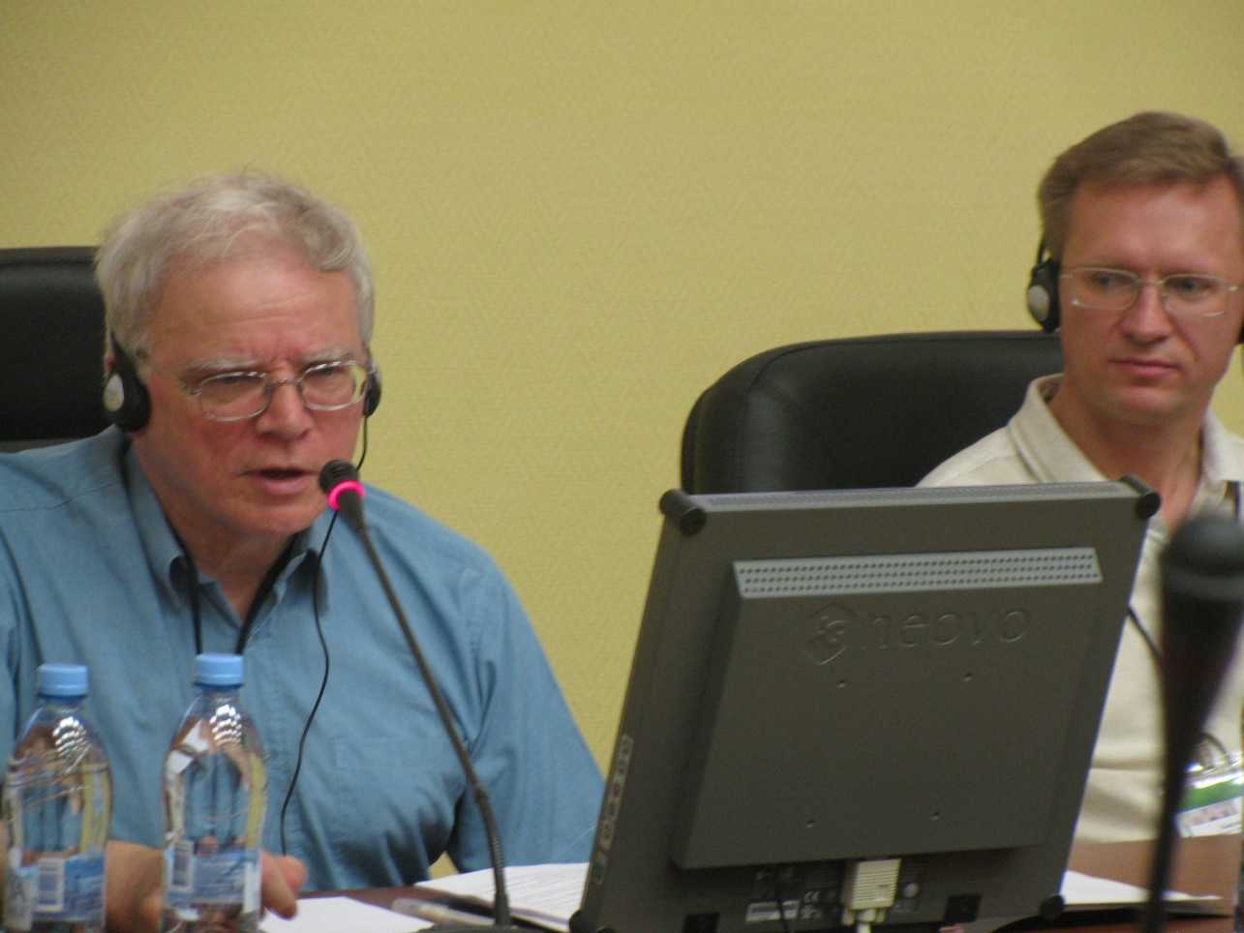
Chairing at Moscow conference

Slide 12
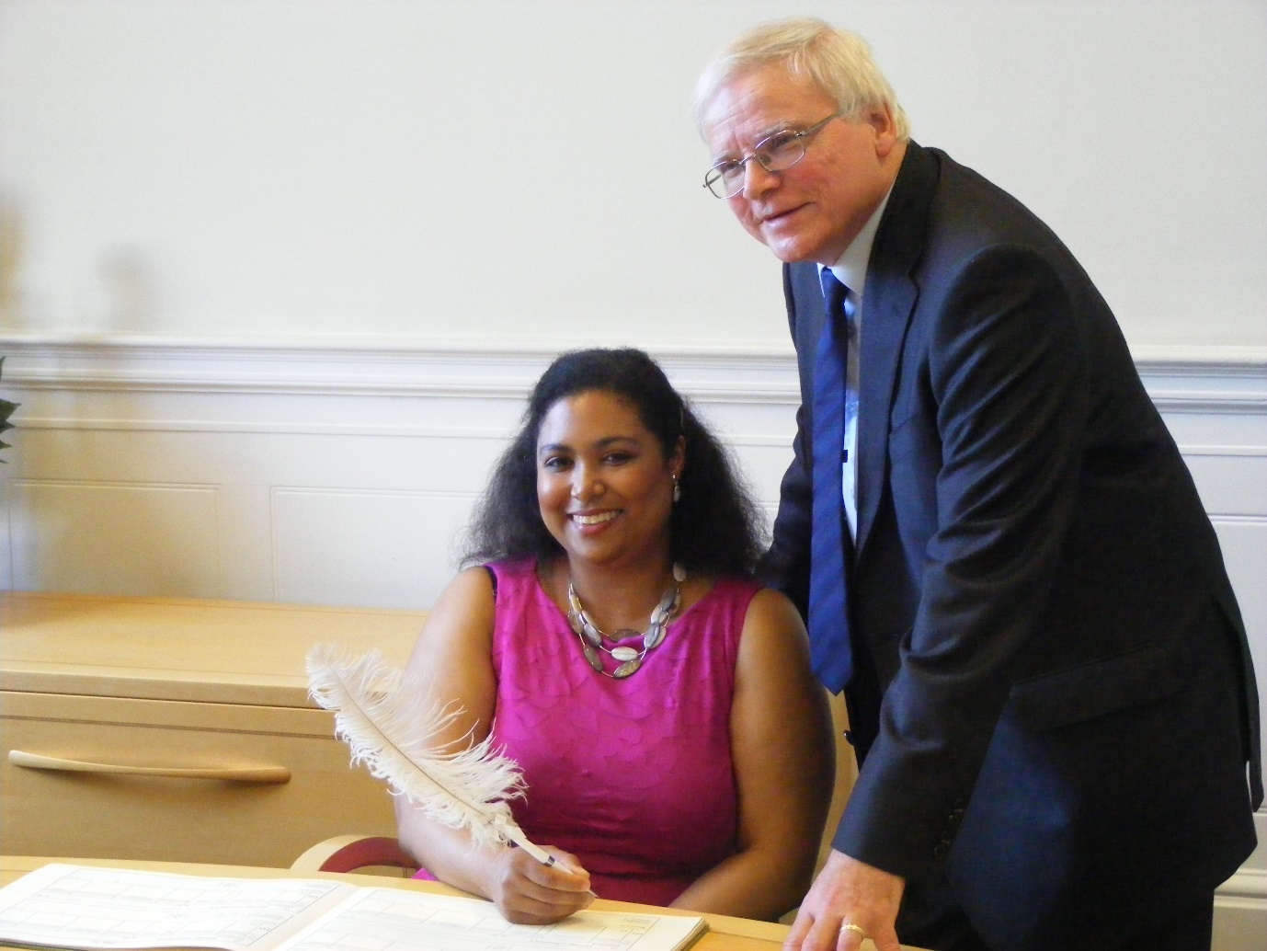
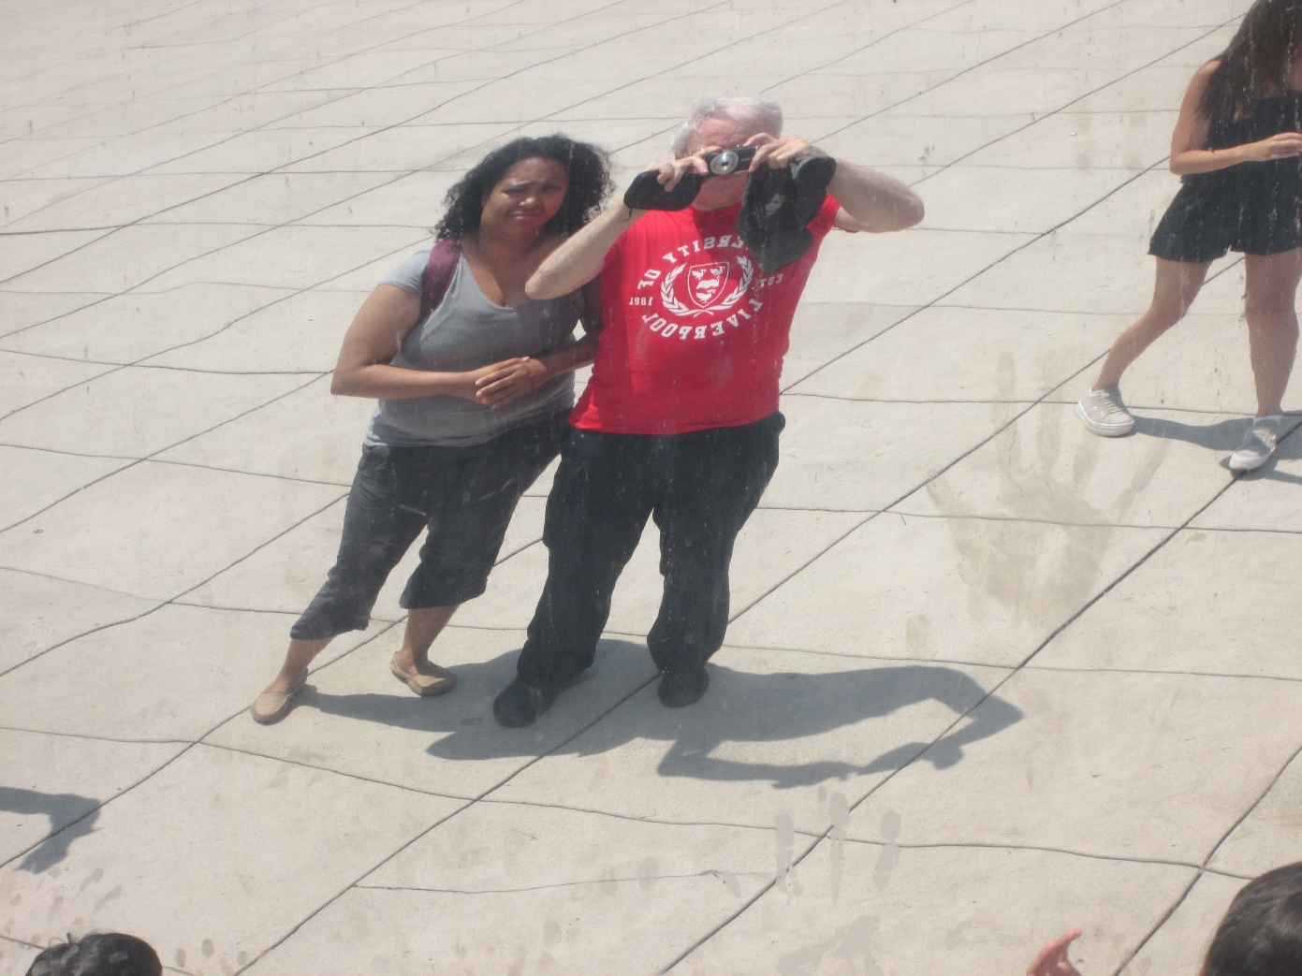
Wedding in Liverpool, 2005
With my intended, Sydney, Chicago. Photograph taken is reflection in large metal sphere

Slide 13
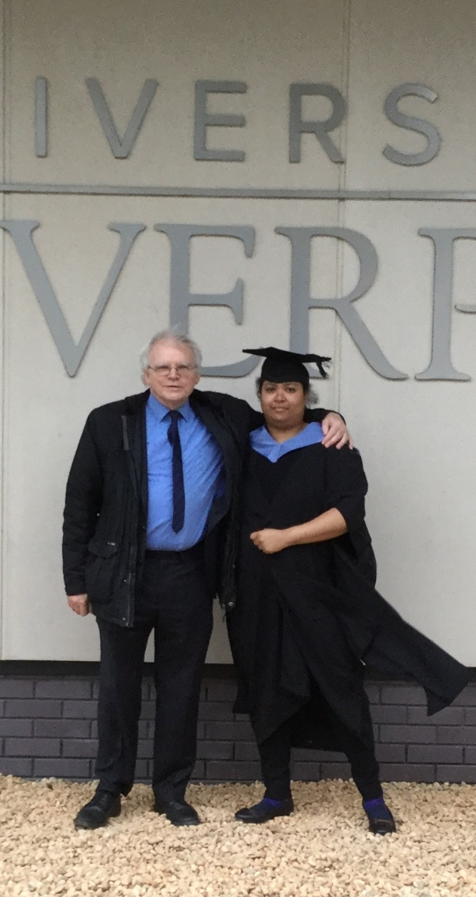
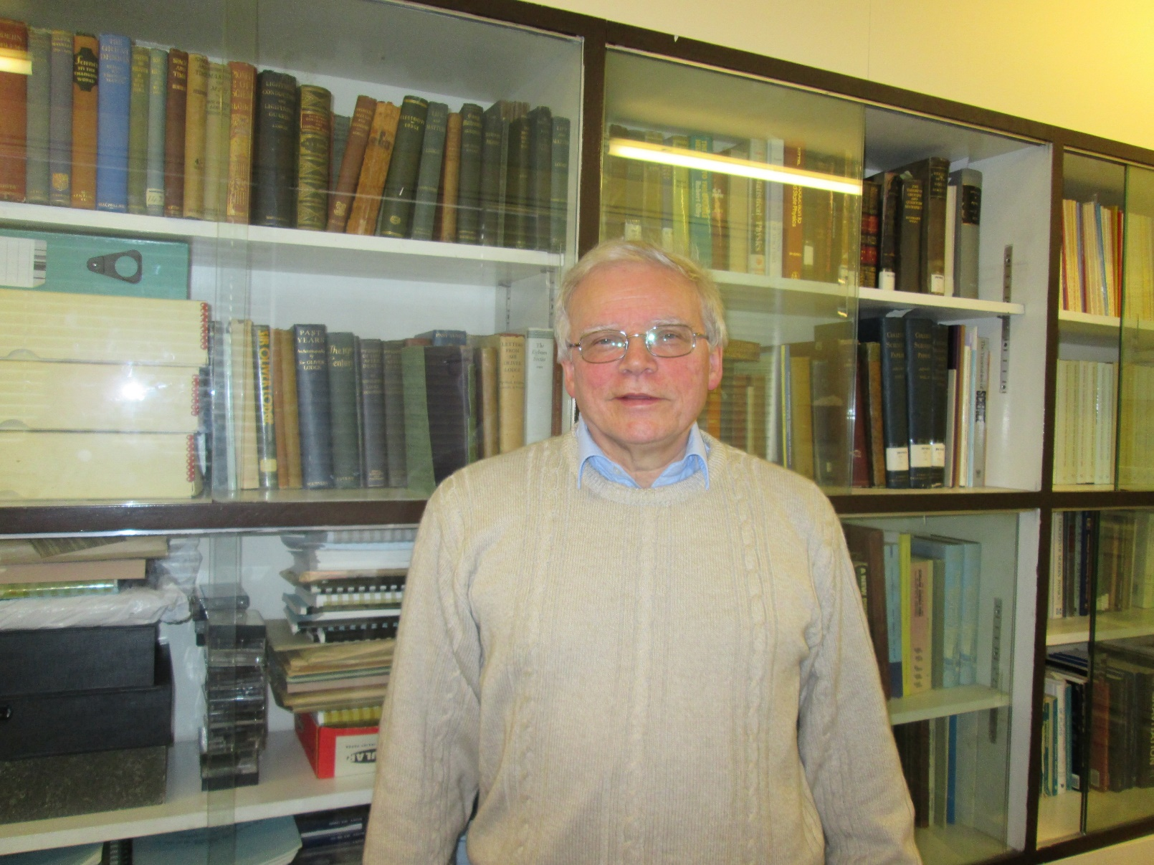
In office in Liverpool
Sydney’s Master’s graduation in Liverpool

