Slide 1
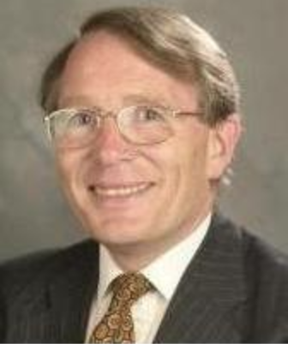
Fray International Sustainability Award
In honor of the distinguished work and lifetime achievements of Dr. Derek J. Fray, Emeritus Professor, University of Cambridge, UK whose illustrious biography includes among others almost 400 scientific papers, approximately 179 patents arising from 62 families of patents and several Fellowships of some of the most prestigious professional societies around the world.
Citation:
Politics : "For Leadership in developing new advanced public policy frameworks related to the efficiency of mineral and metal resources for a global sustainable development"
Corporations: "For Leadership in developing and applying new innovative business plans and operation technologies for a sustainable development of the company in the environment, economy and social points of view"
Academia: " For Leadership in developing new technologies that contribute to a global sustainable development as per FLOGEN Sustainability Framework in the environment, economy and social points of view "

Slide 2
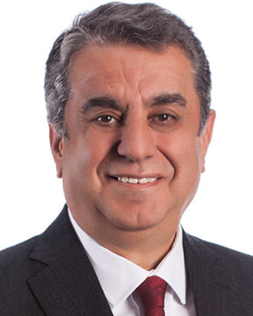
Sustainable Industrial Processing Summit
2024 STARS:
Şener Oktik
Professor
Maltepe University, Turkey
Field: Glass Processing and Applications
FRAY INTERNATIONAL SUSTAINABILITY AWARD
FLOGEN STARS OUTREACH

Slide 3
Dr. Sener Oktik receiving the Fray International Sustainability Award from Dr. Florian Kongoli at FLOGEN SIPS 2024

Slide 4
Dr. Florian Kongoli congratulating Dr. Sener Oktik during the FLOGEN SIPS 2024 award ceremony

Slide 5
Dr. Sener Oktik delivering an acceptance speech during the FLOGEN SIPS 2024 award ceremony

Slide 6
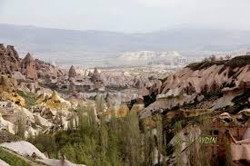
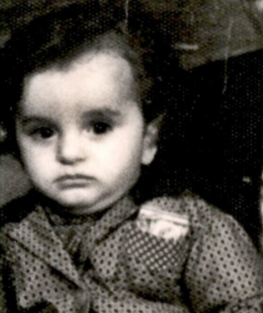
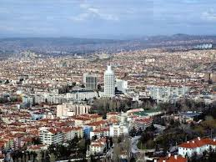
Born in Uchisar (capdocia) and raised in Ankara + Capadocia

Slide 7
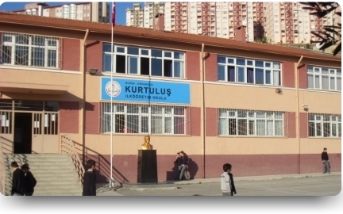
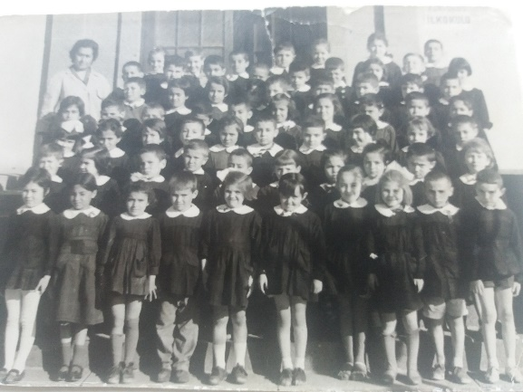
Primary School 1961-1966
Ankara Kurtuluş Primary School
Türkiye

Slide 8
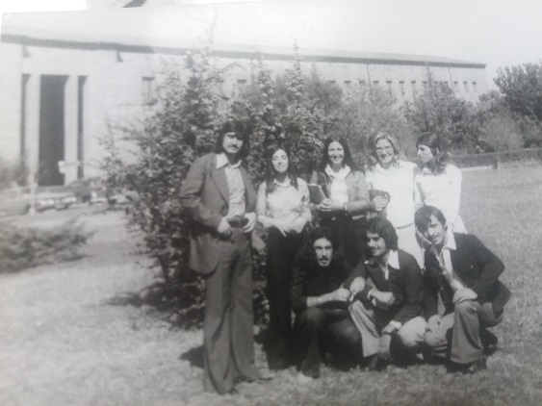
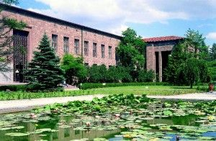
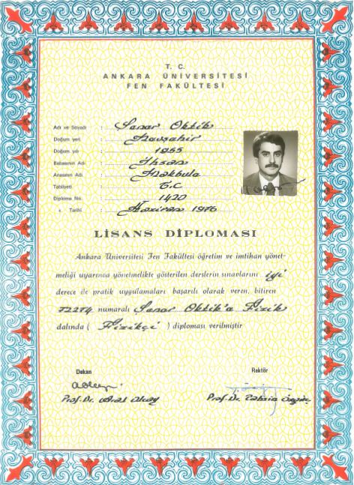
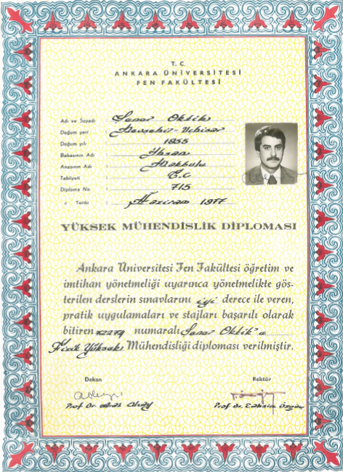
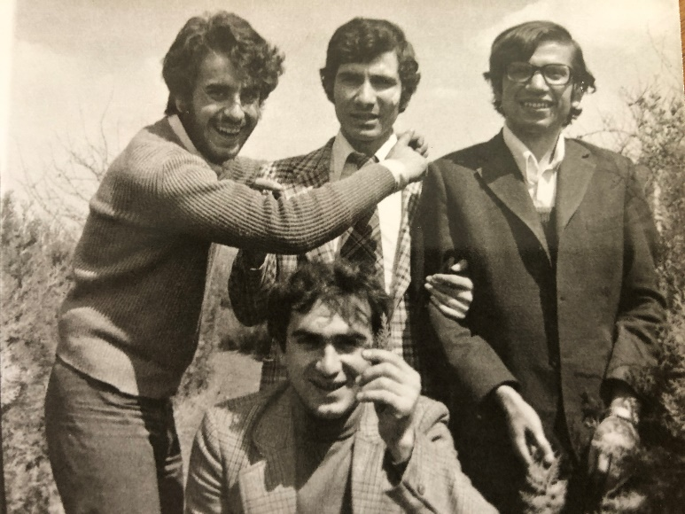
Higher Education 1972-1977
University of Ankara
Science Faculty
Physics : 1972-1976
Enginnering in Physics. 1976-77
Physics
Engineering in Physics

Slide 9
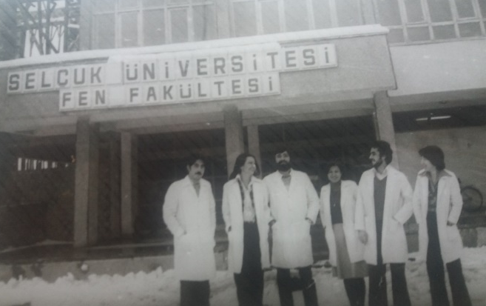
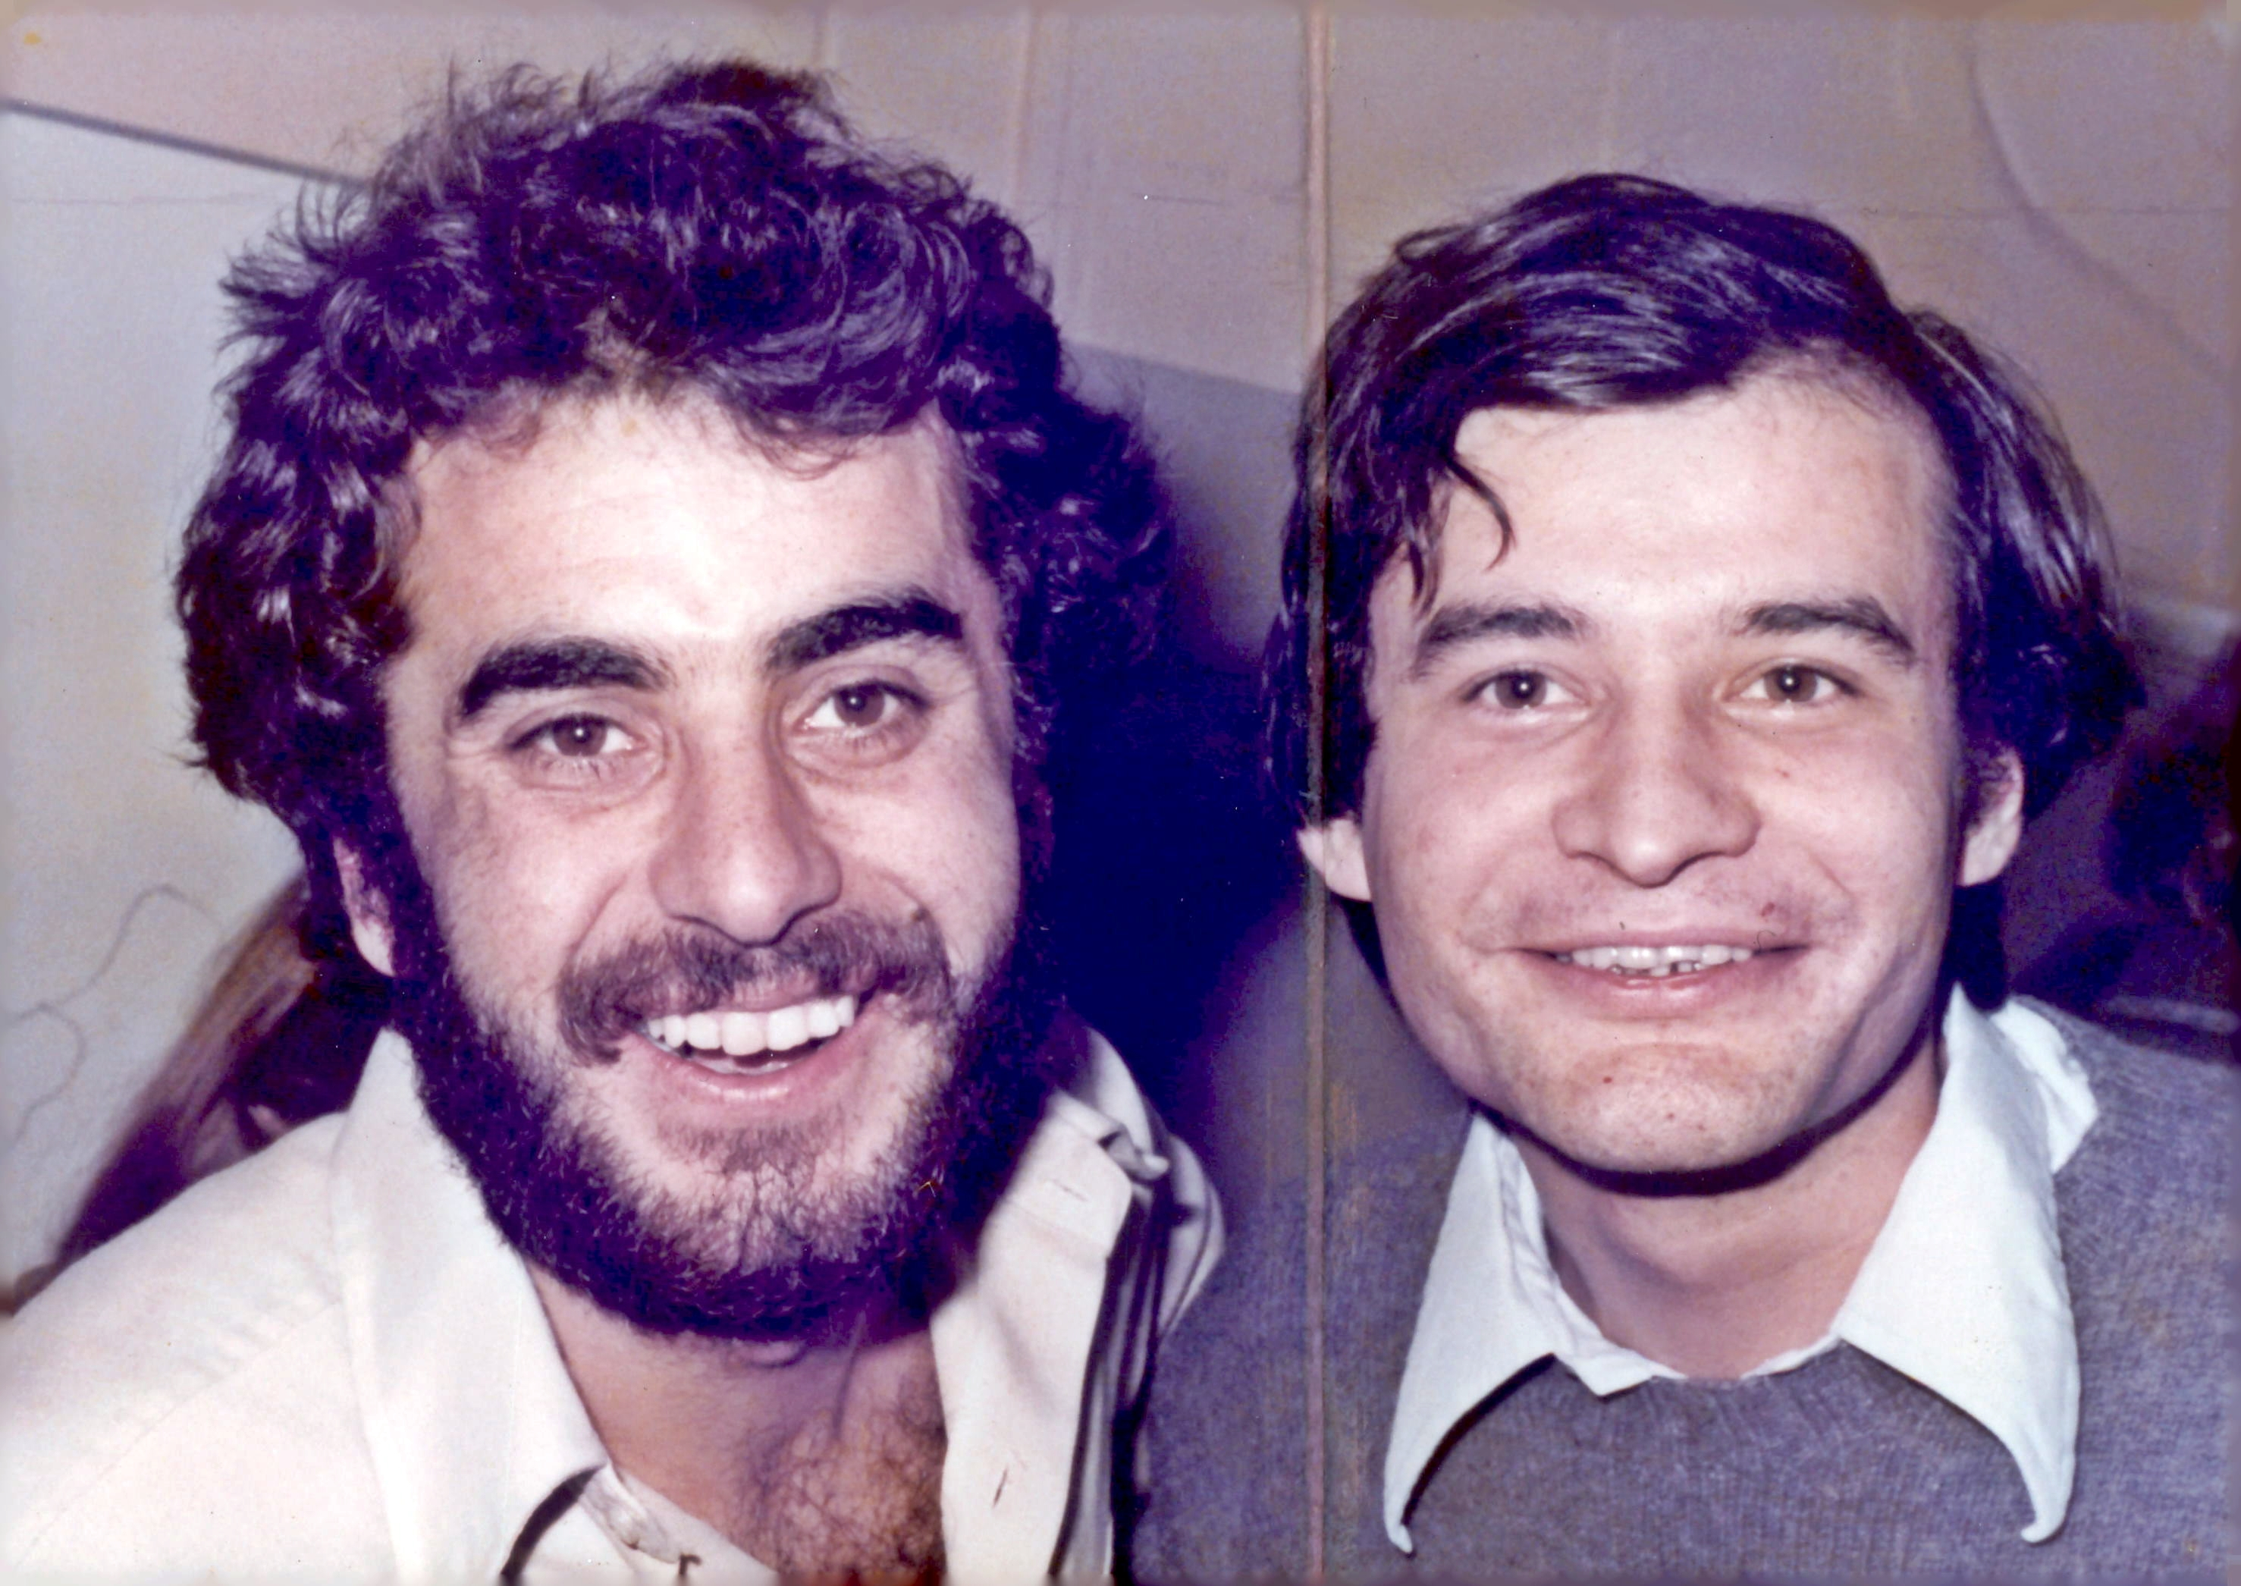
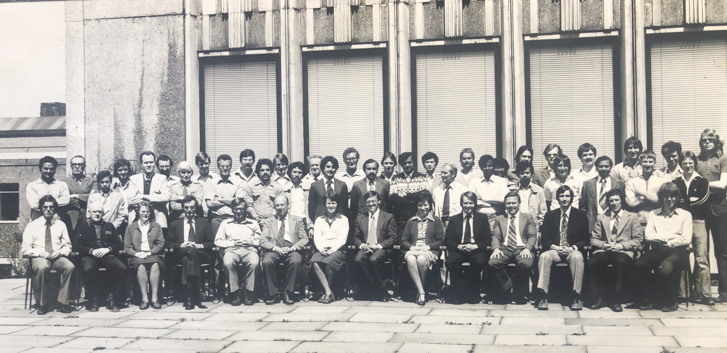
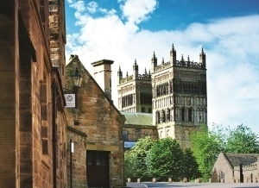
The first step in the carrier road map: Reserach Assistant
University Selcuk Konya (1977-1978)
The secon step in the carrier road map: Graduate studies abroad
Language School Cambridge, UK 1978-79
University of Durham, Department of Applied Physics and Electronics UK 1979-1982

Slide 10
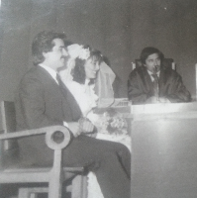
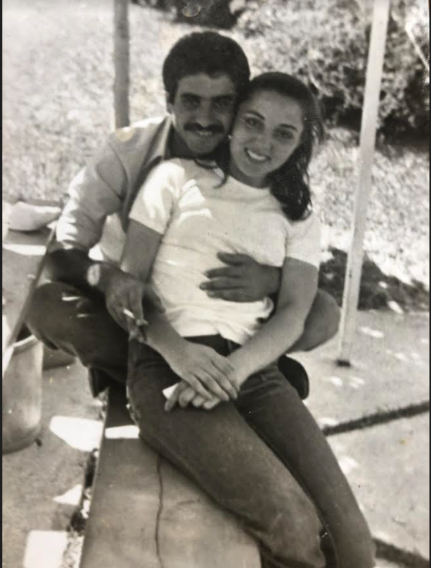
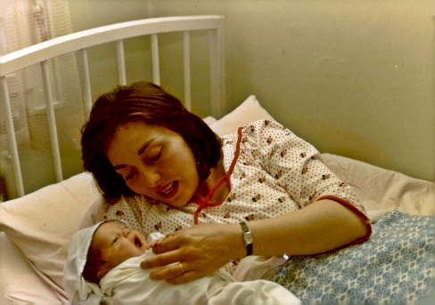
The biggest steps in life: a girl friend + an angament+ a marriage 1980 + First Child 1982

Slide 11
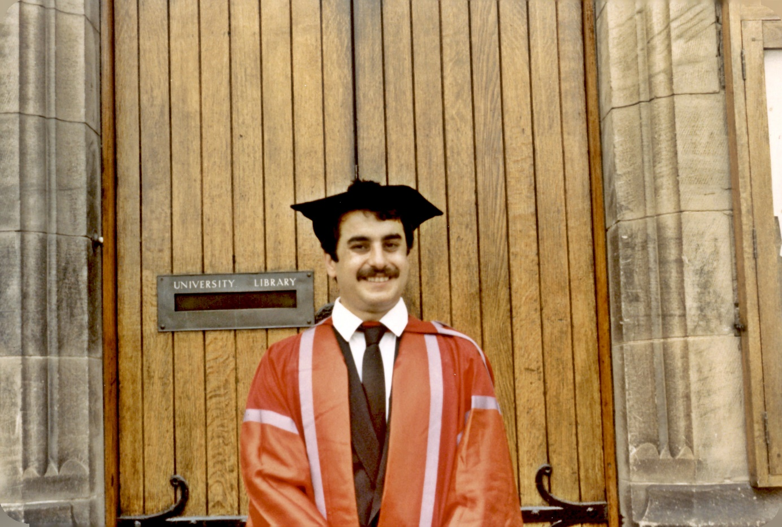
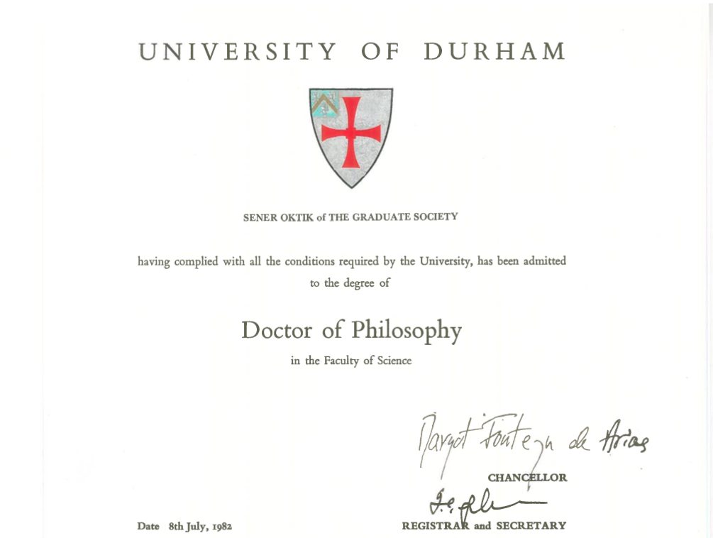
Doctor of Philosophy: University of Durham UK 1982

Slide 12
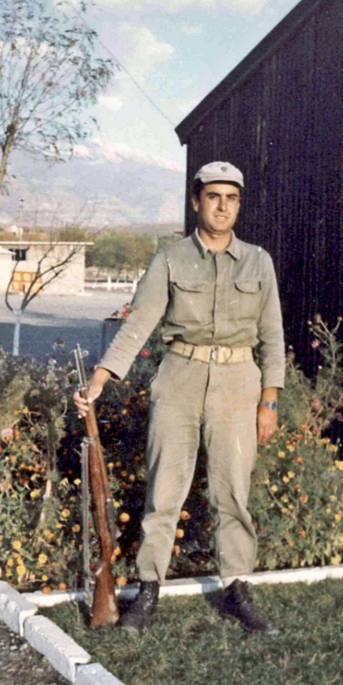
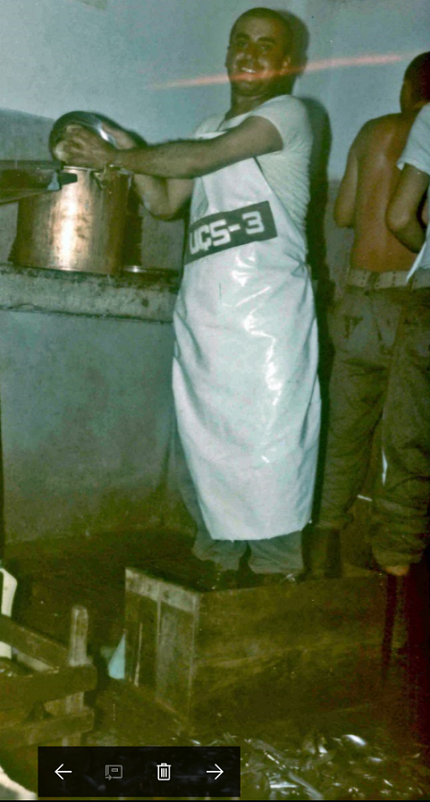
Compulsory army service 1984

Slide 13
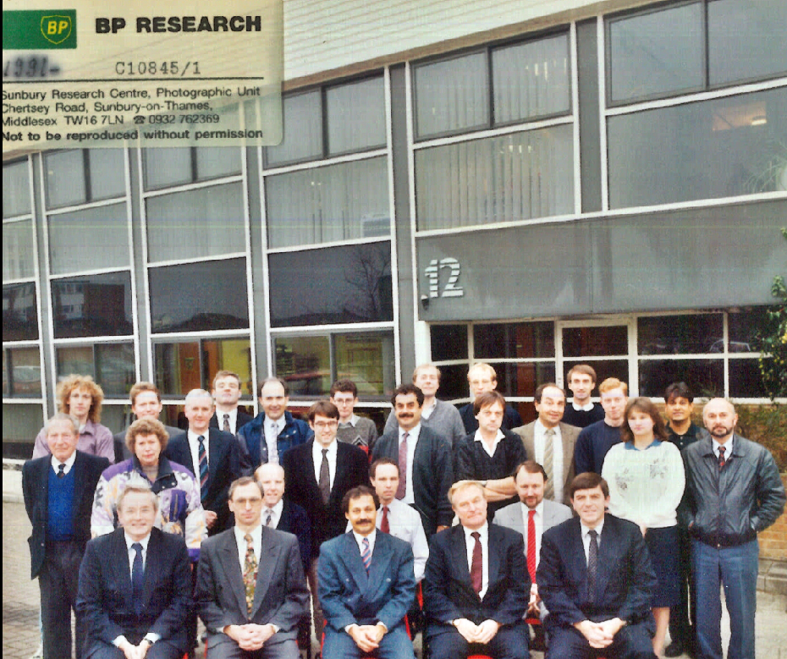
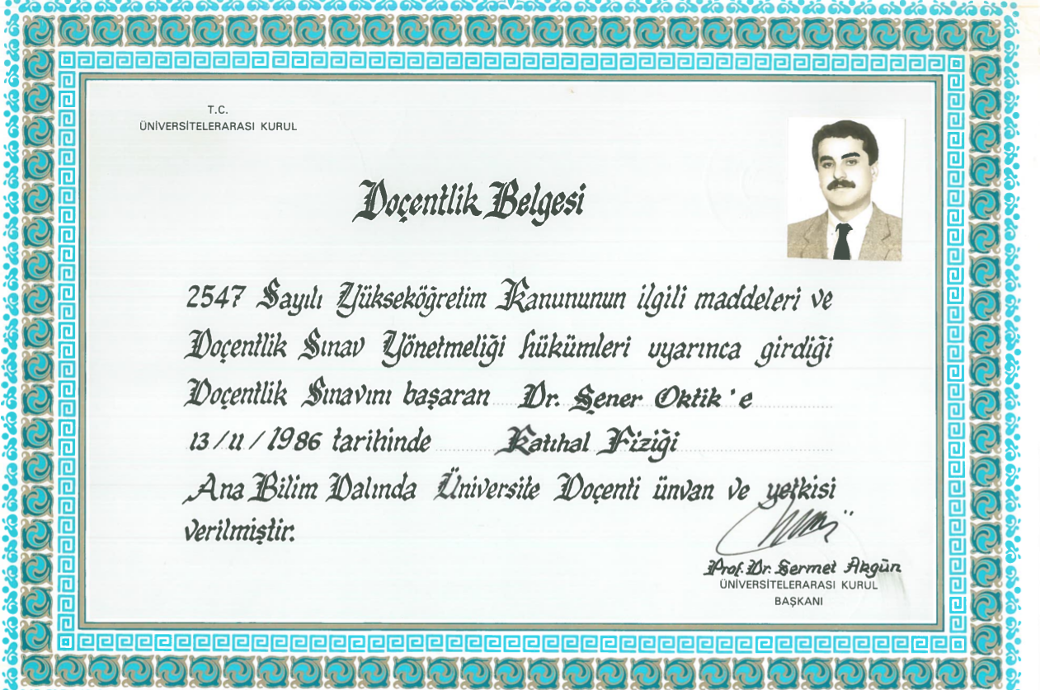
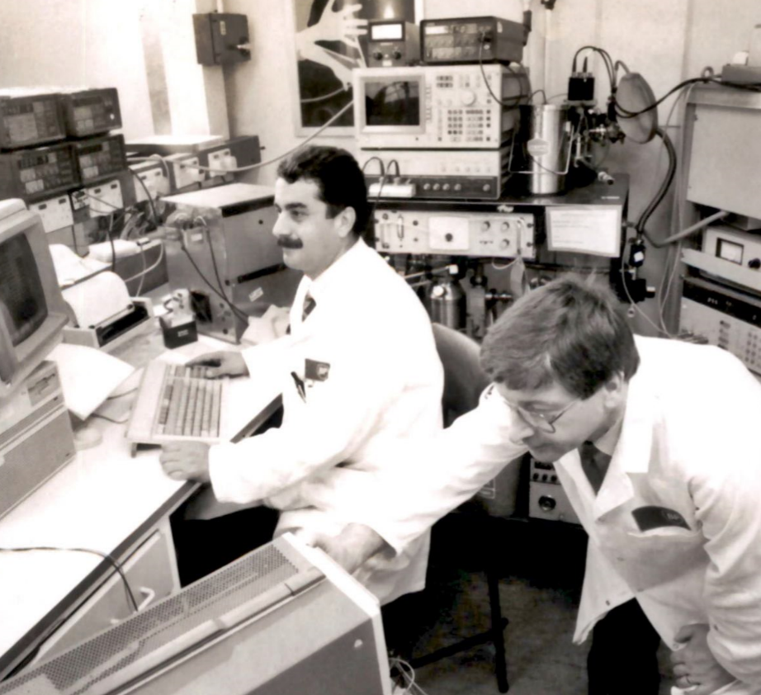
Associate Professor . Higher Education Council 1986
BP Research Center 1986-1995

Slide 14
Becoming Chancellor (Rector) of Muğla University) 2002-2010

Slide 15
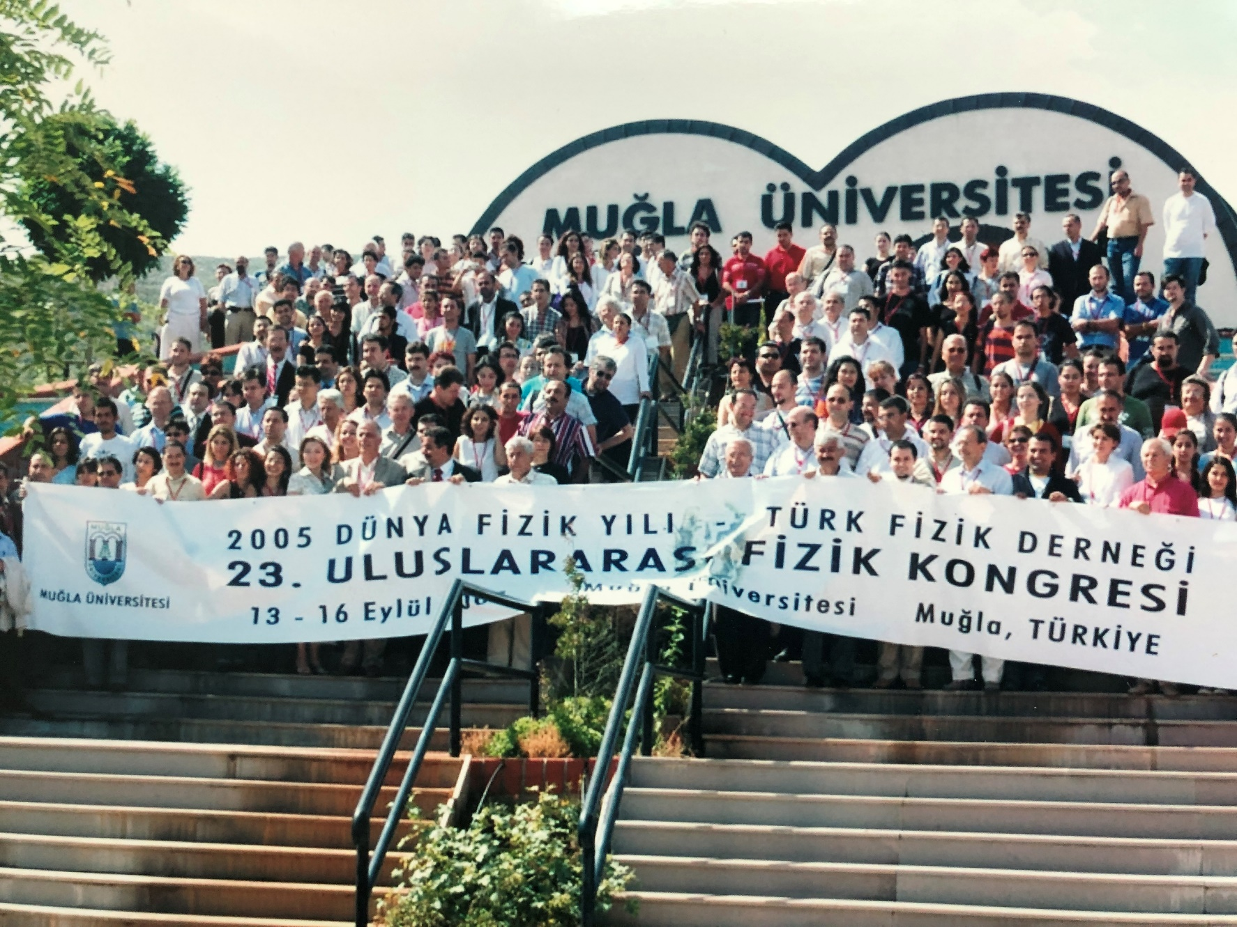
Mugla University organized 23 National Physics Congress at 2005 World Physics Yers (United Nations)

Slide 16
President of Rotary Club in Muğla City 2000

Slide 17
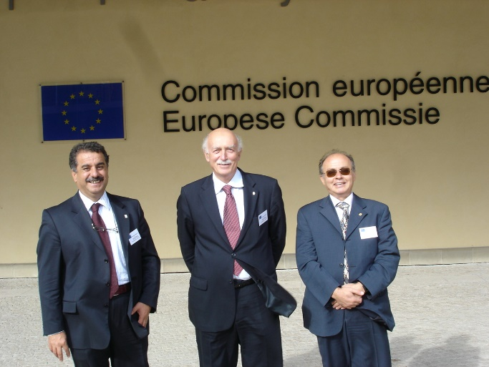
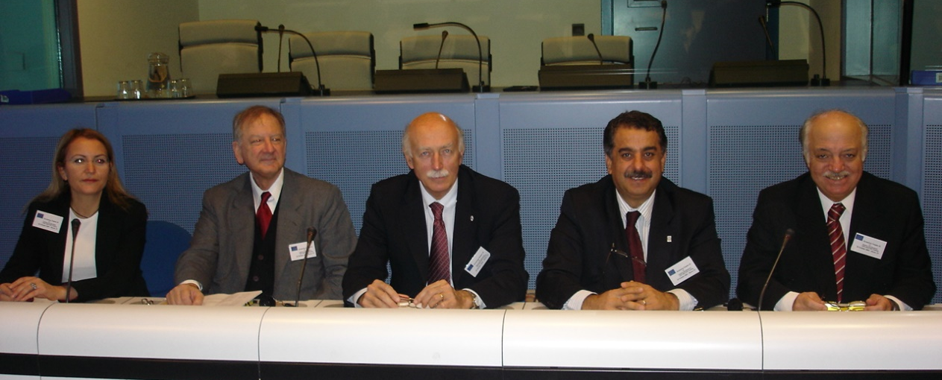
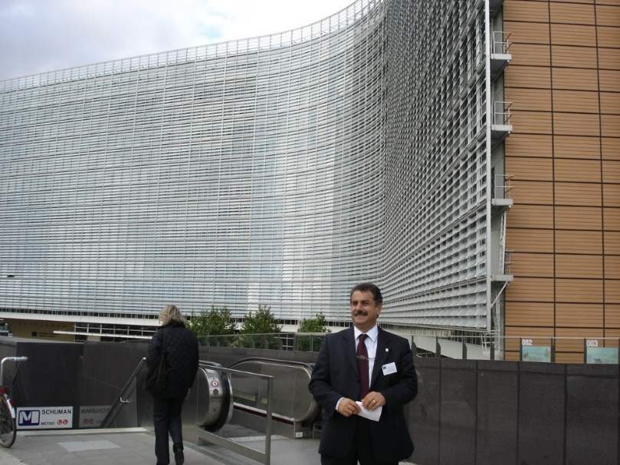
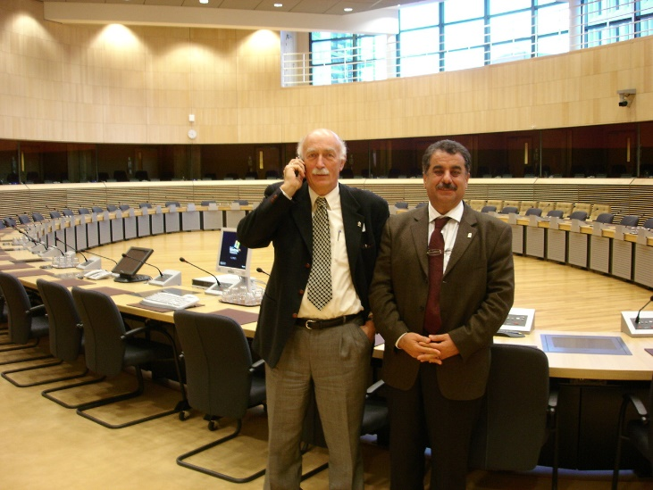
A Member of the Delegation for Accession of Turkey to the European Union (The Chapters 25 and 26) (2005-2006)

Slide 18
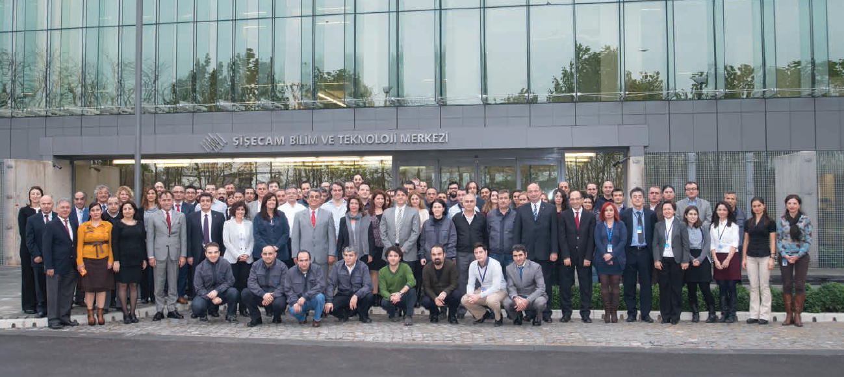
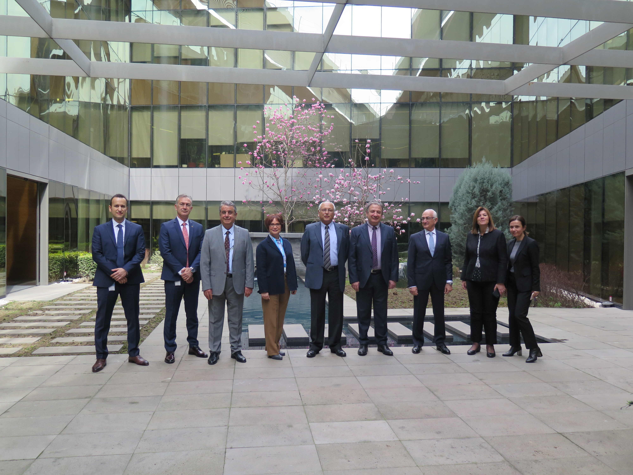
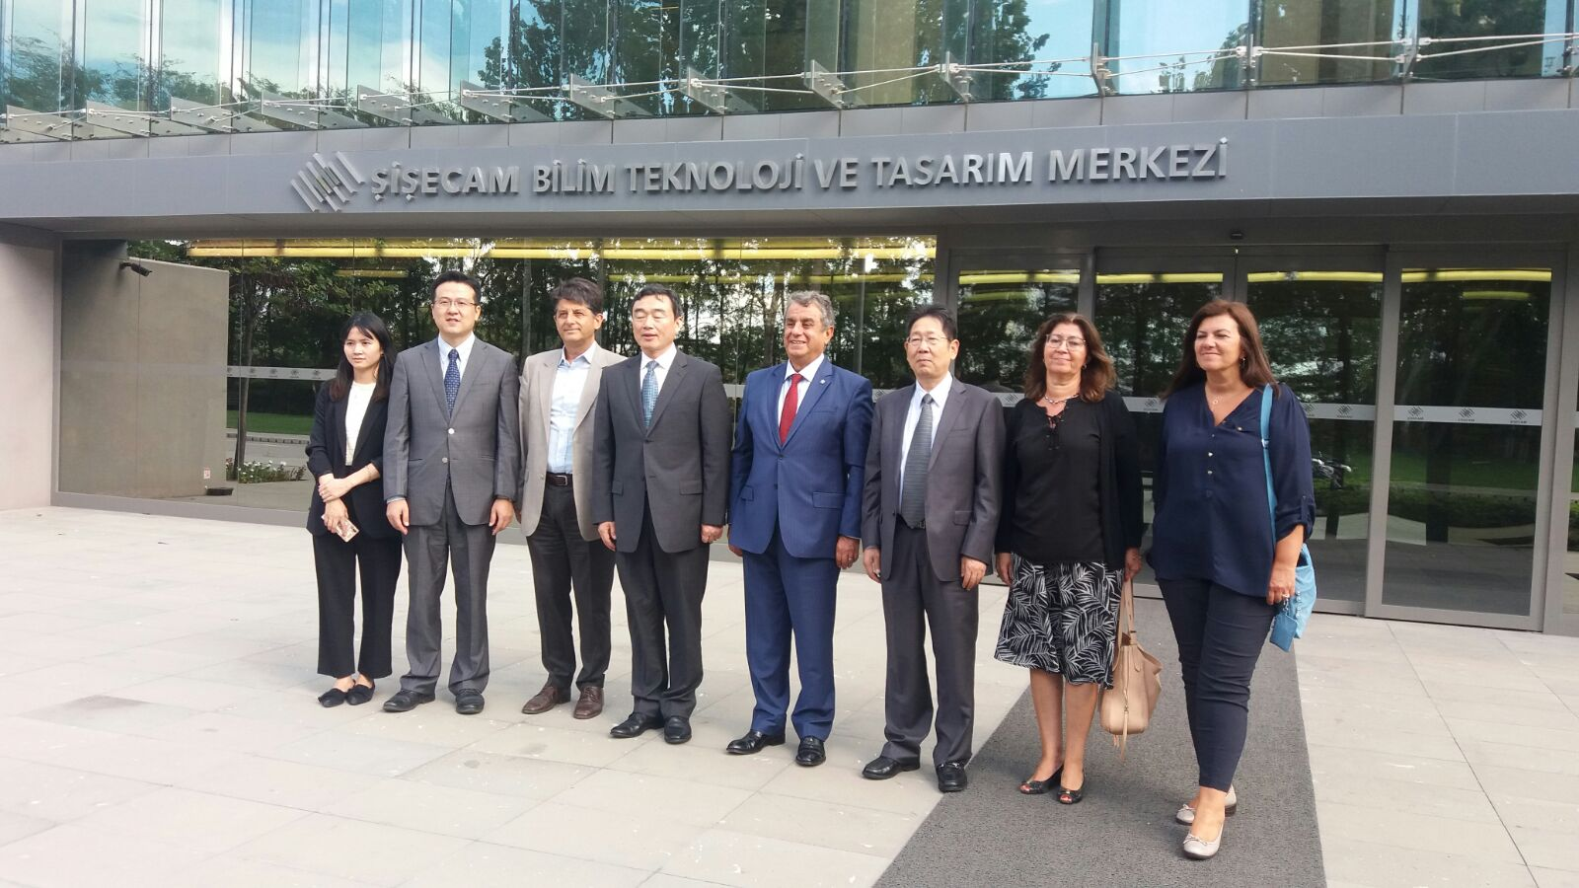
BUİLDING THE ŞİŞECAM RTD CENTER AND SERVING AS CHIEF TECHNOLOGY OFFICER 2012-2020
ŞİŞECAM SCIENCE , TECHNOLOGY AND DESIGN CENTER

