Slide 1
Shechtman International Leadership Award
An Award in honor of Dr. Dan Shechtman, whose unique life-time story of Scientific Conviction, Courage and Persistence brought him a very delayed success in revising the existing concepts of chemistry and shaping the future of an entire new branch of quasi-crystals, a success that culminated with being awarded the 2011 Nobel Prize in Chemistry.
Citation:
"For leadership through courage, conviction, persistence and willingness to break with the taboos and stereotypes in pioneering new ways of thinking that shape the future for a global sustainable development as per FLOGEN Sustainability Framework in the environment, economy and social points of view."

Slide 2
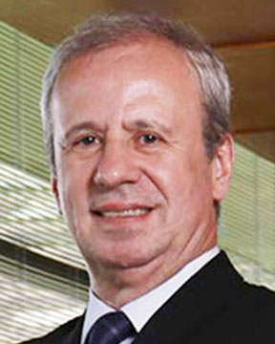
Sustainable Industrial Processing Summit
2024 STARS:
Sergio Leite de Andrade
Vice-President
Strategic Affairs
Usiminas, Brazil
Field: Iron & Steel
SHECHTMAN INTERNATIONAL LEADERSHIP AWARD
FLOGEN STARS OUTREACH

Slide 3
Mr. Sergio Leite de Andrade receiving the Shechtman International Leadership Award from Dr. Florian Kongoli at FLOGEN SIPS 2024

Slide 4
Dr. Florian Kongoli congratulating Mr. Sergio Leite de Andrade during the FLOGEN SIPS 2024 award ceremony

Slide 5
Mr. Sergio Leite de Andrade delivering an acceptance speech during the FLOGEN SIPS 2024 award ceremony

Slide 7
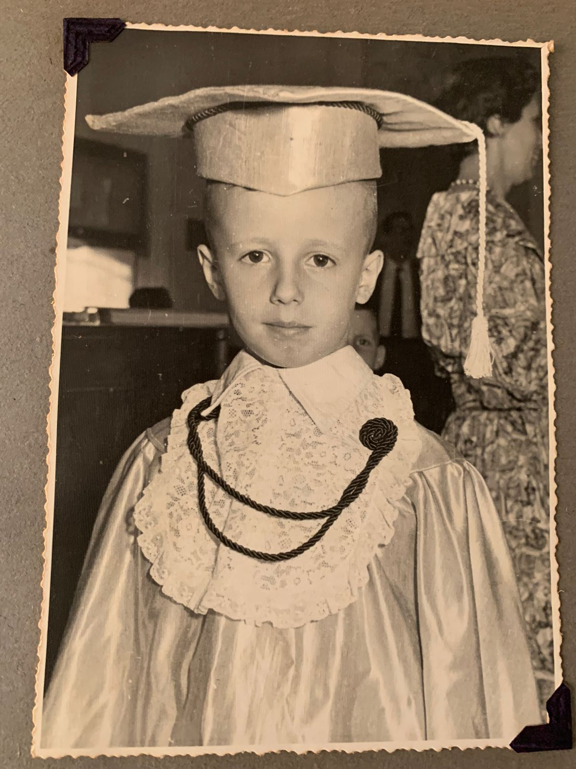

Slide 8
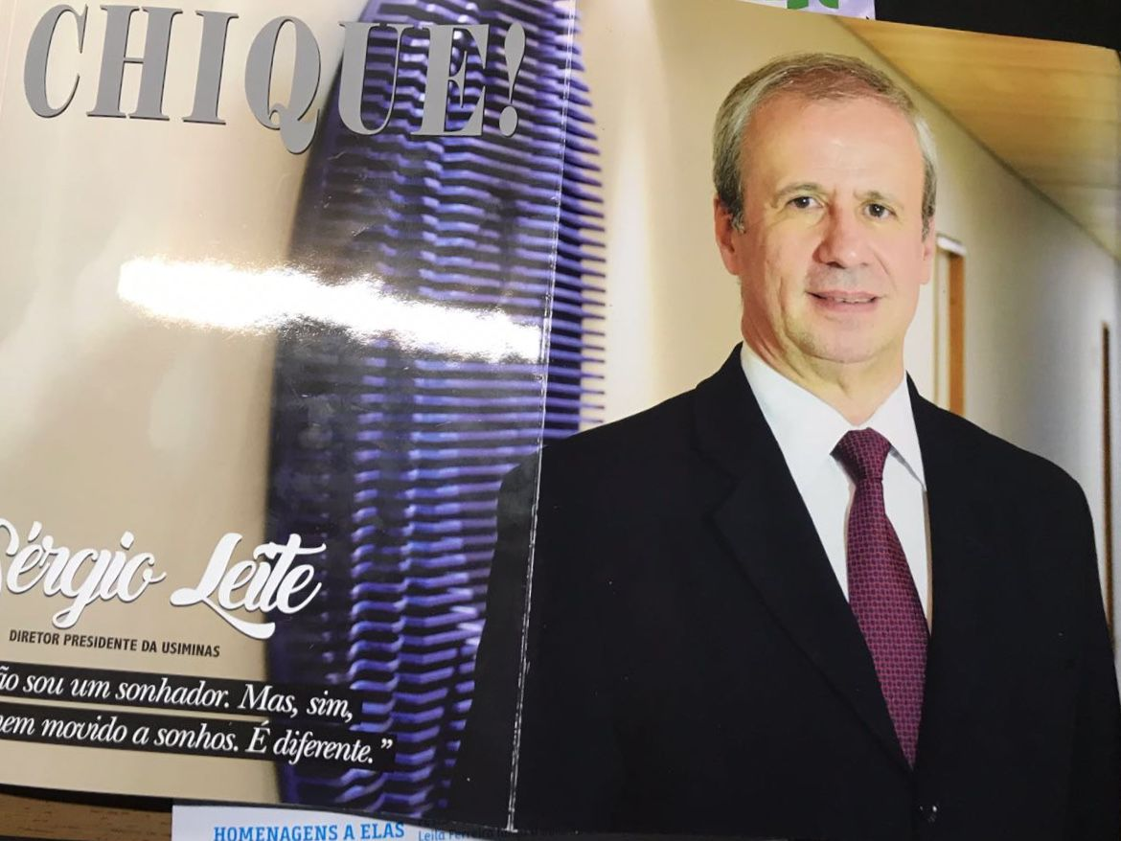

Slide 9
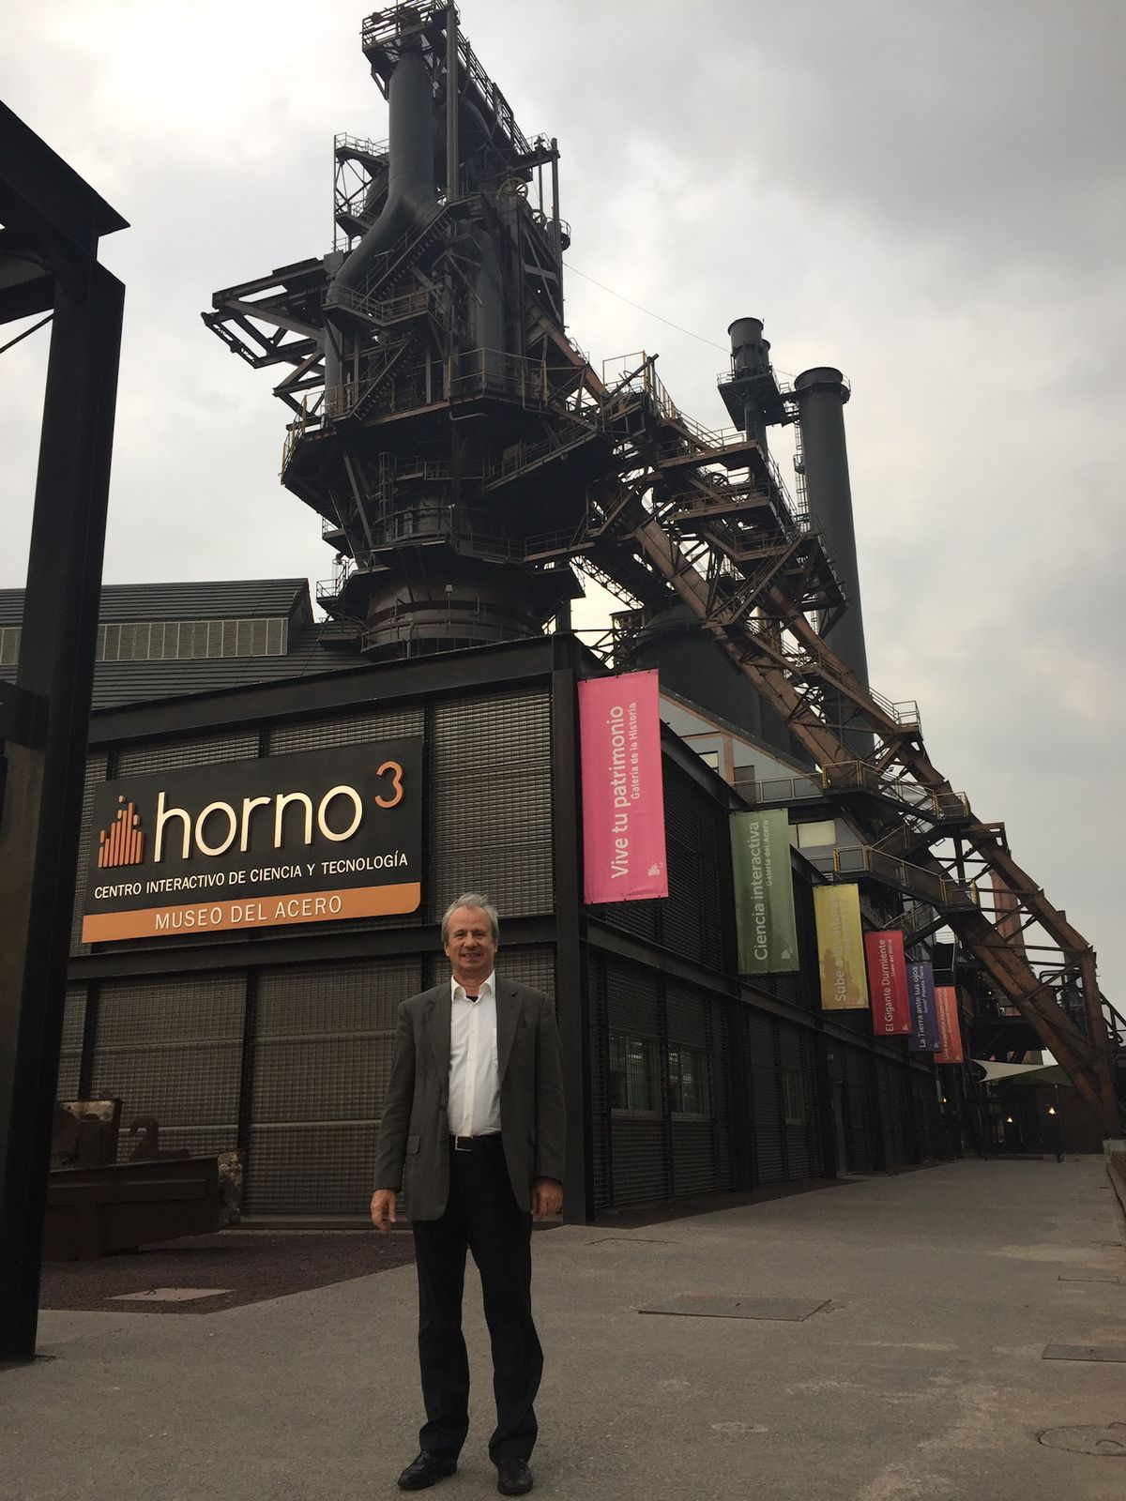

Slide 10
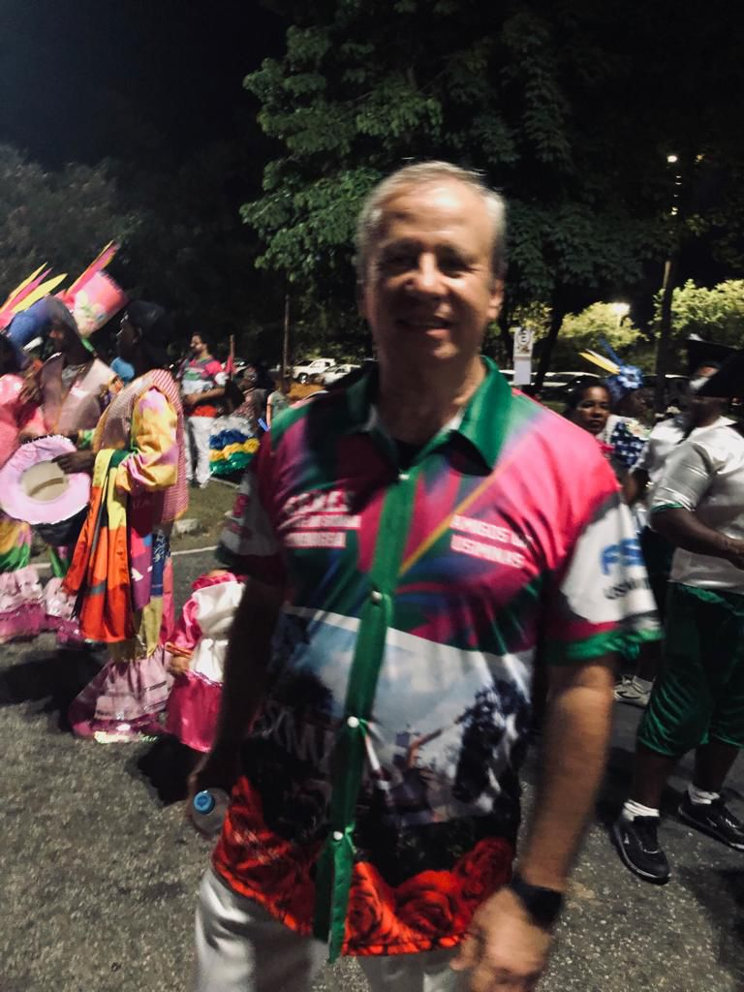

Slide 11
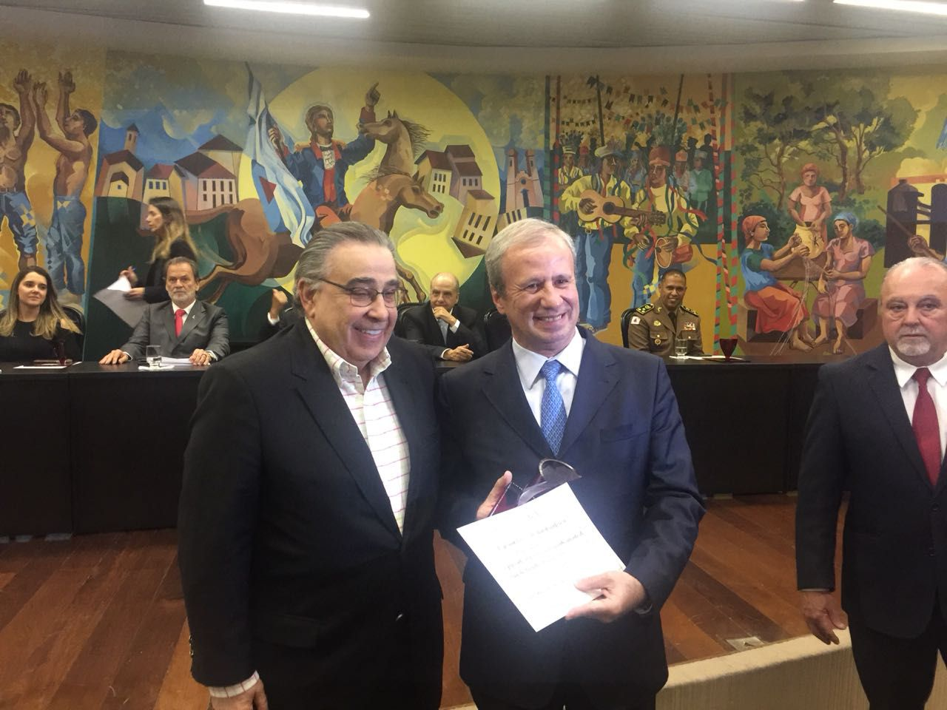

Slide 12
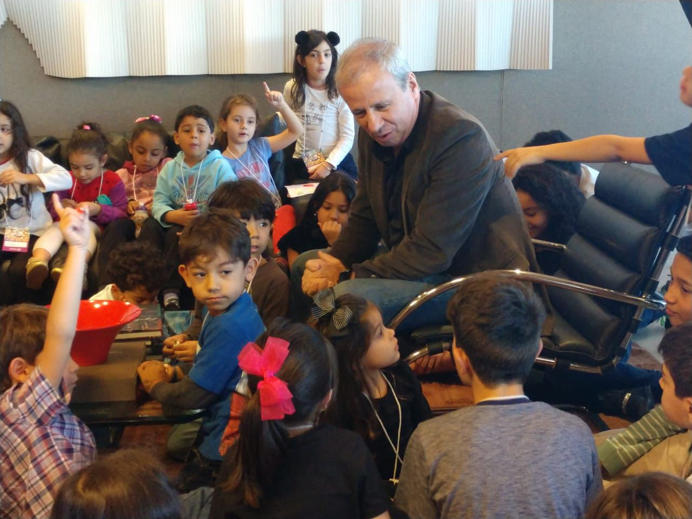

Slide 13
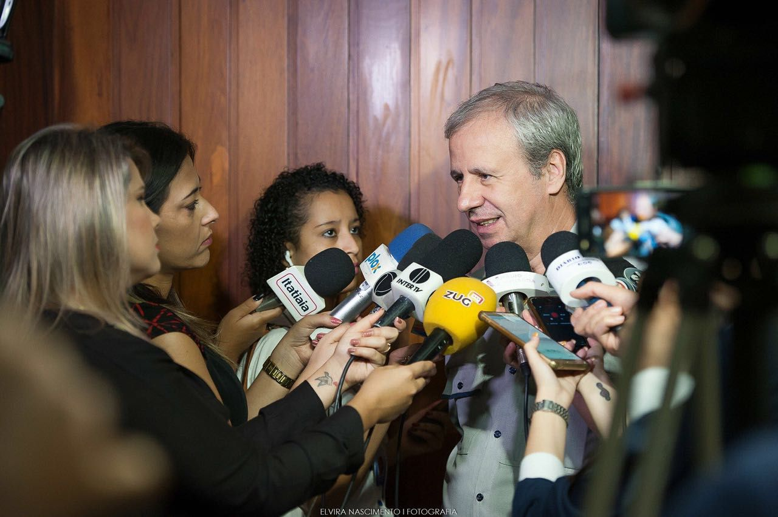

Slide 14
