Slide 1
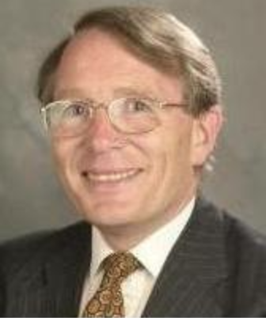
Fray International Sustainability Award
In honor of the distinguished work and lifetime achievements of Dr. Derek J. Fray, Emeritus Professor, University of Cambridge, UK whose illustrious biography includes among others almost 400 scientific papers, approximately 179 patents arising from 62 families of patents and several Fellowships of some of the most prestigious professional societies around the world.
Citation:
Politics : "For Leadership in developing new advanced public policy frameworks related to the efficiency of mineral and metal resources for a global sustainable development"
Corporations: "For Leadership in developing and applying new innovative business plans and operation technologies for a sustainable development of the company in the environment, economy and social points of view"
Academia: " For Leadership in developing new technologies that contribute to a global sustainable development as per FLOGEN Sustainability Framework in the environment, economy and social points of view "

Slide 2
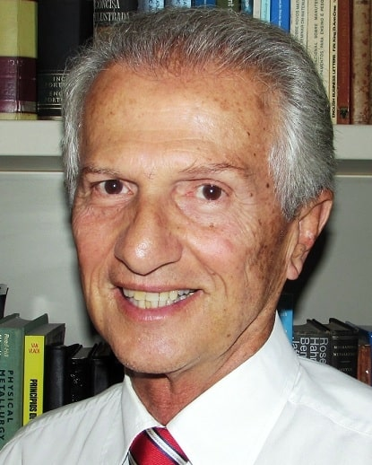
Sustainable Industrial Processing Summit
2024 STARS:
Sérgio Neves Monteiro
Professor
Military Institute of Engineering (IME), Brazil
Field: Composite, Ceramic & Nano Materials
FRAY INTERNATIONAL SUSTAINABILITY AWARD
FLOGEN STARS OUTREACH

Slide 3
Dr. Sergio Monteiro receiving the Fray International Sustainability Award from Dr. Florian Kongoli at FLOGEN SIPS 2024

Slide 4
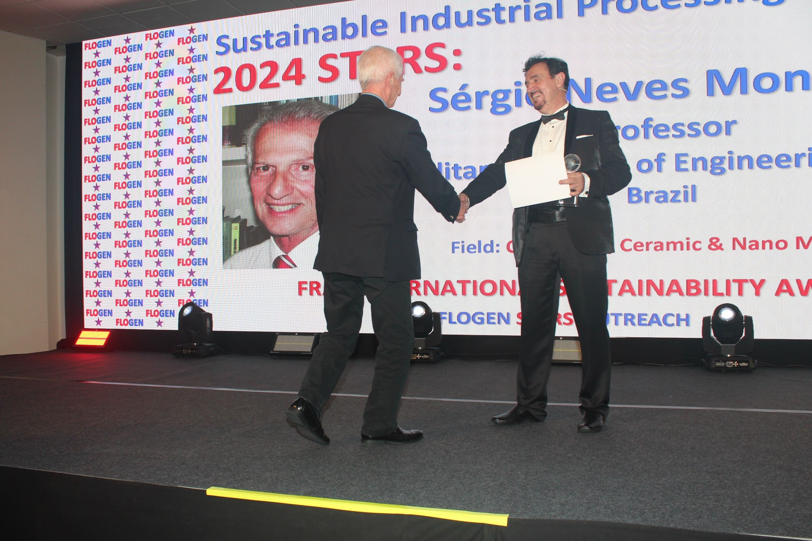
Dr. Florian Kongoli congratulating Dr. Sergio Monteiro during the FLOGEN SIPS 2024 award ceremony

Slide 5
Dr. Sergio Monteiro delivering an acceptance speech during the FLOGEN SIPS 2024 award ceremony

Slide 6
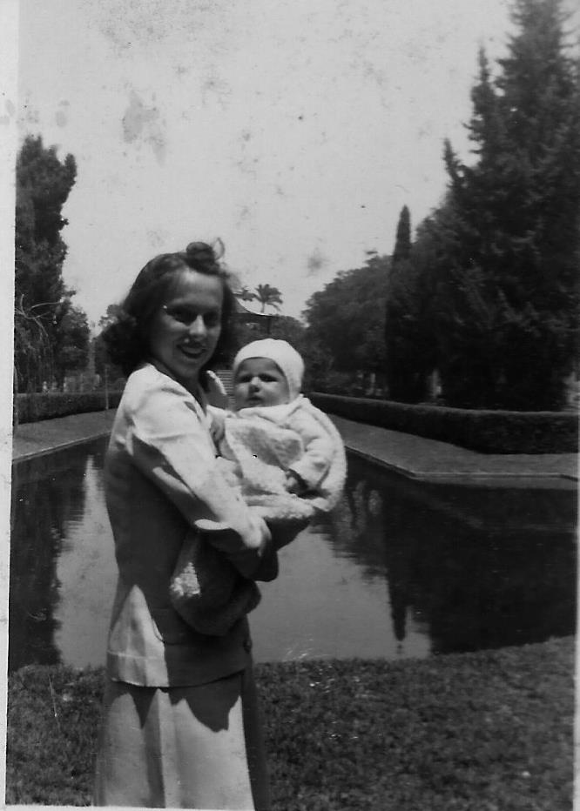
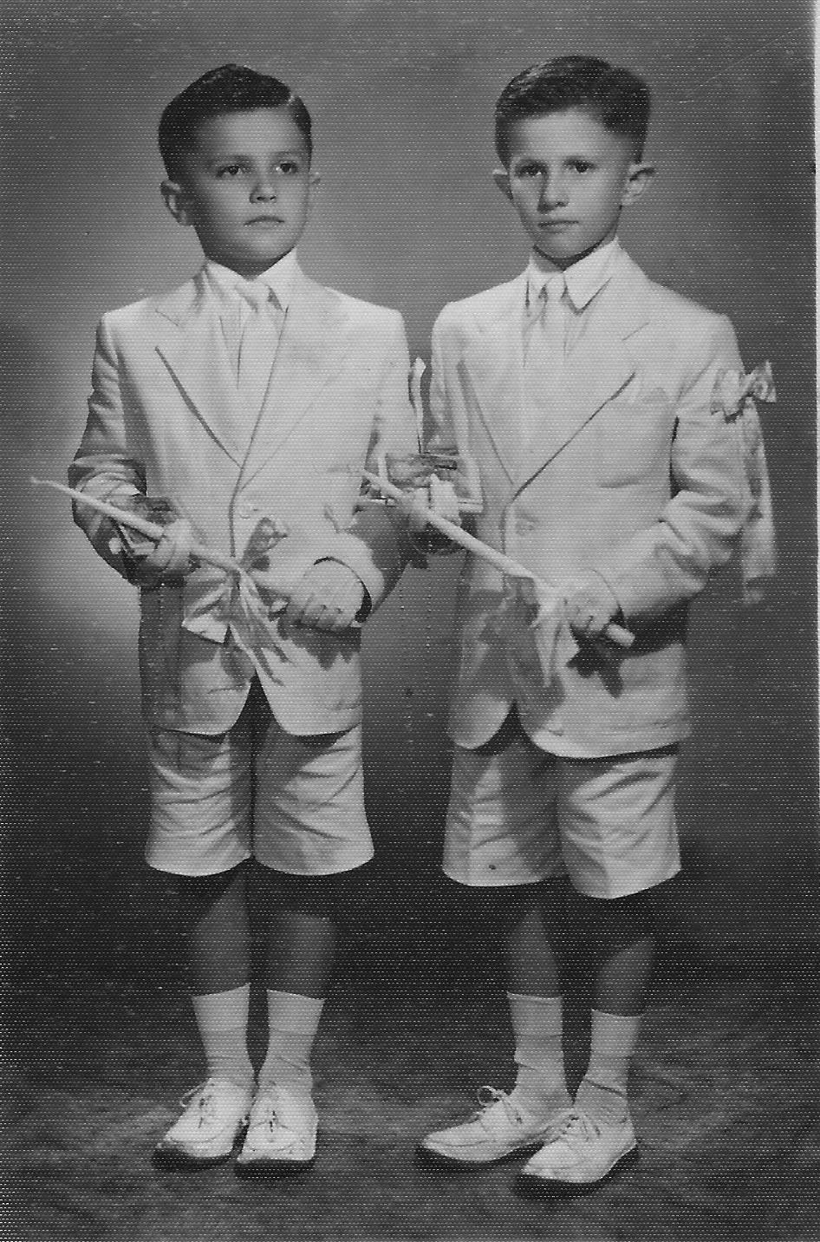
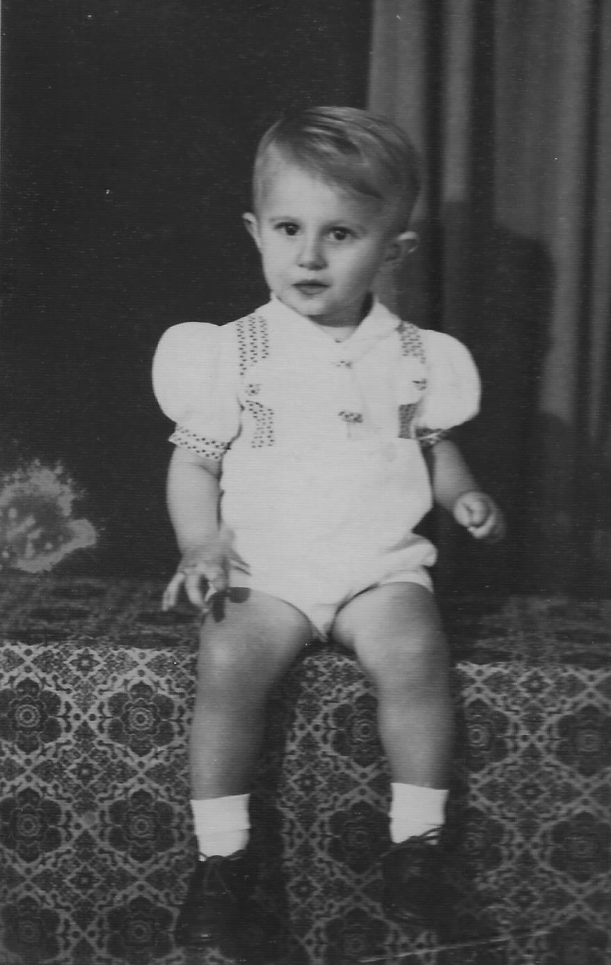
2 years old in Rio
Recently born in mother’s hands
First Communion

Slide 7
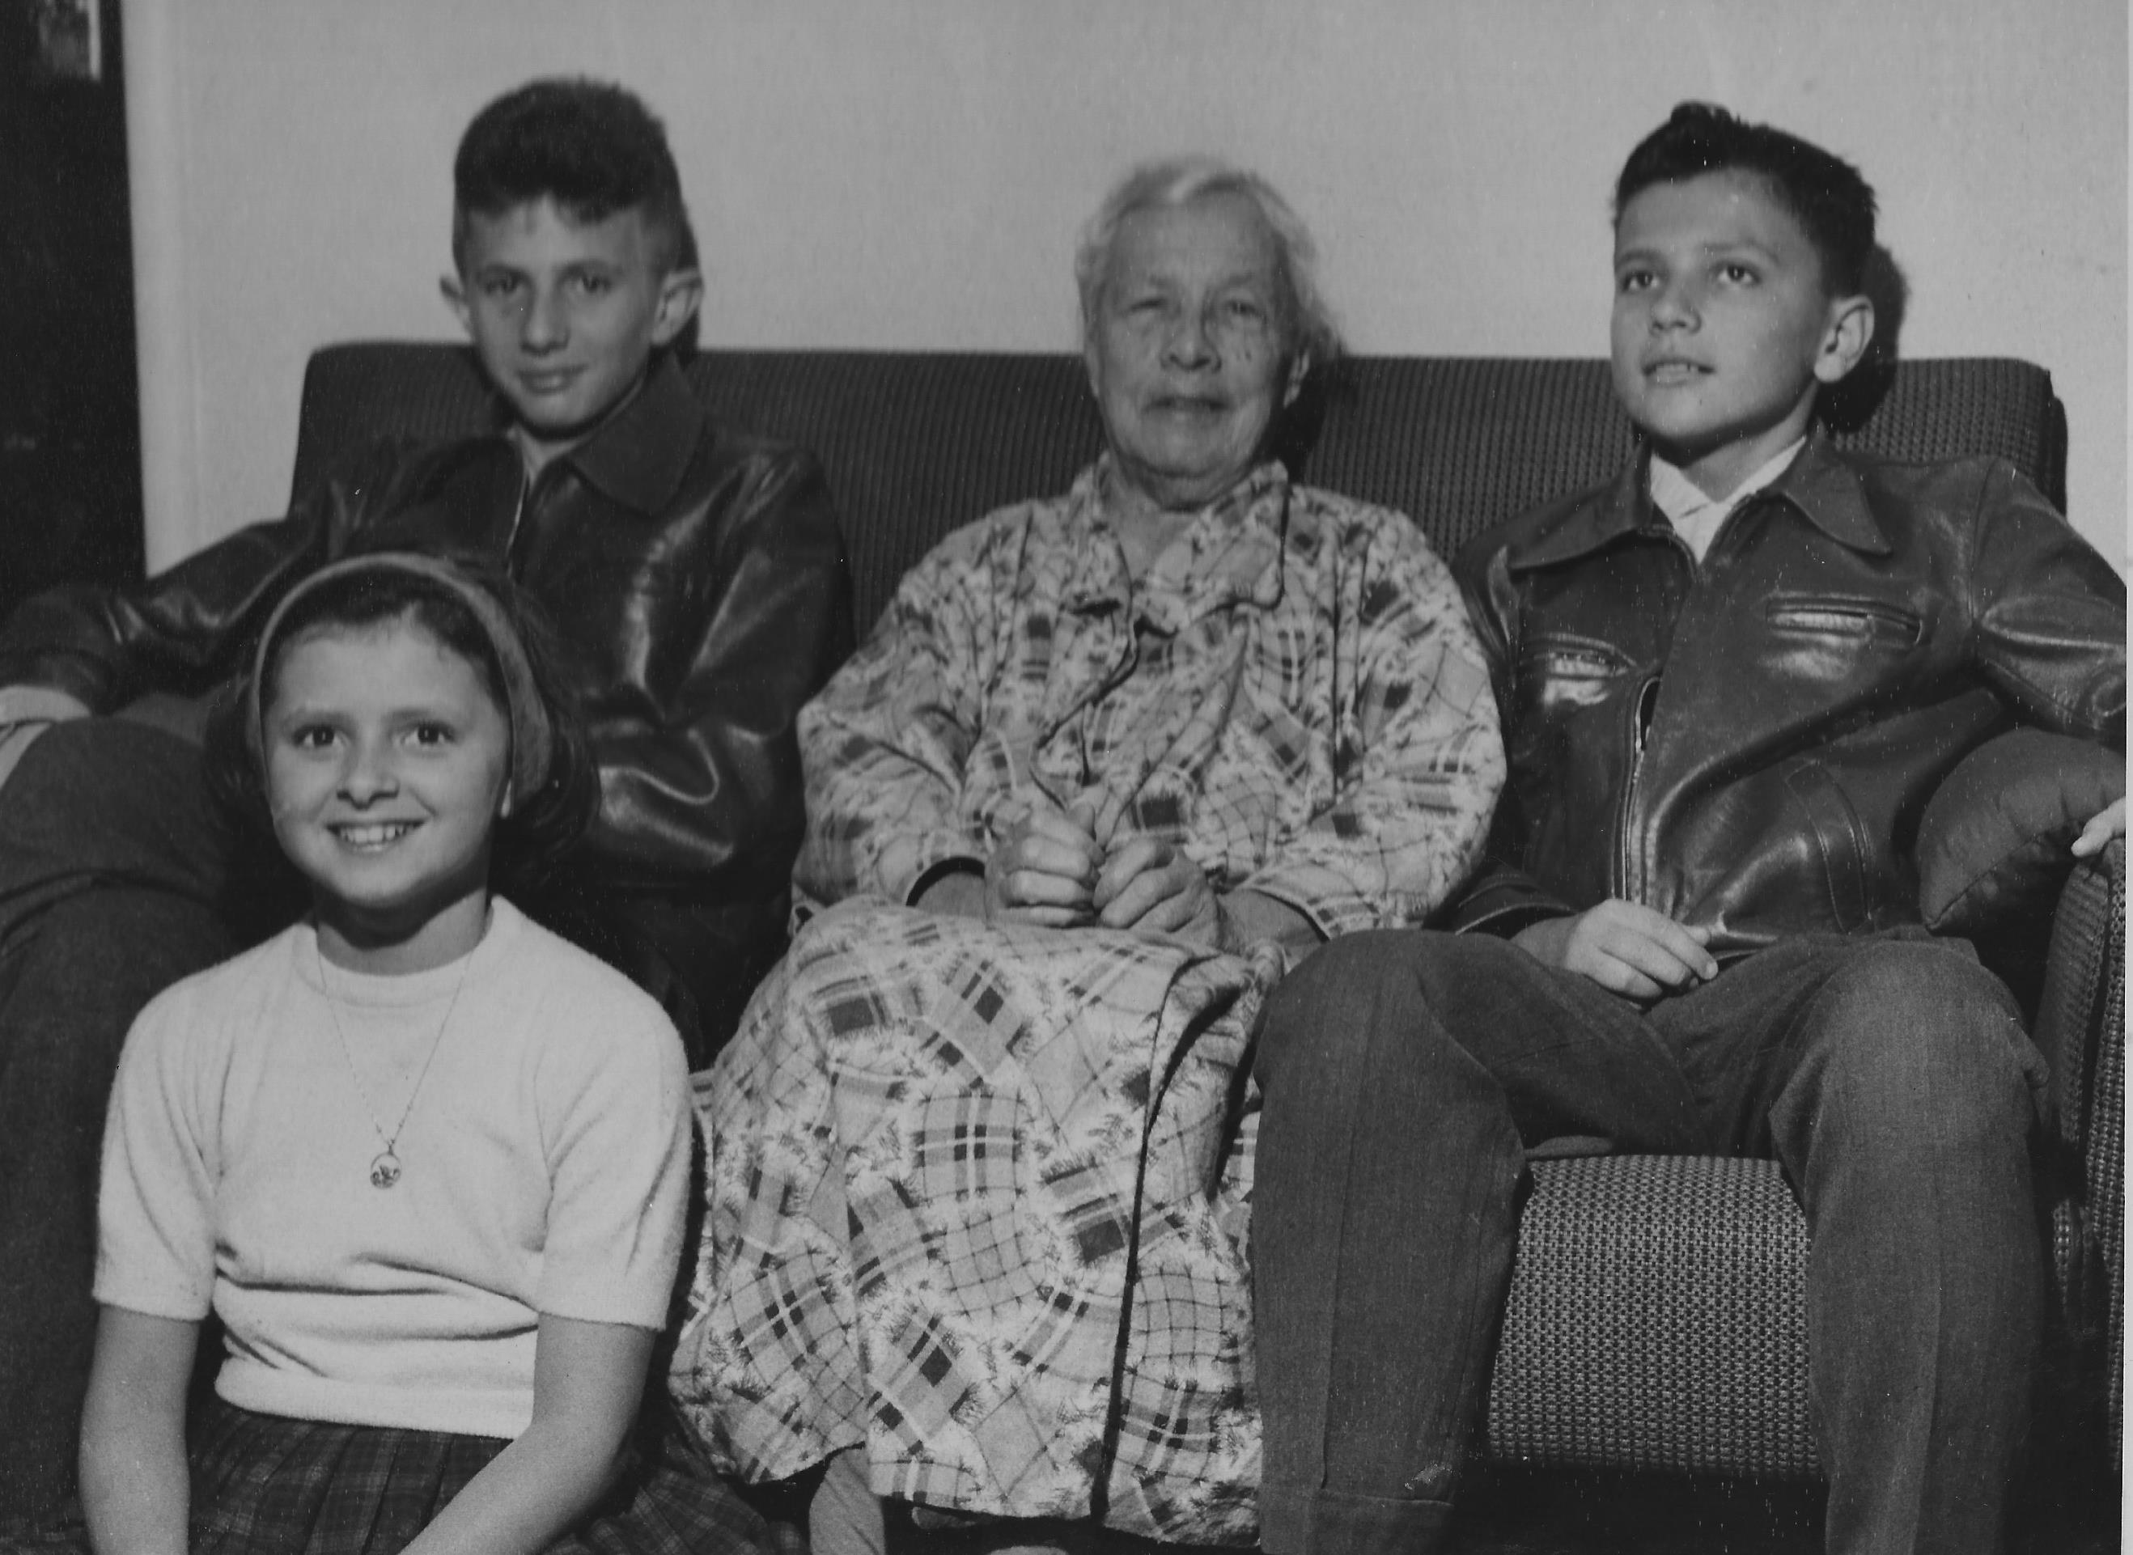
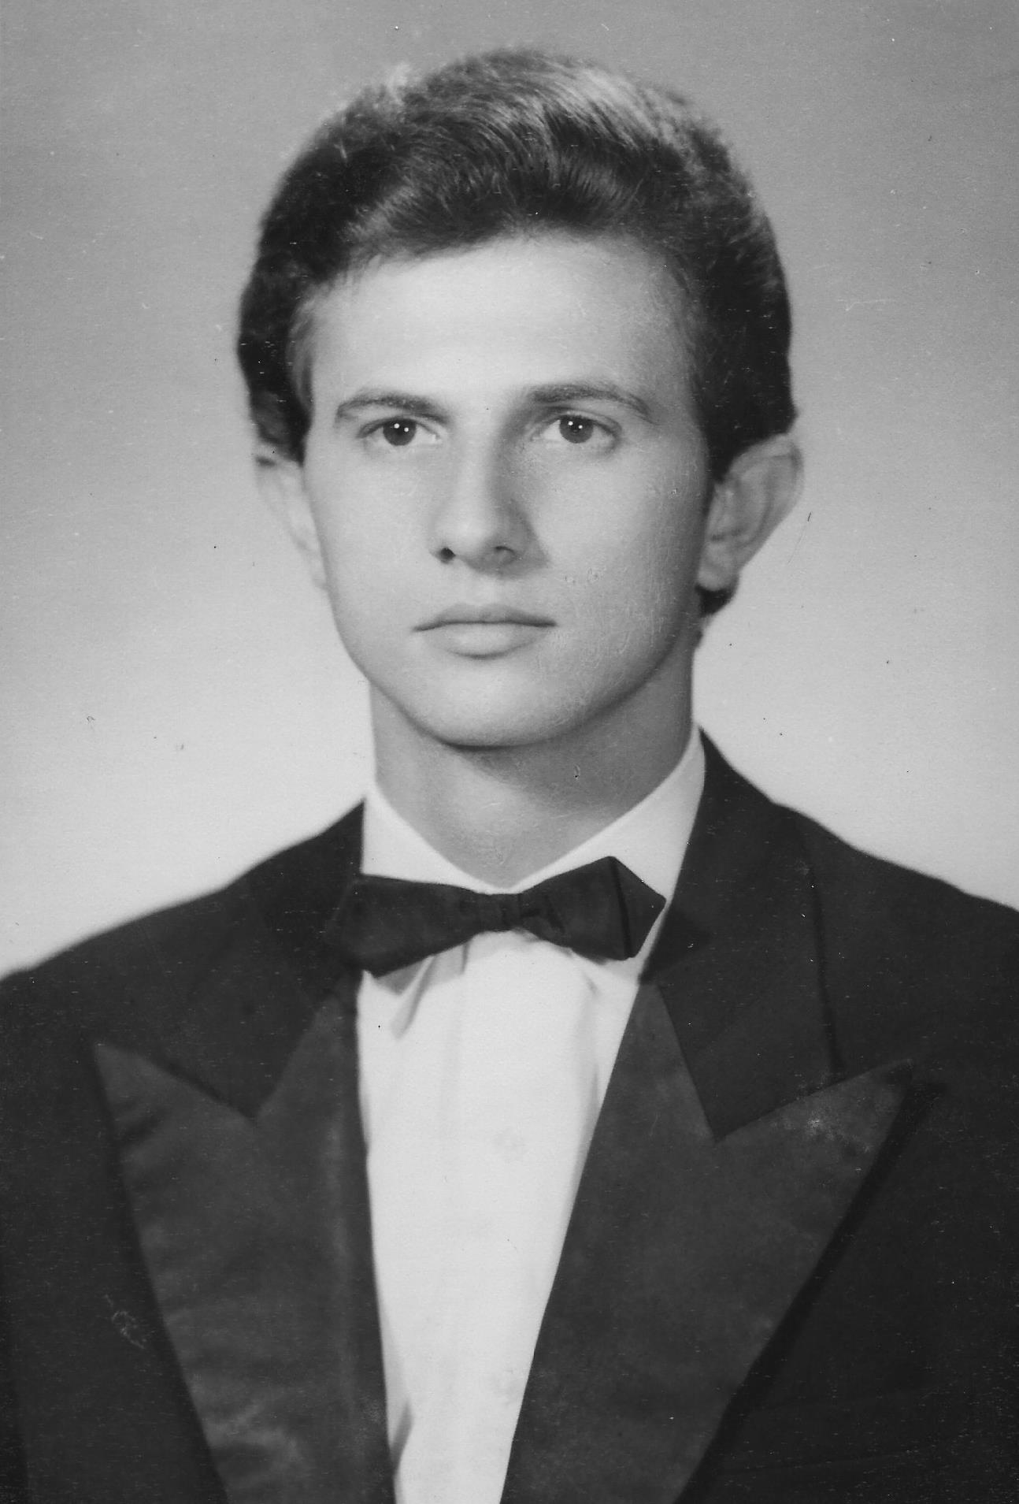
11 years old with grandmother
19 years old, Highschool graduation

Slide 8
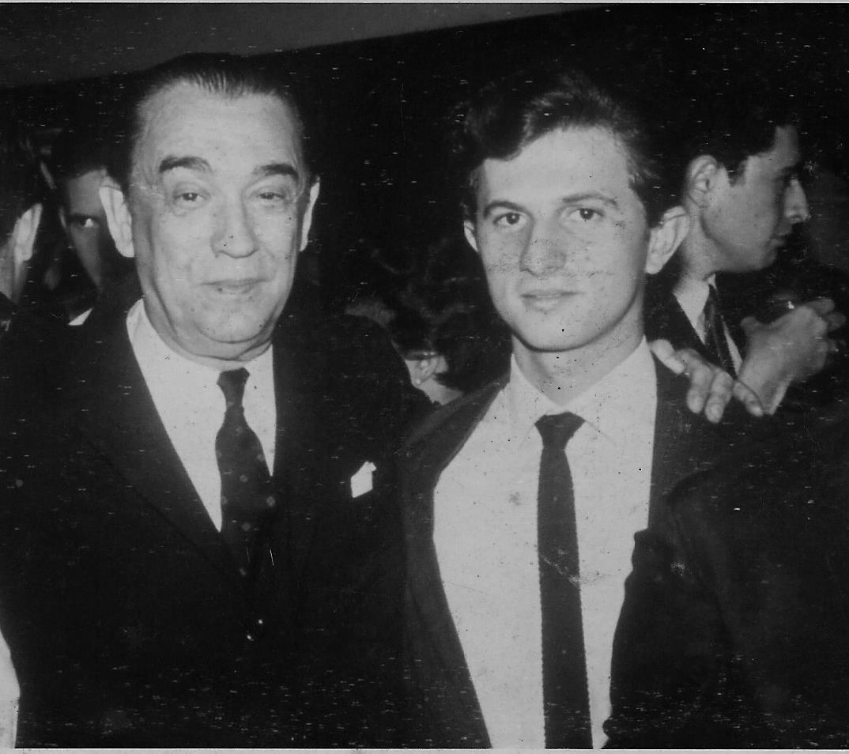
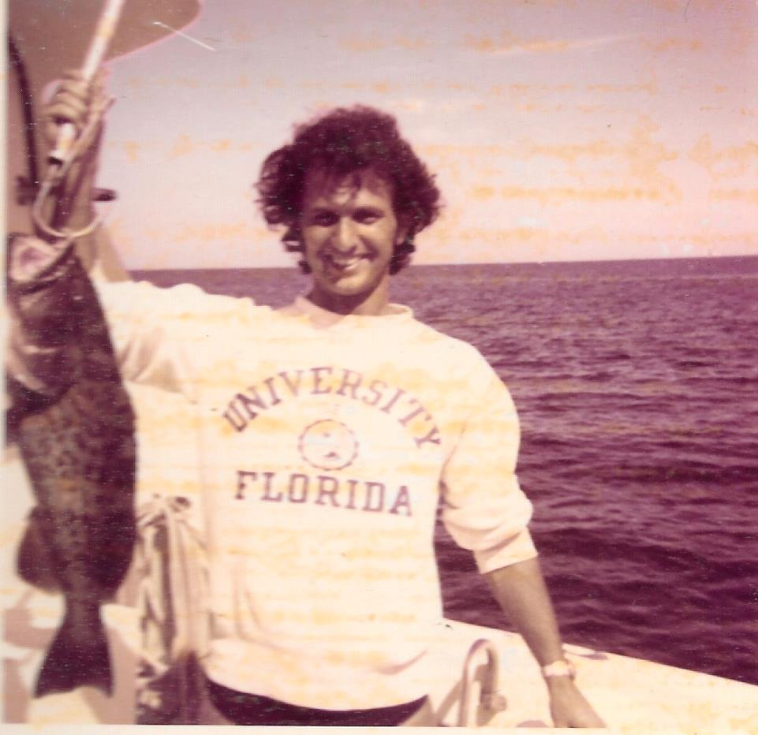
25 years old, MSc graduate student, University of Florida
24 years old, with former Brazilian President Juscelino
Kubistchek

Slide 9
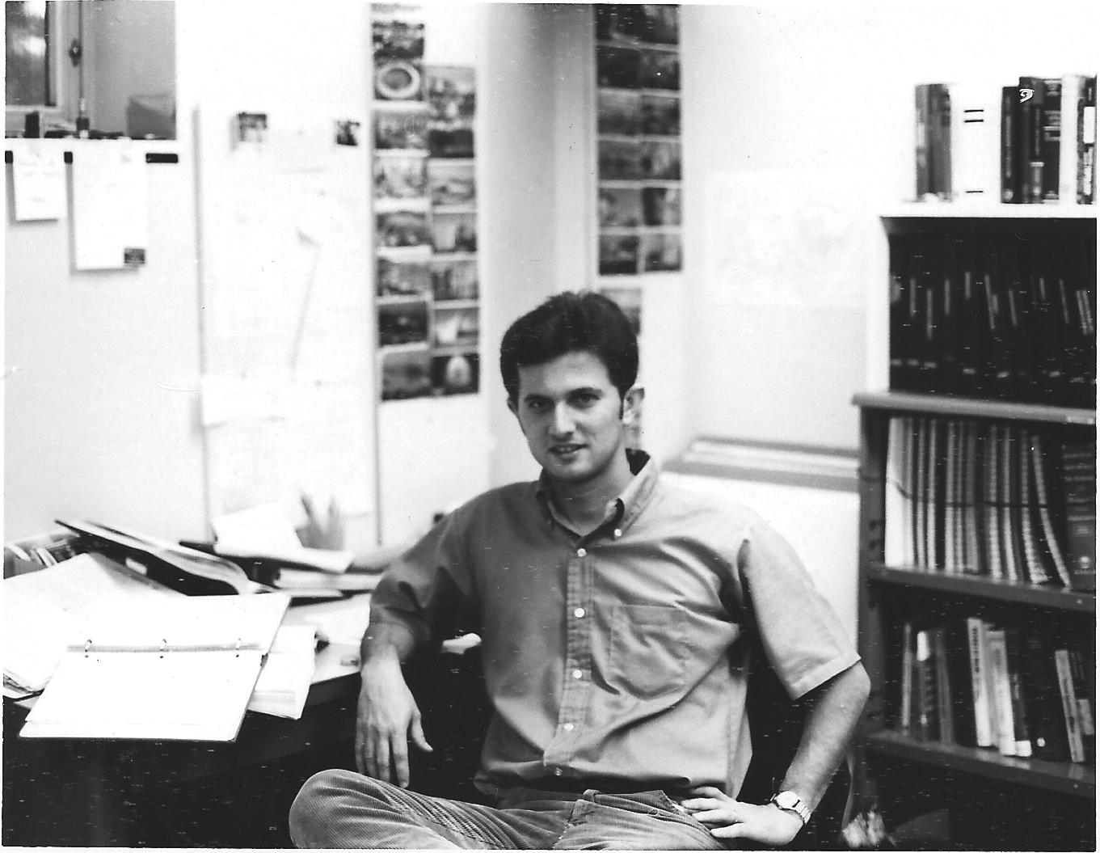
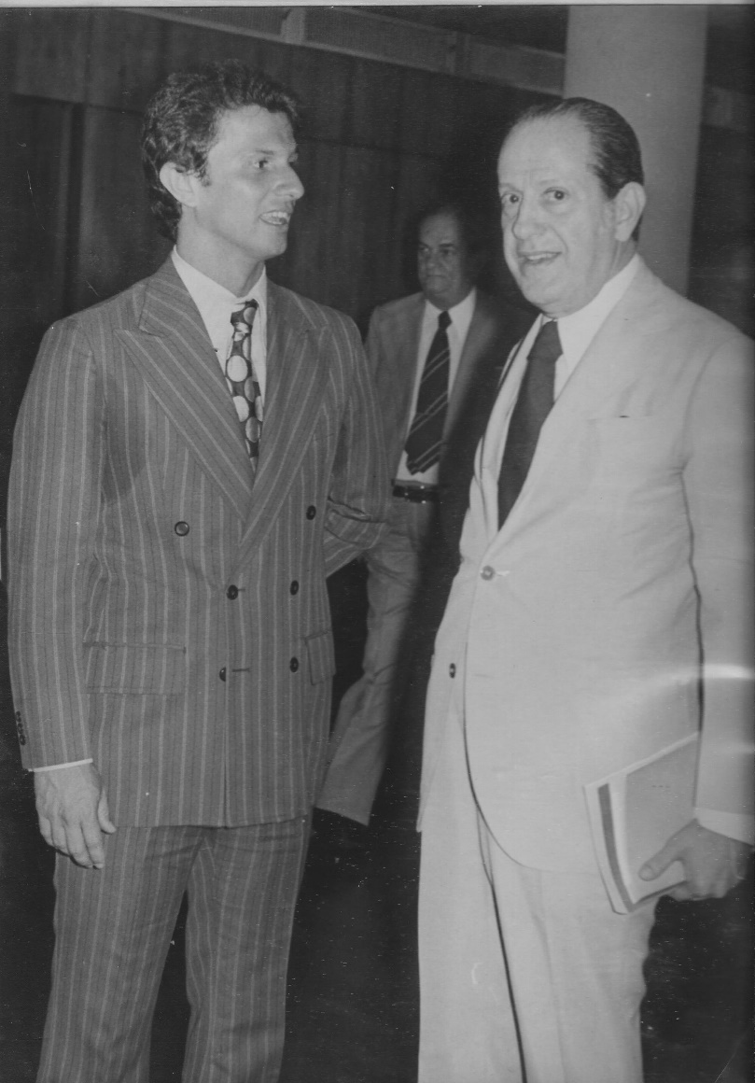
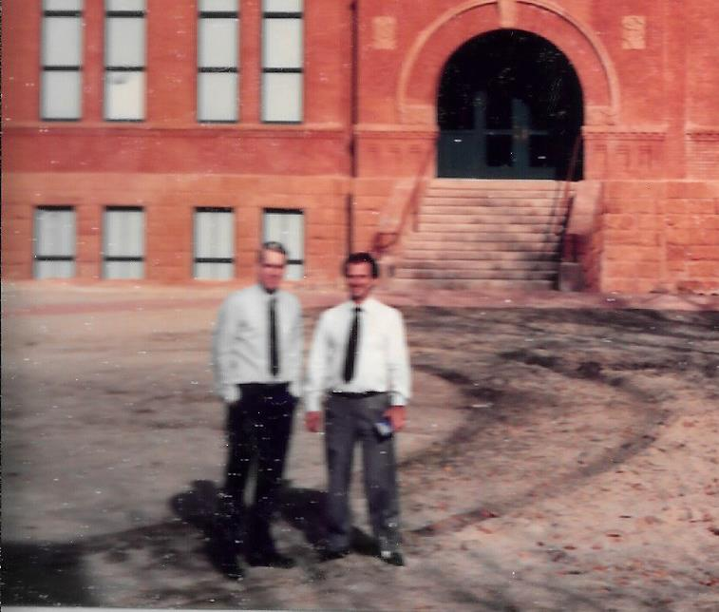
29 years old, PhD student at University of Florida
38 years old, visiting Colorado School of Mines with Prof. Matlock
35 years old, vice rector for graduate courses and research UFRJ with Rector

Slide 10
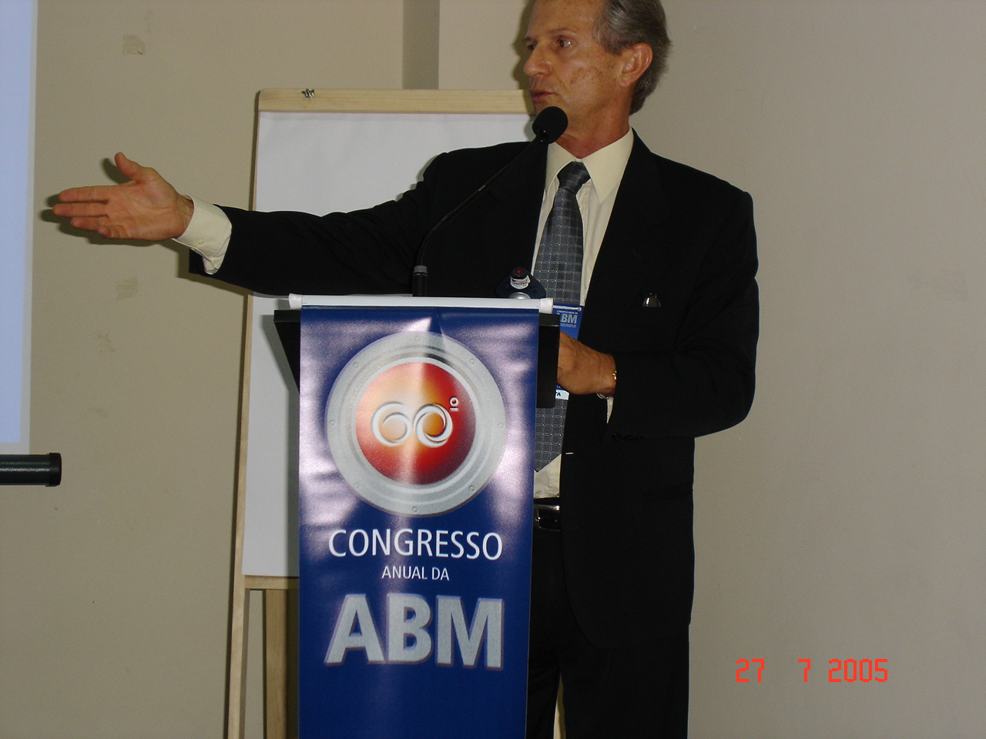
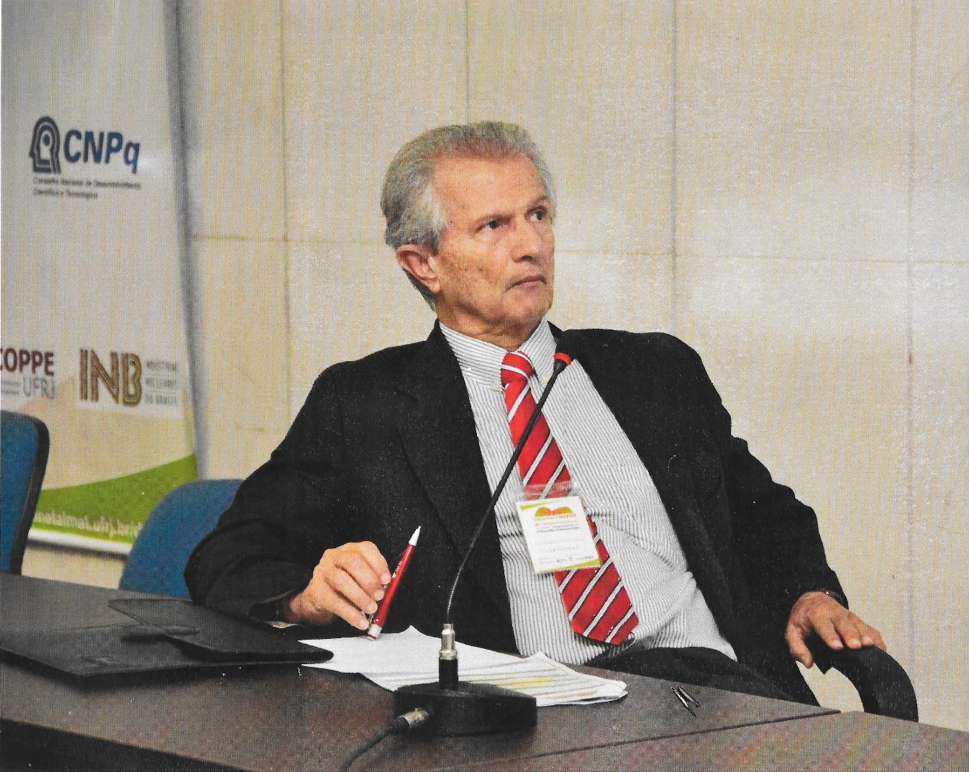
67 years old, Brazilian research council meeting
62 years old, ABM Congress

Slide 11
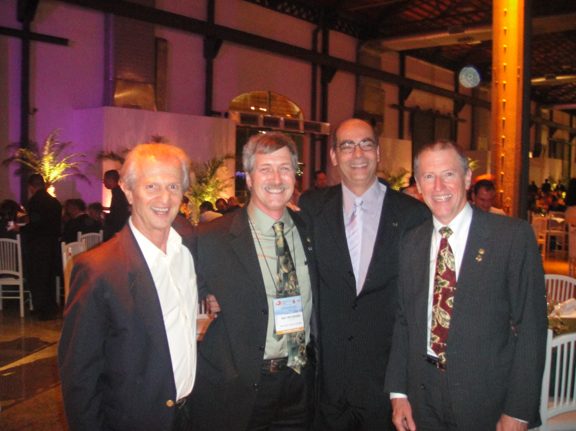
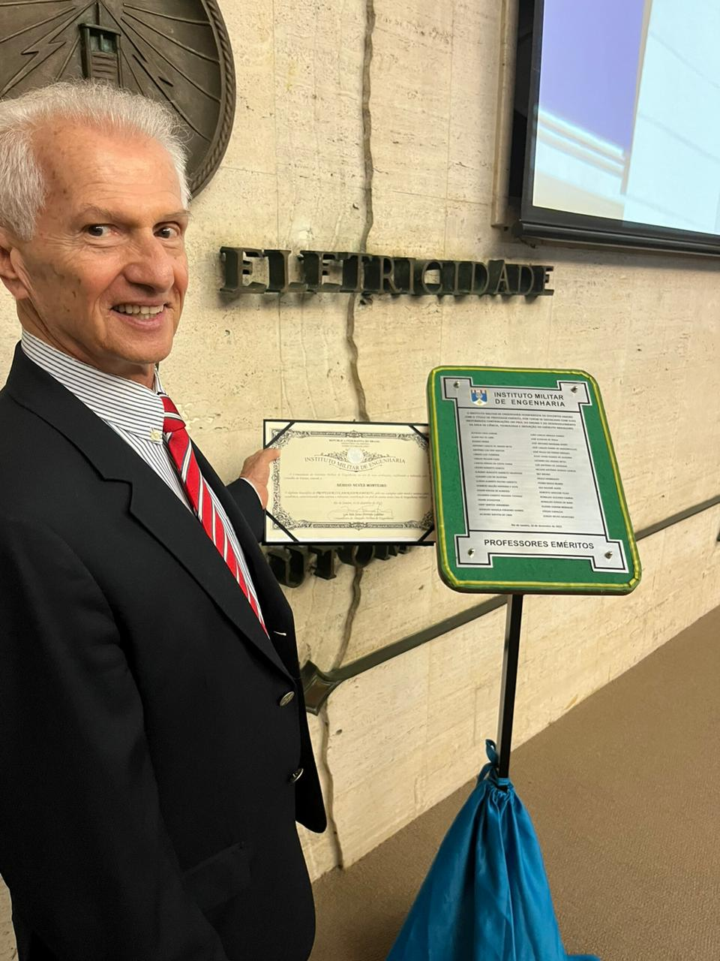
67 years old, TSM-ABM joint conference in Rio
75 years old, best paper award recipient

Slide 12
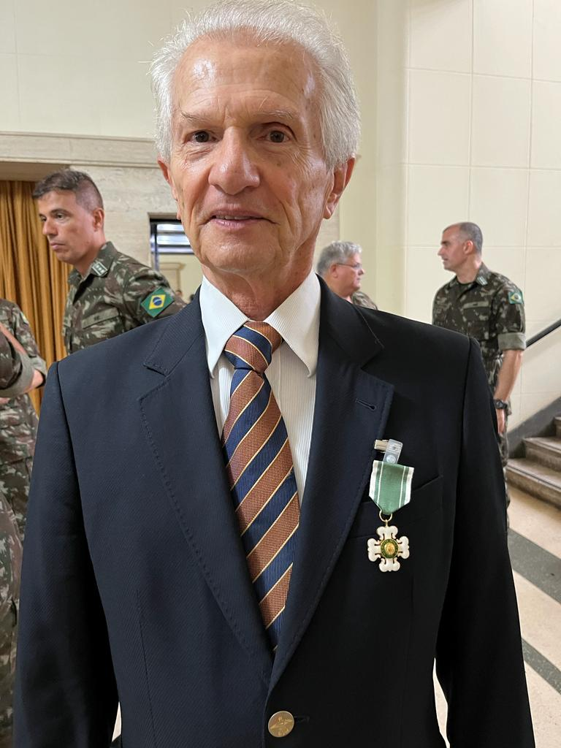
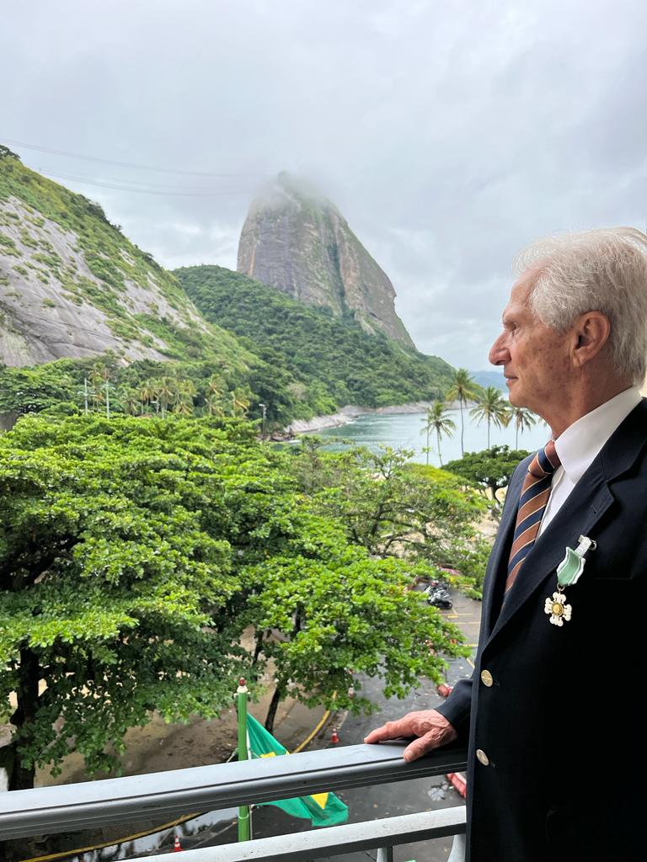
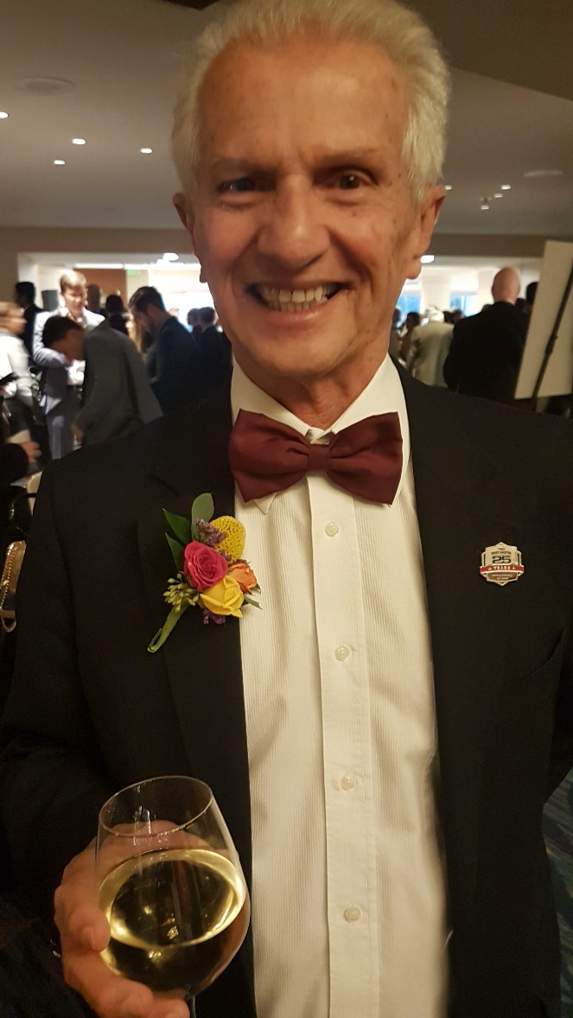
77 years old, TMS Leadership Award recipient
79 years old, Army Medal recipient
79 years old, facing the Sugar Loaf at IME

Slide 13
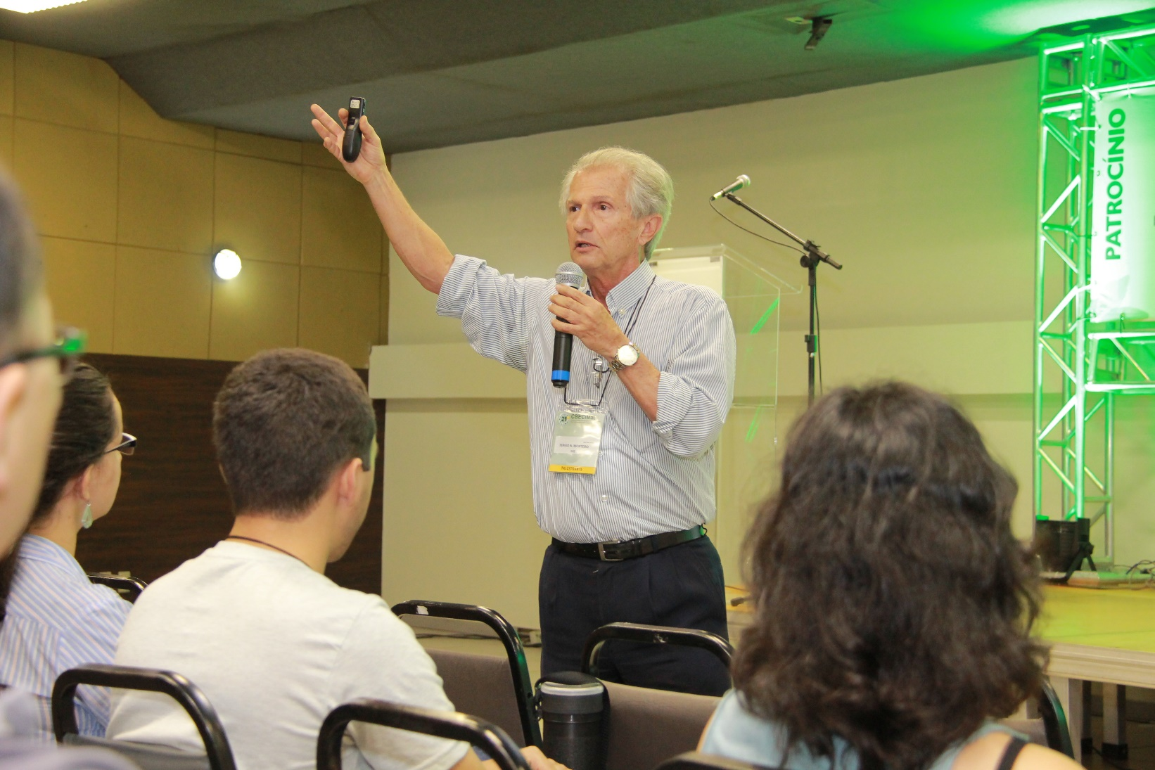
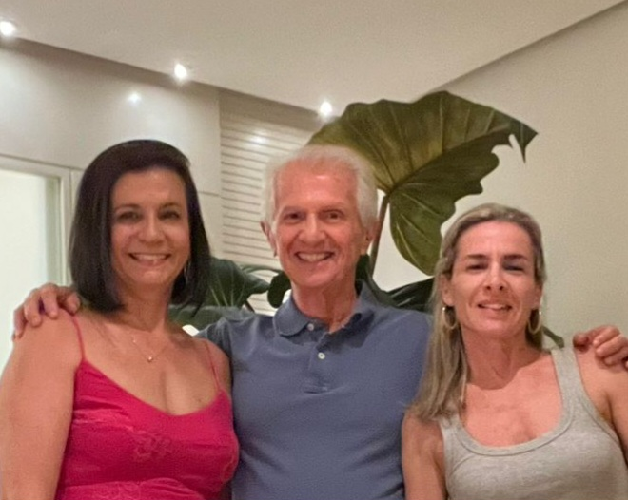
With family
79 years old, CBECIM conference

